Slide 1
UU Theology Sessions
Theologies of our Living Tradition

Slide 2
Session 1: What Is Theology?

Slide 3
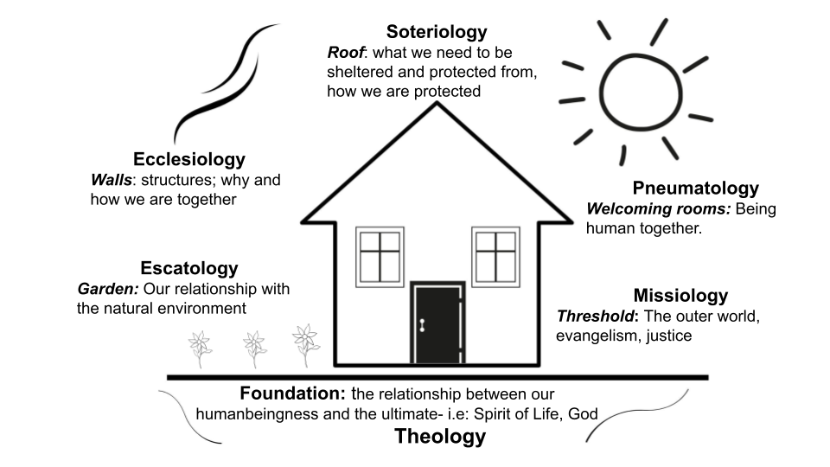
Theological House

Slide 4
Theological House
Based on the presentation by Rev. Dr. Rebecca Parker, LREDA Lectures, 2002
Adapted by the Rev. Jennifer Innis, UU Fellowship, Greenville, SC
Elements: The presence of the spirit of life is immediate and everywhere; immanent, transcendent, and interpersonal
Foundation: Humans have free will, conscience, ability to sense God, reason.
Walls: The church is formed by humans in a free relationship, making a promise to support one another.
Roof: God is loving; we are healed by the power of creative love; Hell is what we do to one another.
Door: Heaven can be here on Earth; we are the beloved community working to recognize ourselves
Windows: We work to be good neighbors. We let ourselves be changed by our neighbors.

Slide 5
Session 2: Early Unitarianism and Universalism

Slide 6
Channing’s Unitarian Christianity
History: Unitarianism goes back to beginning of Christianity with Arianism
Michael Servetus talked about the Unity of God in the Protestant Reformation
William Ellery Channing’s Unitarianism:
Use of reason when reading scripture.
Unity of God
Unity of Jesus (meaning that Jesus is human, not God).
Moral perfection of God
Jesus’s role as teacher, seen as a moral guide
Salvation by character

Slide 7
Universalism
History:
Universalism grew in US in response to the puritan hellfire
Ultra Universalists (Death and Glory) vs. Restorationists (Purgatory then Heaven)
Some tenants of Universalism, inspired by John Murray and Hosea Ballou:
God is all loving, all knowing
Therefore, God would not condemn people to help for eternity
We act morally motivated by our ultimate salvation
No one rejoices in the suffering of others
Happiness and pleasure is the motivator for human action, not fear

Slide 8
Session 3: Expanding Beyond Christian Roots

Slide 9
Transcendentalism
Both an extension of and a reaction to “classic Unitarianism”
Named after “transcendental philosophy,” understanding that reason and logic are intuitive and that there are intuitive truths
Everyone has access to religious experience and God
God is “Nature,” Universal Spirit, the Over-Soul
Self-culture is a focus, or the ever improvement of the self

Slide 10
Humanism
Reaction to both Transcendentalism and modern culture
Not concerned with God, focused on humans
Rejected the supernatural for the tangible and natural
Rejection of dualism
The purpose of religion was the moral development of the self
A focus on the here and now

Slide 11
Session 4: 20th Century Theological Movements

Slide 12
Five Smooth Stones - James Luther Adams
'Revelation' is continuous."
"All relations rest on mutual, free consent and not on coercion."
Moral obligation to establish a just and loving community.
Good things don't just happen, people make them happen.
The resources for change justify an attitude of ultimate optimism." Hope.

Slide 13
Religious Liberalism - James Luther Adams
Religious “liberalism”, refers to free religious, or free choice
JLA sees the possibility of liberal religion being a force against oppression, facism, and other “faiths”
In reality (at the time), liberal churches did little to fight against oppression
The five smooth stones outline a liberal religion that can fight against oppression
With freedom comes responsibility
With community comes power

Slide 14
Social Implications of Universalism - Social Gospel
Comes out of the Social Gospel Movement
A movement of liberal Christian leaders calling for social reforms based on an understanding of the gospel
Focuses on the here and now
Focuses on the need to make social justice and change
The end of religion is not about the individual self, but justice for the community

Slide 15
Process Theology
Trying to reconcile religion and the understanding of God with modern discoveries of science like the speed of light
Originated from process philosophy by Alfred North Whitehead
God is not a being, not “matter” or a supernatural deity
God is the process of becoming, of creativity
Humans share in the process of creation and becoming
God is persuasive not commanding

Slide 16
Liberation Theology
Gustavo Gutierrez
“The Preferential Option for the Poor” = God sides with the poor and the oppressed and is called to free people from all poverty and oppression
Spiritual and voluntary poverty, are states where people decide to align with the poor and oppressed and to advocate for justice
Dr. James Cone
Jesus is Black. The message of God is for the liberation of black people.
Ontological blackness: “God’s elective affiliation with Blackness as a foundational symbol of oppression—as well as reflections on the utter, particular, and beautiful humanity of Black people.” *
*Definition by Todne Thomas in his article “James H. Cone and the Mysteries of Black Social Life”

Slide 17
Liberationism and Liberalism
Specific group of people
Liberation of community
Uses specific texts
Freedom means liberation
Universal comes from the particular
Vision to welcome everyone
Freedom of the individual
Draws from many texts
Freedom means free choice
Universal means expanding vision

Slide 18
Pedagogy of the Oppressed
Education is never neutral
Content must reflect the experience and issues of the participants
Education should hinge on problem-posing (as opposed to "banking education")
Reflection must be linked to action in praxis.
Radical transformation should be the final result.

Slide 19
Session 5: 21st Century Theology

Slide 20
Discuss:
Thandeka describes Unitarian Universalists as having a common emotional experience but with different ways of explaining it theologically. What have you found to be a common emotional experience in Unitarian Universalism?
Thandeka says we “love beyond belief,” but Rebecca Parker identifies limits to what we can believe as UUs. Are the limits described by Parker true for you, and do you see any other limits to belief besides those she describes?

Slide 21
Discuss:
Authors Thandeka, Rebecca Parker, Paula Cole Jones, and Paul Rasor, each in different ways, describe the challenges in identifying a common Unitarian Universalist theology or experience. Is such a common theology possible or even desirable? How would you begin to articulate a common Unitarian Universalist theology—what does it mean to be a Unitarian Universalist?

Slide 22
Where are We Headed?
What are the pressing theological questions for our movement right now?

