Slide 1
WELCOME!
Family Ministry Training:
unpacking “family”
Facilitators:
Co-facilitator Co-facilitator
family ministry training

Slide 2
WORKSHOP 6
Opening Worship
Hymn 361…
Enter, Rejoice and Come In
Words & Music: Louise Ruspini
family ministry training

Slide 3
Enter, rejoice and come in.
Enter, rejoice and come in.
Today will be a joyful day;
Enter, rejoice and come in.
family ministry training

Slide 4
Open your ears to the song.
Open your ears to the song.
Today will be a joyful day;
Enter, rejoice and come in.
family ministry training

Slide 5
Open your hearts ev’ry one.
Open your hearts ev’ry one.
Today will be a joyful day;
Enter, rejoice and come in.
family ministry training

Slide 6
Don’t be afraid of some change.
Don’t be afraid of some change.
Today will be a joyful day;
Enter, rejoice and come in.
family ministry training

Slide 7
Enter, rejoice and come in.
Enter, rejoice and come in.
Today will be a joyful day;
Enter, rejoice and come in.
family ministry training

Slide 8
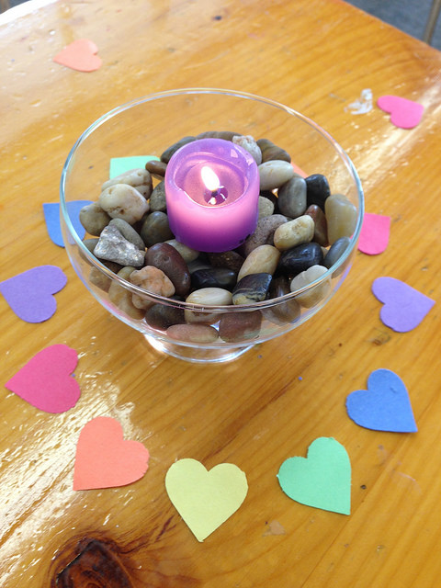
Introductions
I’m ___________ from ______________
I need you to know ______.
family ministry training

Slide 9
The Mission of the UU Church of Anytown is
to serve the needs of our members for intellectual stimulation and spiritual growth;
to provide religious education to our children and youth;
and to make the world a better place.
Small Group Ministries
Social Events
Adult
Education Programming
Sunday Sanctuary Worship
Pledge Drive
Social Action
Efforts
Building Maintenance
Religious Education Programming
Fundraisers
family ministry training

Slide 10
Religious Education Programming
Sunday Sanctuary Worship
Adult
Education Programming
The Mission of the UU Church of Anytown is to be a beacon of liberal religion
in our community and in our own lives.
Social Action
Efforts
Small Group Ministries
Pledge Drive
Social Events
Fundraisers
Building Maintenance
family ministry training

Slide 11
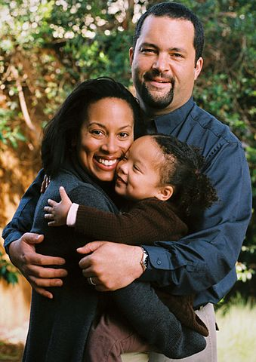
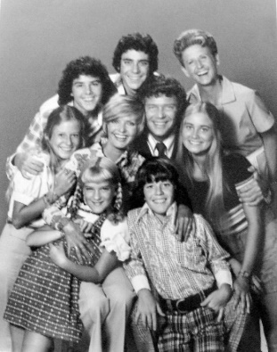
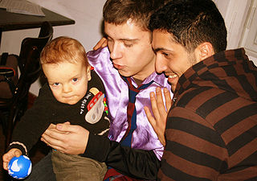
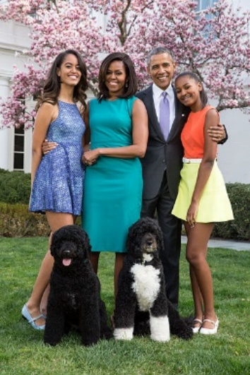
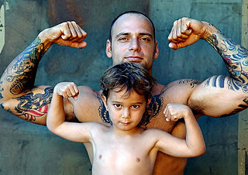
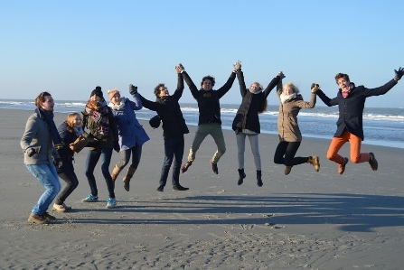
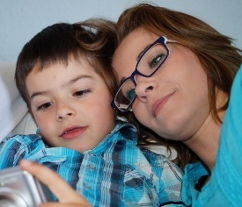
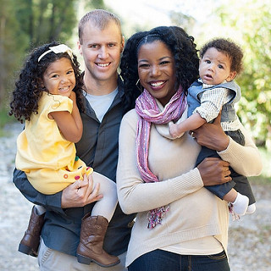
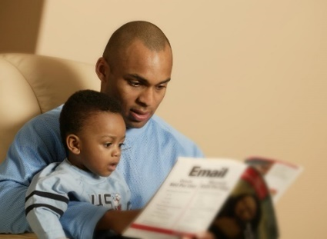
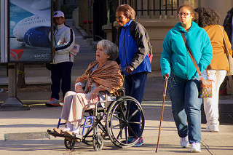
The mission of a UU congregation is to nurture generations
of Unitarian Universalists.

Slide 12
Does the congregation have a clearly articulated understanding of its mission?
Does the congregation have a clear, concise mission statement? Can you write it from memory?
How identified do you think the congregation is with it? (Are you living it?)
What would it mean for the congregation to change its mission statement to something like this: “Our mission is to nurture the next generations of Unitarian Universalists.”
family ministry training

Slide 13
Families
are the heart
of congregational life.

Slide 14
Brainstorm:
Who would need to be “on board” if we were going to make the change to really acting as if families are the heart of congregational life?
family ministry training

Slide 15
Fish Bowl Round #1:
How would you describe
this far-reaching vision of
family ministry to the
Ministry Team?
family ministry training

Slide 16
Fish Bowl Round #2:
How would you explain
this new way of understanding the congregation to the
Religious Education Committee?
family ministry training

Slide 17
Fish Bowl Round #3:
How would you explain
this new way of understanding the congregation to the
Board?
family ministry training

Slide 18
Processing Prompts
How did it feel to have these conversations?
Did it seem easier to talk about this with one of the two groups?
Were there things said that you hadn’t thought of?
Were there things you’d thought of that weren’t said?
family ministry training

Slide 19
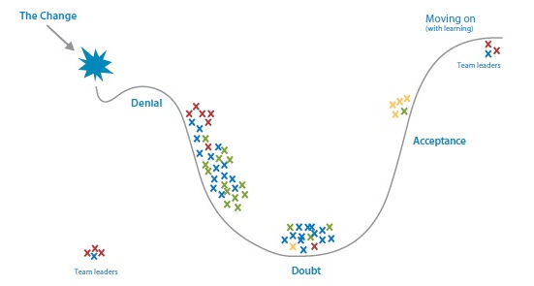
The change curve:
leadership
family ministry training

Slide 20
If we’re going to do this …
Who needs to be brought on board (and in what order)?
Should this be an explicit or implicit change?
family ministry training

Slide 21
What we take away…
What is the story I will tell about my experiences during these workshops? Who will I tell it to? How will I tell it?
Making a commitment
What commitment will I make to myself to move forward with the ideas that have excited me here?
Who are the kindred spirits I have met here (or already know)? What is my plan to connect with them?
family ministry training

Slide 22
WORKSHOP 6
Closing Worship
Hymn 1028…
The Fire of Commitment
Words: Mary Katherine Morn and Jason Shelton
Music: Jason Shelton
family ministry training

Slide 23
From the light of days remembered
Burns a beacon bring and clear
Guiding hands and hearts and spirits
Into faith set free from fear
family ministry training

Slide 24
When the fire of commitment
Sets our mind and soul ablaze
When our hunger
And our passion meet
To call us on our way
When we live with deep assurance
Of the flame that burns within
Then our promise finds fulfillment
And our future can begin.
family ministry training

Slide 25
From the stories of our living
Rings a song both brave and free
Calling pilgrims still to witness
To the life of liberty
family ministry training

Slide 26
When the fire of commitment
Sets our mind and soul ablaze
When our hunger
And our passion meet
To call us on our way
When we live with deep assurance
Of the flame that burns within
Then our promise finds fulfillment
And our future can begin.
family ministry training

Slide 27
From the dreams of youthful vision
Comes a new, prophetic voice
Which demands a deeper justice
Built by our courageous choice
family ministry training

Slide 28
When the fire of commitment
Sets our mind and soul ablaze
When our hunger
And our passion meet
To call us on our way
When we live with deep assurance
Of the flame that burns within
Then our promise finds fulfillment
And our future can begin.
family ministry training

Slide 29
Families

