Slide 1
WELCOME!
Family Ministry Training:
unpacking “family”
Facilitators:
Co-facilitator Co-facilitator
family ministry training

Slide 2
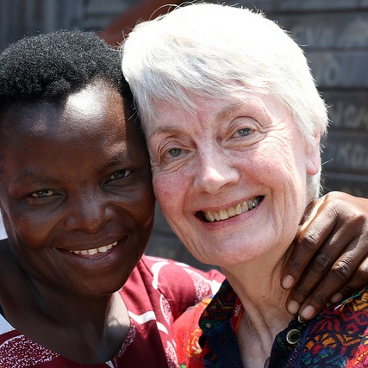
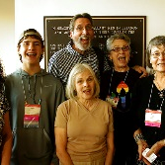
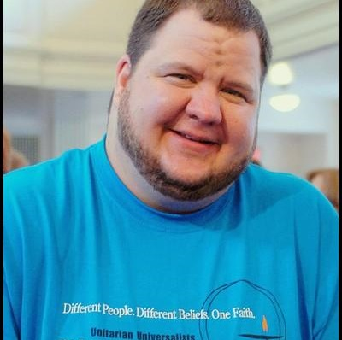
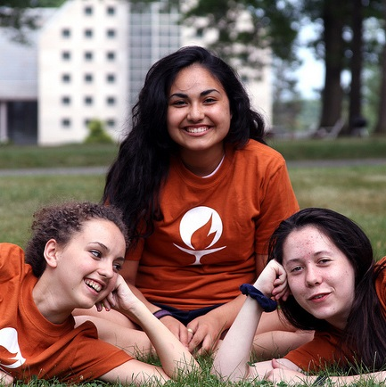
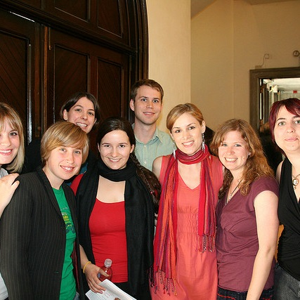
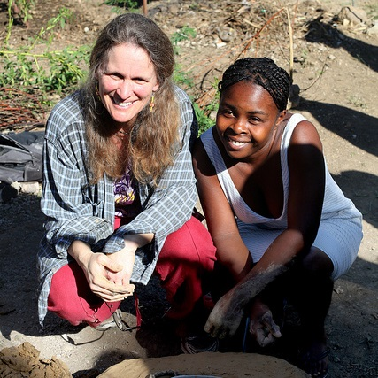
WORKSHOP 4
Opening Worship
For each new morning
Words: Ralph Waldo Emerson
Music: Old One Hundredth
family ministry training

Slide 3
For each new morning
with its light,
For rest and shelter of the night,
For health and food,
For love and friends,
For everything
life’s goodness sends.
Thank you
family ministry training

Slide 4
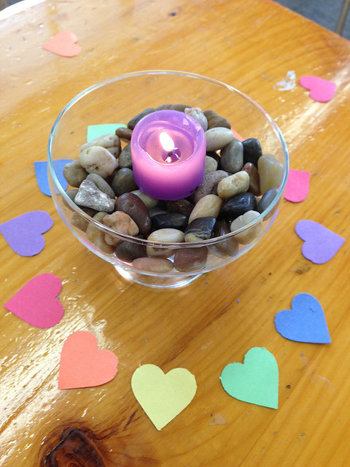
Introductions
I’m ___________ from ______________
where I ________________.
family ministry training

Slide 5
Ministry within Families
Ministry within families is about interactions between family members that reflect the care and tending of one another’s souls.
family ministry training

Slide 6
Your family when you were a child
What did you learn about ministering within families? (Explicitly or implicitly)
Your current family
What is the culture regarding ministering to one another?
Faith communities
What messages about ministering within the families have you received from faith communities throughout your life?
family ministry training

Slide 7
Ministry within Families
Identify all the ways a person in this age group/life stage might offer ministry to other members of the family as well as all the ways a person in this age group/life stage might be ministered to by members of their family.
family ministry training

Slide 8
Consider
Name some of the ways your/your congregation’s ministry cultivates and supports ministry within families
What are some things you wish you or your congregation were doing to cultivate and support ministry within families?
What help, support or resources do you have for this work? What help support or resources do you need for this work?
How can ministry teams of religious professionals collaborate and support each other in this work?
family ministry training

Slide 9
Full Circle: Fifteen Ways to Grow Lifelong UUs
Kate Tweedie Erslev
Embrace our UU identity
Recognize religious education/faith development as an important portal to institutional involvement
Share the value of attending the congregation regularly, at least three times a month
Ritualize holiday events and celebratory activities
Prepare all for the negative side of community
family ministry training

Slide 10
Full Circle: Fifteen Ways to Grow Lifelong UUs
Kate Tweedie Erslev
6) Provide background for teachers in every weekly session plan
7) Provide parent handouts in every session plan/educate the congregation about what the children and youth are learning/doing
8) Offer opportunities for all ages to live out UU values
9) Offer engaging religious school for Kindergarten through sixth grade
10) Take every opportunity for religious professionals and lay leaders to mentor children and teens
family ministry training

Slide 11
Full Circle: Fifteen Ways to Grow Lifelong UUs
Kate Tweedie Erslev
11) Sweep teens into immersions experiences
12) Bolster and protect youth groups
13) Connect with young adults
14) Sing together
15) Celebrate founders, lifers and heritage
family ministry training

Slide 12
Full Circle: Fifteen Ways to Grow Lifelong UUs
Kate Tweedie Erslev
Addition:
16) Encourage and support the development of active spiritual practice(s)
family ministry training

Slide 13
WORKSHOP 4
Closing Worship
Hymn 348…
Guide My Feet
Words: Traditional
Music: Spiritual
family ministry training

Slide 14
Guide my feet
While I run this race.
Guide my feet
While I run this race.
Guide my feet
While I run this race,
For I don’t want to run
This race in vain.
family ministry training

Slide 15
Hold my hand
While I run this race.
Hold my hand
While I run this race.
Hold my hand
While I run this race,
For I don’t want to run
This race in vain.
family ministry training

Slide 16
Stand by me
While I run this race.
Stand by me
While I run this race.
Stand by me
While I run this race,
For I don’t want to run
This race in vain.
family ministry training

Slide 17
Search my heart
While I run this race.
Search my heart
While I run this race.
Search my heart
While I run this race,
For I don’t want to run
This race in vain.
family ministry training

