Slide 1
WELCOME!
Adult Faith Development and Programming
Renaissance Module
Leaders: ____________________
& __________________
renaissance program

Slide 2
Opening Worship
Hymn 361…
Enter, Rejoice, and Come In!
renaissance program

Slide 3
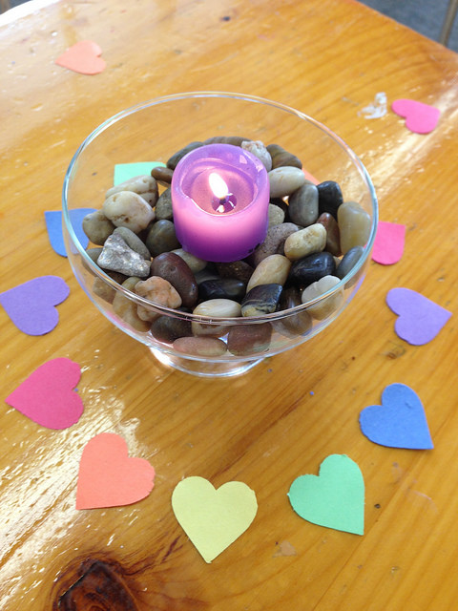
Introductions
I’m ___________ from ______________
where I ________________.
Share an object representing your role
if you brought one…
renaissance program

Slide 4
Pressing Questions
What questions must be addressed in order for this module to meet your needs and expectations?
renaissance program

Slide 5
Creating Our Covenant
One definition of covenant:
“The common understandings, agreements, and promises made, one to another, that define our mutual obligations and commitments to each other as we try to live our faith and vision."
~ UU Lay Leader Walter Herz
renaissance program

Slide 6
Creating Our Covenant
Do…
Speak about events, programs, or systems within your congregations
Refrain from…
Sharing unflattering stories about individuals
renaissance program

Slide 7
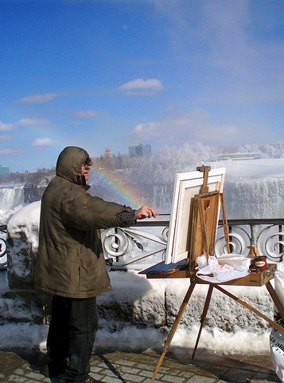
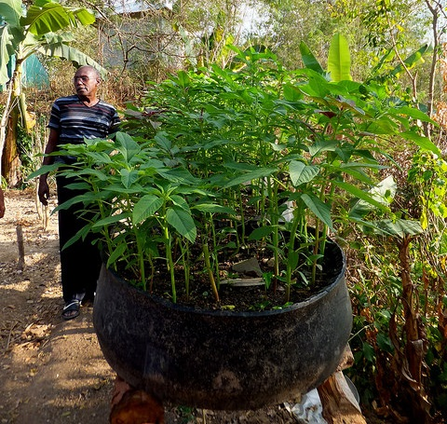
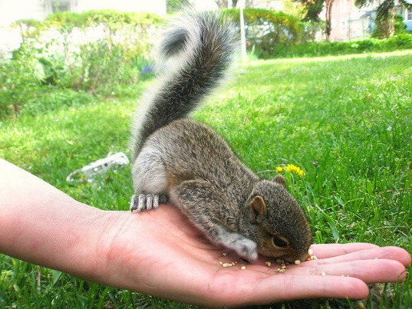
All Adults Are Learners
Your recent learnings
What do all these have in common?
Brainstorm…
renaissance program

Slide 8
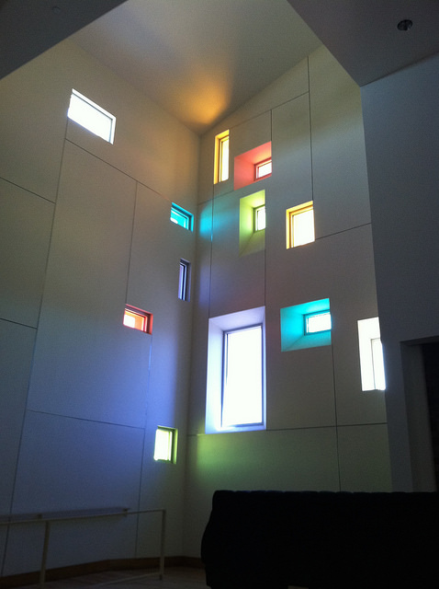
Perspectives
Language describing adult programs in your congregations…
What do you call it?
Goals for adult programming… Why do you do it?
renaissance program

Slide 9
Perspectives on
“Faith Development”
“Spirituality” is an individual’s personal experience with the sacred, and with wonder, awe, mystery, and/or connection to the whole | “Faith” is a sense of hope, trust, or being at home in the universe
Faith Development (sometimes called formation) involves an interplay of spiritual experience and a religious tradition (in our case, Unitarian Universalism) | Unitarian Universalist Faith is an informed sense of being at home in the universe shaped by the theology, traditions, values, and principles of Unitarian Universalism
renaissance program

Slide 10
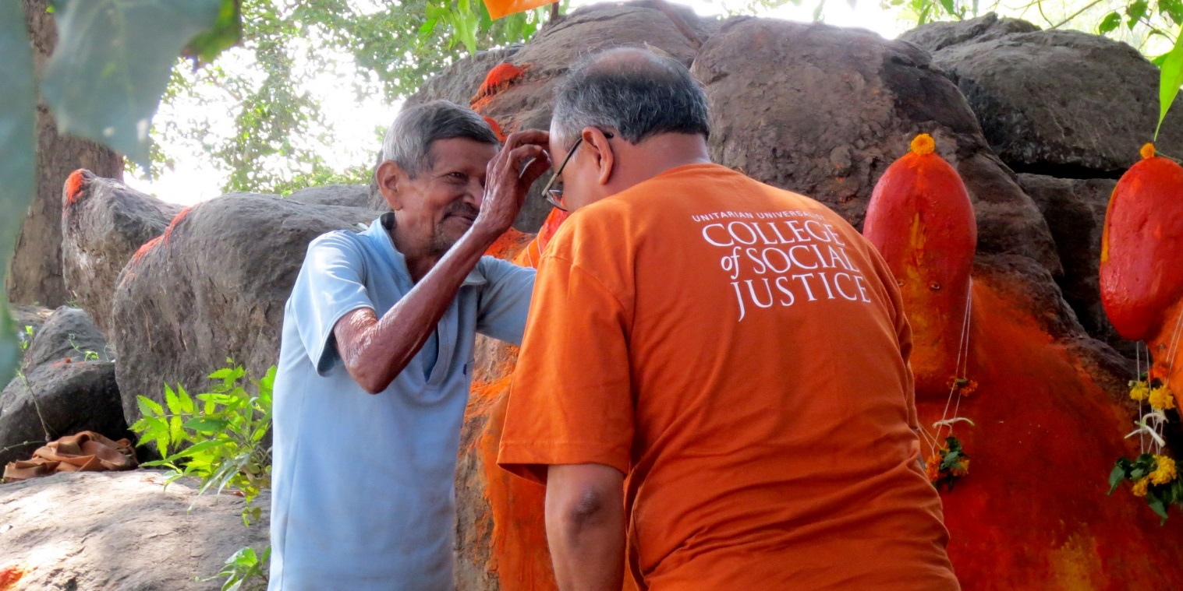
Adult Spiritual Growth
“Spirituality” according to Elizabeth J. Tisdell
renaissance program

Slide 11
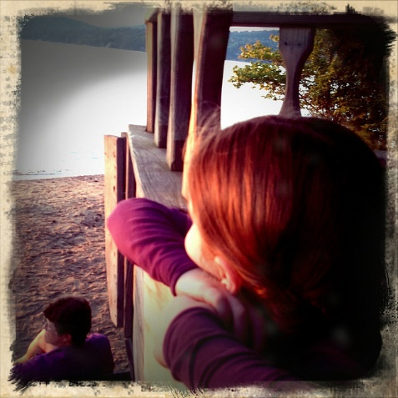
Shimmering Moments
When have you experienced a
“shimmering moment”?
What were the circumstances?
What happened?
How did you know you had experienced spiritual growth, been changed, or deepened your sense of what it means to be human?
Did the spiritual growth or deepening happen in the moment, or did it take place over time?
renaissance program

Slide 12
Shimmering Moments
How do shimmering moments
happen in our congregations?
What can we do
to nurture them?
renaissance program

Slide 13
Session 2:
Transformative Learning through Stories
renaissance program

Slide 14
renaissance program

Slide 15
Childhood Stories
Being successful?
Being a good person?
Interacting with others?
Cultural stories
Do they still shape your thinking?
Experiences that don’t fit into existing narratives?
What did you learn about…
renaissance program

Slide 16
renaissance program

Slide 17
Transformative Learning
Recall a time when you experienced the discomfort or dissonance that resulted when new information did not fit your existing story.
What were the circumstances?
What did you do?
What did you learn?
Did your story change?
Journal & Share…
renaissance program

Slide 18
renaissance program

Slide 19
Space between the Logs
When have you experienced the space between the logs that allows for transformation?
When have you seen spaciousness that allows for transformation in your congregation?
Journal … Draw …
Write Poetry…
renaissance program

Slide 20
Stories in
Adult Faith Development
Read the story and engage with the activity questions as if you were experiencing this in an Adult Faith Development group in your congregation
Step back from the experience and notice how the questions connect the story with life experiences and deepen their Unitarian Universalist faith
In groups of 4 or 5…
renaissance program

Slide 21
Stories in
Adult Faith Development
How did the questions connect the story with life experiences?
How did the activities hold possibility for:
Growing in spirit?
Increasing your connection to UU values?
Deepening your faith?
Did you experience transformative learning?
Did your “story” about something change?
Discuss…
renaissance program

Slide 22
Session 3:
Applying
Theoretical Models to Faith Community Life and Programming
renaissance program

Slide 23
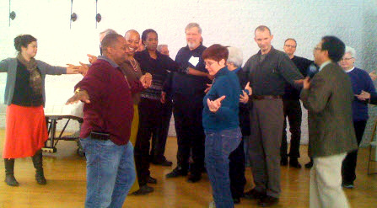
Practicing Beloved Community
Jacqui Lewis’ work at
Middle Collegiate Church
(Dutch Reformed) in New York City
If you had to tell one story that summarizes what your congregation is about, what would that be?
How is adult programming connected to your congregation’s story?
Handout 10
Share with a partner…
… Mosaic Makers …
renaissance program

Slide 24
Who are the Adults
in Our Congregations?
Border experiences – encounters with those whose stories and perspectives are different from your own
What about generational perspectives and identities?
Consider different life situation perspectives adult people bring to your congregation
Brainstorm…
renaissance program

Slide 25
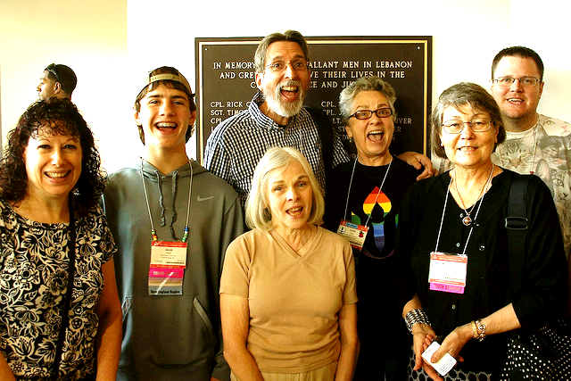
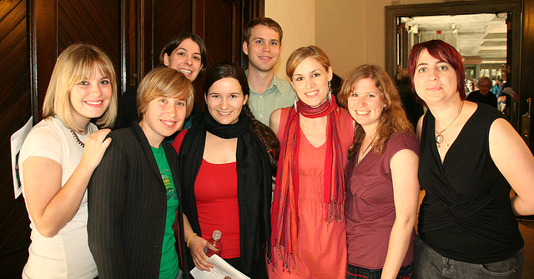
Mixing & Huddling
renaissance program

Slide 26
Mixing & Huddling
What are the groups, programs, and opportunities in your congregation?
Who actually participates?
Chalice group?
Coffee hour?
Multigen service?
Men’s Lunch?
Work Days?
Parents of young children?
Young adults?
Committees?
renaissance program

Slide 27
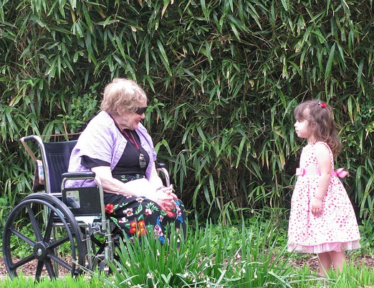
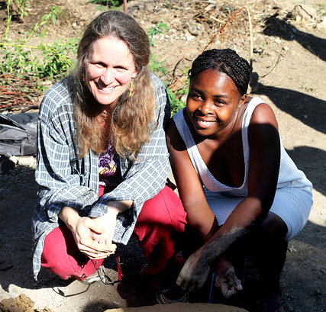
Journaling & Sharing
When have you had an interaction with someone from a different generation that deepened your understanding of what you value or what it means to be human?
When have you had an interaction with someone of a different race, culture, or economic background from your own that deepened your understanding of what you value or what it means to be human?
renaissance program

Slide 28
Generations Theory
Generalizations based on dominant culture
How does this match with your experience?
Whose perspectives are missing in these summaries?
Given differing perspectives and cultures in each generation, how might adult programming recognize the presence of four or five generations of adults in a congregation?
Handout 13
Discuss…
renaissance program

Slide 29
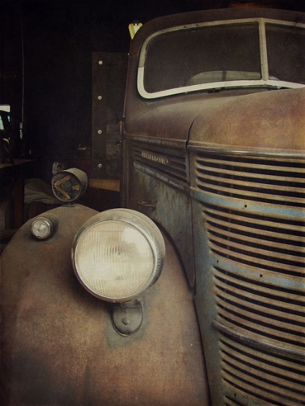
Generations Theory
Discuss…
What are the implications of generations theory for multigenerational programming in the congregation that includes children and youth as well as several generations of adults?
How can we “mix” several generations
and what opportunities might we offer for
generational cohorts to “huddle”?
renaissance program

Slide 30
Program Mission
Ideally, what is the role of adult programming in
the lives of individual members of the congregation?
Ideally, what is the role of adult programming in
supporting the congregation’s mission?
Your program mission
Handout 14
Share…
renaissance program

Slide 31
Session 4:
Responding to
Cultural and Faith Community Context
renaissance program

Slide 32
Cultural Context
Form 3 or 4 different groups
Discuss one set of questions
Note the highlights on newsprint
Share with large group
Handout 15 & “Reframing Hope”
renaissance program

Slide 33
Electronic Media in Adult Faith Development
What possibilities can you see for the use of electronic media in adult programming?
Brainstorm…
renaissance program

Slide 34
Needs, Capacity, and Responsibility
Share Suggestions & Comments based on your experience…
How much programming can your congregation actually support, in terms of volunteers, building space, budget, and participants? How do you determine that?
What times of the week are available for programming? When are people likely to come?
Handout 16
renaissance program

Slide 35
Needs, Capacity, and Responsibility
Is there a formal application process, structure, or timeline for programming proposals?
Who decides what programs are to be offered?
Discuss…
renaissance program

Slide 36
Needs, Capacity, and Responsibility
How is programming supported? Who is responsible for logistics? Advertising? Supporting volunteers? Dealing with difficult situations if they arise?
Very general needs assessment to get you started
Discuss…
Handout 17
renaissance program

Slide 37
Next Steps for Your Congregation’s Program
Group Work...
Keep in Mind...
Form small groups with similar programs
Help each other determine the next practical step each person should take to strengthen or improve their program.
Mission
Balance: Mixing and Huddling
Generational Balance
Needs Assessment
Capacity
Defining and Assigning Responsibilities
Creating Holding Environments for Multicultural Interaction
renaissance program

Slide 38
Session 5:
Practical Tools for Working with Volunteers
renaissance program

Slide 39
TAPESTRY OF FAITH
Faith Development curricula and other resources for all ages that nurture:
UU identity,
spiritual growth
a transforming faith, and
vital communities of justice and love.
renaissance program

Slide 40
Tapestry of Faith is
focused on
outcomes
including . . .
renaissance program

Slide 41
UU Identity
Spiritual Growth
Ethical Development
Faith Development
renaissance program

Slide 42
UU Identity
Curricula draw from and are grounded in:
Principles and Sources
UU History and Tradition
Participation in Faith Community
renaissance program

Slide 43
Sampling of Adult UU Identity Programs
The New UU (six sessions)
Faith Like a River: Themes in Unitarian Universalist History (16 sessions)
Resistance and Transformation: Unitarian Universalist Social Justice History (16 sessions)
All programs are modular. Sessions can be used alone, or in any combination.
renaissance program

Slide 44
Spiritual Development: The Longing of the Soul
Feelings of wonder, awe, mystery, holy
Connection to God, ultimate, transcendence
Sense of being part of something larger
Spiritual mindfulness, spiritual practices
Worship, rituals, sacred texts
renaissance program

Slide 45
Tidbits from Tapestry
In Spirit in Practice, participants “try out” moving meditation, prayer beads, & other spiritual practices
In Spirit of Life, participants hear the story, “A Hospital Blessing” and create a blessing ritual
In What Moves Us: Unitarian Universalist Theology, adults explore Hosea Ballou’s main theological question: Does God want people to be happy?
In From the High Hill: Odyssey Writing for Elders, two weekend retreats—one for preparation, one for presentations— frame an individual period of remembering, sorting, reflecting, and writing
renaissance program

Slide 46
Ethical Development: Becoming Our Best Selves
Curricula support and encourage:
Living Our Values and principles
Moral Agency: Making the World a Better Place
Right Relationship
Good Citizenship of Wider Communities
Stewardship of Religious Community
Stewardship of the Earth
renaissance program

Slide 47
More Tapestry Tidbits
In What We Choose: Ethics for Unitarian Universalists, presents an old fable, explored through new lenses
In Principled Commitment, committed couples practice effective communication
In Harvest the Power: Developing Lay Leaders, the Heavenly UU Congregation and Choir provide a case study for applying systems theory
In Building the World We Dream About , participants explore racial/ethnic identity and develop multicultural competence
renaissance program

Slide 48
Faith Development: Growing in Faith Together
Curricula support and encourage:
Making meaning and finding purpose
Acting on values, reflecting on action
Addressing Big Religious Questions
and….
renaissance program

Slide 49
Faith Development: Growing in Faith Together
Curricula are a tool for forming children, youth, and adults who:
Explore and articulate theology,
philosophy, and beliefs
Know what they set their hearts to
Find a sustaining faith in Unitarian Universalism
renaissance program

Slide 50
Methodology: Stories
We learn best through stories
Stories have layers of meaning
Multigenerational faith communities are grounded in stories- personal stories, communal stories, and stories from the heritage and sources of Unitarian Universalism
Stories all draw from our sources- including our seventh source- UU history and heritage
renaissance program

Slide 51
Samples of Stories
(from List of Stories from All Programs)
Anansi and the Pot of Wisdom
Cathedral of the World
Belonging: Fannie Barrier Williams
The Cellist of Sarajevo
The Fowler and the Quail
A Hospital Blessing
Jesus and the Sheep
And dozens more!
renaissance program

Slide 52
Methodology: Praxis
Belonging
Story
Meaning
Reflection
Action
renaissance program

Slide 53
What’s Great about Tapestry?
Available free online
Draws from all six Sources- and adds a seventh, our UU history
Emphasizes community, interdependence and relationship
Consistently uses anti-racist, anti-oppressive, multi-cultural lenses
renaissance program

Slide 54
What’s Great about Tapestry?
Adaptable for church size and methodologies
Family/parent friendly
Lifespan
Outcome-focused
renaissance program

Slide 55
What’s Great about Tapestry?
Complete
Modular – youth and adult workshops
Searchable – stories and key words
renaissance program

Slide 56
What’s Great about Tapestry?
Spiritual Preparation
Faith in Action
Taking It Home
Including All Participants
renaissance program

Slide 57
Children/youth/adults need:
To learn with their minds, hearts and hands
To engage in integrated experiences that are anchored by soul-stirring narratives
To learn faith by doing faith
To be empowered as knowers, practitioners, and creators of Unitarian Universalism
To know the transformative power of justice and love
renaissance program

Slide 58
Children/youth/adult programs include:
Central narratives or core stories
Activities that engage participants in active, meaningful learning
Community building
Faith in Action activities for children, youth, adults and multi-generational groups
Enrichment materials for teachers/facilitators
Follow up and outreach activities for families/individuals
Flexibility for different sizes and models of programming
renaissance program

Slide 59
Other resources
to check out
In Print
Our Whole Lives (Adults and Young Adult)
Stirring the Nation’s Heart : Eighteen Stories of Prophetic Unitarians and Universalists of the Nineteenth Century
Discussion Guides -Skinner House books
Common Read discussion guides:
The Death of Josseline
Acts of Faith
renaissance program

Slide 60
Tapestry of Faith Weaving the Fabric
of our Faith
For more information, contact:
religiouseducation@uua.org
renaissance program

Slide 61
Volunteer Facilitator Recruitment, Training, and Support
Facilitator has bigger responsibility than to just be a presenter…
They must be committed to creating conditions that foster the development of the people in the programs they lead
We must be intentional in our recruitment, training, and support of volunteer facilitators
Whom should we recruit to lead or facilitate programs in our congregations?
How do we support them?
renaissance program

Slide 62
Volunteer Facilitator Recruitment, Training, and Support
Discuss questions on handout
Record highlights on newsprint…
Quick review of highlights
You can use these handouts in your own congregations!
Handout 18
Handout 19
renaissance program

Slide 63
Challenging Facilitation Scenarios
Groups of 4 to 6 people
Each group prepares a role play with the scenario
Prepare two versions of the scenario using techniques from Sharing the Floor
Each group gets five minutes to present both versions
Group Work…
renaissance program

Slide 64
Putting It Together to Take Home
Form groups based on pressing concerns and other discussions
Focus on addressing a big-picture issue that’s relevant to your context
Prepare a 10-minute presentation via PowerPoint or newsprint
You can adapt these presentations for your own context when you get home
Handout 20
renaissance program

Slide 65
Closing Worship
renaissance program

