Slide 1
Getting Involved without Getting in Trouble
Understanding the IRS Election-Year Guidelines for Clergy and Congregations
Co-Sponsored by the:
Unitarian universalist association of congregations
Unitarian universalist ministers association Clara barton chapter
Unitarian universalist ministers association

Slide 2
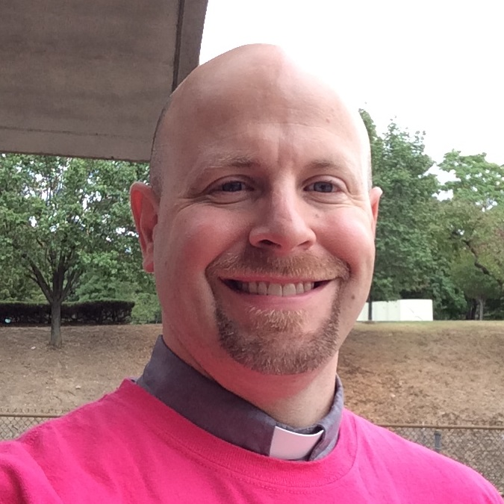
Led by:
Rev. Rob Keithan
Faith Organizing and Training Consultant
Affiliated Community Minister of All Souls Church in Washington, DC
Rev. Rob Hardies
Senior Minister
All Souls Church, Unitarian in Washington, DC

Slide 3
Agenda
Summary: The Three-Point System
Enforcement
Specific Guidelines
Advocacy and Lobbying
Political Campaign Activities
Individual Activity by Religious Leaders
Issue Advocacy v. Political Campaign Intervention
Case Study of What You Can Do: The Reeb Voting Rights Project (Rev. Rob Hardies, Senior Minister of All Souls Church in Washington, DC)
Q&A

Slide 4
Based on The Real Rules: Congregations and the IRS Guidelines On Advocacy, Lobbying, and Elections
The Real Rules is composed largely of direct quotes from the most recent and relevant IRS publications, organized in a way that is intended to be user-friendly. All references are clearly documented with footnotes.
Main source:
Tax Guide for Churches & Religious Organizations. Publication 1828 (Rev. 08-2015).
Most definitive guidance:
Revenue Ruling 2007-41, 2007-25 I.R.B. (June 18, 2007)

Slide 5
Disclaimer
This resource is not intended to be formal legal advice; nor should it be used in place of legal counsel. It is intended to clarify Internal Revenue Service guidelines as they relate to religious organizations in the hope that more congregations will (1) choose to become involved in working for justice; and (2) know when it is important to seek legal advice.

Slide 6
Summary: The Three-Point System
ISSUE ADVOCACY: Without limits on time, effort and expense, congregations and their representatives may engage in issue advocacy through activities such as educating and mobilizing congregants and the general public.
LOBBYING: Within narrow limits on time, effort and expense, congregations and their representatives may engage in lobbying—defined by the IRS as advocating for or against specific pieces of legislation—as an "unsubstantial" portion of an organization's activities.
POLITICAL CAMPAIGN INTERVENTION: There is a total limit on partisan activity, which the IRS calls political campaign intervention. Congregations and their representatives can do nothing that advocates for or against candidates for public office or political parties.

Slide 7
Application to Individuals
The restrictions on lobbying and political campaign intervention described here apply only to a congregation as a legal entity, or to a person or group speaking in the name of the congregation. A minister or congregation member may freely engage in these activities as an individual.
However, if the person(s) are identified by or likely to be associated with the congregation, it may be helpful to clearly state that they are speaking as individuals.

Slide 8
Enforcement
When it participates in political campaign activity, a church or religious organi­zation jeopardizes both its tax-exempt status and its eligibility to receive tax-deductible contributions. In addition, it may become sub­ject to an excise tax on its political expenditures. This excise tax may be imposed in addition to revocation, or it may be imposed instead of revocation. Also, the church or religious organization should correct the violation.
A congregation that engages in any political campaign activity also needs to determine whether it complies with the appropri­ate federal, state or local election laws, as these may differ from the requirements under IRC Section 501(c)(3).

Slide 9
Enforcement, continued
The IRS Guidelines are civil regulations related to tax-exempt status; there is nothing about political activities that could result in criminal charges.
Congress has imposed special limitations, found in section 7611 of the Internal Revenue Code, on how and when the IRS may conduct civil tax inquiries and examinations of churches. The IRS may begin a church tax inquiry only if an appropriate high-level Treasury official reasonably believes, on the basis of facts and circumstances recorded in writing, that an organization claiming to be a church or convention or association of churches may not qualify for exemption.
In other words, there is a very high threshold for opening an inquiry.

Slide 10
General Issue Advocacy
There is no limit on the amount of time, effort, or expense congregations may devote to working on general issues such as civil rights, civil liberties, economic justice, the environment, or peace.
Ex: Congress should take action to protect reproductive rights!

Slide 11
Lobbying
No congregation may qualify for 501(c)(3) status if a substantial part of its activities is attempting to influence legislation (commonly known as lobbying).
A congregation or religious organization will be regarded as attempting to influence legislation if it contacts, or urges the public to contact, members or employees of a legislative body for the purpose of proposing, supporting, or opposing legislation, or if the organization advocates the adoption or rejection of legislation.

Slide 12
Lobbying, continued
Legislation includes:
Action by Congress, any state legislature, any local council, or similar governing body, with respect to acts, bills, resolutions, or similar items (such as legislative confirmation of appointive offices):,or
Action by the public in a referendum, ballot initiative, constitutional amendment or similar procedure.
Ex: Senator X should vote for the Women’s Health Protect Act!
Legislation does not include actions by executive, judicial, or administrative bodies.

Slide 13
Measuring Lobbying: the Substantial Part Test
To evaluate what is “substantial,” the IRS considers a variety of factors, including the time devoted (by both compensated and volunteer workers) and the expenditures devoted by the organization to the activity, when determining whether the lobbying activity is substantial.
According to the Alliance for Justice, “the IRS has provided no absolute guidance on how much lobbying is ‘substantial,’ but most tax practitioners generally advise that charities can safely devote 3-5% of their overall activities toward lobbying.”

Slide 14
Lobbying During Election Years
Congregations may support or criticize legislators, lobby them, and work to hold them accountable. However, close to an election, the IRS may view a sudden entry into the political arena as partisan. A track record of consistent activity is the best safeguard against these charges.
Congregations may encourage voting for or against particular ballot measures in an election year—this counts as lobbying and not political campaign intervention.
State and local election laws may be different—especially with ballot measures.

Slide 15
Political Campaign Activities
Congregations are absolutely prohibited from directly or indirectly participating in, or intervening in, any political campaign on behalf of (or in opposition to) any candidate for elective public office.
Contributions to political campaign funds or public statements of position (verbal or written) made by or on behalf of the organization in favor of (or in opposition to) any candidate for public office clearly violate the prohibition against political campaign activity.

Slide 16
Individual Activity by Religious Leaders
The political campaign activity prohibition isn’t intended to restrict free expression on political matters by leaders of churches or religious organizations speaking for themselves, as individuals.
Religious leaders can’t make partisan comments in official organization publications or at official church functions.
To avoid potential attribution of their comments outside of church functions and publications, reli­gious leaders who speak or write in their individual capacity are encouraged to clearly indicate that their comments are personal and not intended to represent the views of the organization.

Slide 17
Example 2
Minister B is the minister of Church K, a Section 501(c)(3) organization, and is well known in the com­munity. Three weeks before the election, he attends a press conference at Candidate V’s campaign headquarters and states that Candidate V should be re-elected. Minister B doesn’t say he is speaking on behalf of Church K. His endorsement is reported on the front page of the local newspaper and he is identified in the article as the minister of Church K. Because Minister B didn’t make the endorsement at an official church function, in an official church publication or otherwise use the church’s assets, and did not state that he was speaking as a representative of Church K, his actions didn’t constitute political campaign intervention by Church K.

Slide 18
Example 3
Minister C is the minister of Church I, a Section 501(c)(3) organization. Church I publishes a monthly church newsletter that is distributed to all church members. In each issue, Minister C has a column titled “My Views.” The month before the election, Minister C states in the “My Views” column, “It is my per­sonal opinion that Candidate U should be re-elected.” For that one issue, Minister C pays from his per­sonal funds the portion of the cost of the newsletter attributable to the “My Views” column. Even though he paid part of the cost of the newsletter, the newsletter is an official publication of the church. Because the endorsement appeared in an official publication of Church I, it constitutes political campaign inter­vention by Church I.

Slide 19
Issue Advocacy v. Political Campaign Intervention
Congregations must avoid any issue advocacy that functions as political campaign intervention.
Even if a statement does not expressly tell an audience to vote for or against a specific candidate, an organization delivering the statement is at risk of violating the political campaign intervention prohibition if there is any message favoring or opposing a candidate.

Slide 20
Key factors:
Whether the statement identifies one or more candidates for a given public office;
Whether the statement expresses approval or disapproval for one or more candidates’ positions and/or actions;
Whether the statement is delivered close in time to the election;
Whether the statement makes reference to voting or an election;
Whether the issue addressed in the communication has been raised as an issue distinguishing candidates for a given office;
Whether the communication is part of an ongoing series of communications by the organization on the same issue that are made independent of the timing of any election; and
Whether the timing of the communication and identification of the candidate are related to a non-electoral event such as a scheduled vote on specific legislation by an officeholder who also happens to be a candidate for public office.

Slide 21
Inviting a Candidate to Speak and Business Activity
General Rule: there must be equal opportunity.
For exam­ple, a church or religious organization that invites one candidate to speak at its well-attended annual banquet, but invites the opposing candidate to speak at a sparsely attended general meeting, will likely be found to have violated the political campaign prohibition, even if the manner of presentation for both speakers is oth­erwise neutral.
Any good, service or facility must be available to the candidates equally.

Slide 22
Websites
The IRS treats a website the same as printed material.
When an organization establishes a link to another website, the organization is respon­sible for the consequences of establishing and maintaining that link, even if the organization doesn’t have control over the content of the linked site.
Links to candidate-related material, by themselves, do not necessarily constitute political campaign intervention. The facts and circum­stances to be considered include, but are not limited to, the context for the link on the organization’s website, whether all candidates are represented, any exempt purpose served by offering the link and the directness of the links between the organization’s website and the Web page that contains material favoring or oppos­ing a candidate for public office.

Slide 23
Other Internet Communications
While the IRS has not provided guidance in this area, any organization that uses these or other internet communications in an official organizational capacity would do well to treat them in the same manner as a printed communication, with the same guidelines and prohibitions.
Internet communications used by members of a congregation in a non-official capacity may or may not be subject to the IRS guidelines. Those utilizing technology owned by, maintained by or held in the name of the congregation, such as a listserv program, could be interpreted as an official activity.

Slide 24
Other Internet Communications, continued
Lacking clear guidance, the UUA—based on consultation with legal counsel and our concern for congregational well-being– recommends that congregations consider the IRS guidelines as applying to any internet communications activity that is owned or supported by the congregation.
While the IRS may find that communications fora that originate outside the congregation, such as a free discussion groups, might not be subject to the guidelines, the UUA recommends ensuring that equal access is given to any group that may want to discuss partisan issues. The congregation may also reasonably determine that all partisan communications should be prohibited in these fora.

Slide 25
Voter Education, Voter Registration, and Get-Out-The-Vote Drives
Certain voter education activities (including the presentation of public forums and the publication of voter education guides) conducted in a non-partisan manner do not constitute prohibited political campaign activity. In addition, other activities intended to encourage people to participate in the electoral process, such as voter registration and get-out-the-vote drives, would not constitute prohibited political campaign activity if conducted in a non-partisan manner.
IRS guidance: It must be conducted in a non-partisan manner.
General Guideline: It’s OK to focus on educating and engaging certain communities so long as it’s done in a nonpartisan manner, such as focusing on communities with historically low turn-out.

Slide 26
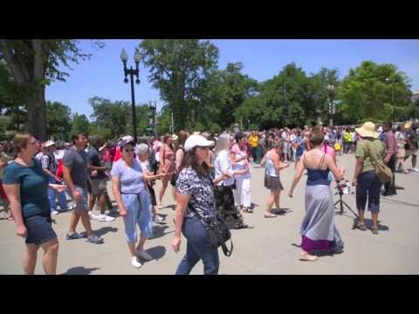
Case Study of What You Can Do: The Reeb Voting Rights Project

Slide 27
Reeb’s 2016 Effort
Anti-Racism Training for all volunteers
In-person Voter Registration Drive in Northern Virginia
In partnership with New Virginia Majority and Unitarian Universalists for Social Justice (UUSJ) in the National Capital Region
Trip to North Carolina for Voter Registration/Education
In partnership with UU Fellowship of Raleigh, Eno River UU Fellowship and Monument of Faith Pentecostal Church in Durham, Democracy North Carolina, and You Can Vote.
North Carolina Phone Bank House Parties
North Carolina megaPhone Bank at All Souls

Slide 28
Strategies
Partner with UU congregations and people of color-led organizations in the key area(s)
Partner with secular organizations that have enough structure and resources to use our volunteers effectively
Provide multiple entry points for helping: actually going there in person, which is irreplaceable, but also doing phone banking and letter-writing
Invite other UU congregations near All Souls to join in

