Slide 1
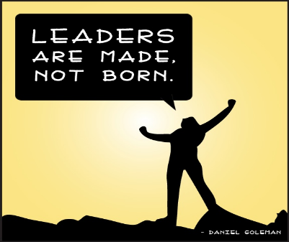
Made, Not Born: Cultivating Leaders in Our Congregations General Assembly 2018 June 21, 2018 Mark: m.mjbernstein@verizon.net Marie: marie@fvuuf.org
Notes:
Marie and Mark introduce themselves.

Slide 2
Notes:
Mark: Our premise is this. Leaders don’t just walk into a UU congregation and start leading.
Marie: They need to be carefully grown,
Mark: cultivated,
Marie: nurtured,
Mark: warmed by the sun,
Marie: enriched by the rain.
Mark: Oh wait, these are instructions on how to grow tomatoes.
Marie: Even an experienced leader must learn how to be a leader in a UU congregation.
Mark: Because UU congregations are not like the real world. And we can’t recruit leaders like the real world. Why then is it so difficult to recruit leaders in our UU congregations. Well the answer is largely a matter of perception…and history.

Slide 3
Notes:
Mark: People don’t want church to be like work…and leading others seems like too much work. Especially if they see themselves as leaders in their professional lives….or if they hate their jobs.

Slide 4
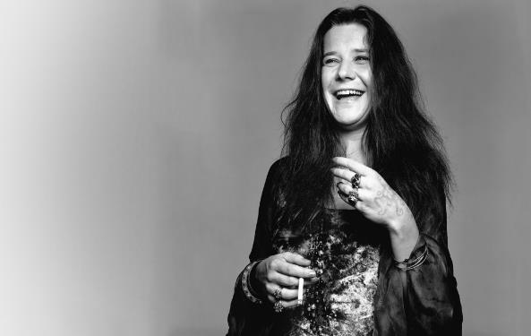
Leadings just another word for…
no one else to do.
Notes:
Marie: Leadership in our congregations has a bad rap. With apologies to Janis Joplin, people truly believe that leading is just another word for one who does everything. And in some congregations, that is exactly what happens.

Slide 5
I’m a member of the Board and my term ends in two months…
THANK GOD!!!
Notes:
Mark: And it also doesn’t help when someone says….

Slide 6
Notes:
Marie: We Unitarian Universalists tend to rebel against authority. We don’t want to be told what to do, how to believe, what to think. Leadership in our congregations is often confused with being in authority. In a bad way. In a dark way. And we don’t want to be seen as imposing our will on others or going to the dark side.

Slide 7
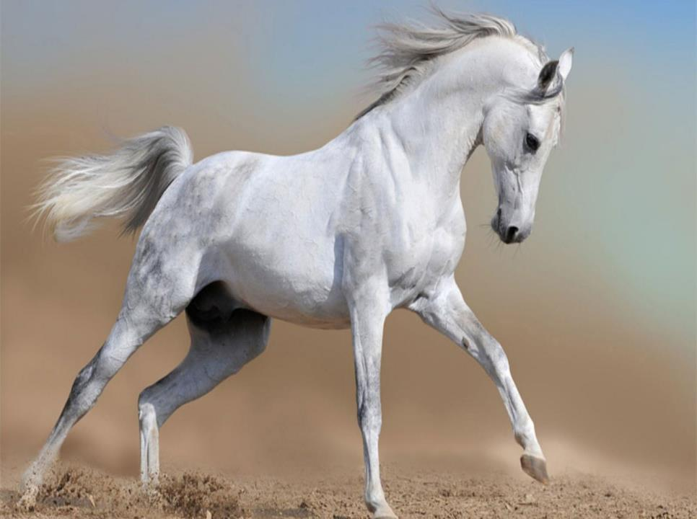
Notes:
Mark: In many congregations, we recruit people to lead out of a sense of desperation. We need a savior to rescue us. We imagine someone riding in on a white charger to rescue us or to fix a broken system. This scares many people away.

Slide 8
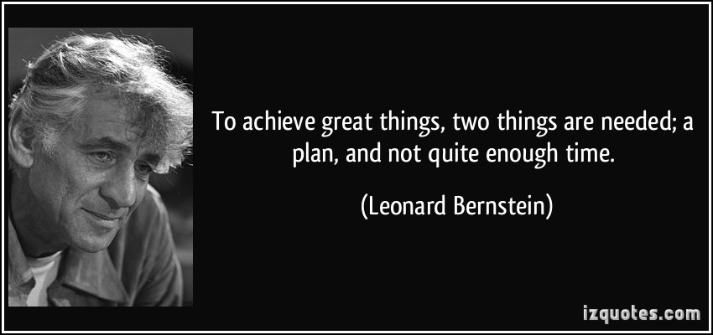
Notes:
Mark: I don’t have enough time. I would love to take a leadership role, but I am so busy with other things in my life that I could not do justice to it. This congregation deserves someone who is able to commit the necessary time required to do this job right.

Slide 9
Notes:
Marie: So now its your turn. Which of these reasons most resonate with you and your congregation? Have we left anything out. Please turn to a neighbor or two and take about three minutes to discuss the issues you are having concerning the cultivating of leaders in your congregation.
Following discussion, ask a few attendees to share an additional issue or insight from their conversation. Allow no more than five minutes.

Slide 10
IT’S TOO MUCH LIKE WORK
I’LL WIND UP DOING EVERYTHING
IT’LL BURN ME OUT
I DON’T WANT TO TELL PEOPLE WHAT TO DO
I CAN’T FIX EVERYONE’S PROBLEMS
I DON’T HAVE ENOUGH TIME

Slide 11
Notes:
Marie: So we want to talk with you about a couple of models that can be effective in nurturing leadership in our congregations; in making the path to leadership easier, smoother, more compelling and less threatening.

Slide 13
Fox Valley UU Fellowship
Developing the Power of Spiritual Leadership
To provide emerging leaders with an opportunity to explore the theory and practice of what it means to be a spiritual leader; and get a more systemic overview of the Fellowship as an institution; and form deep relationships with fellow participants.

Slide 14
UUCDC Member Journey A life cycle strategy to grow membership
Note: Member life cycle starts at the bottom of funnel; potential to lose members at any stage of funnel.
Larger #s of committed members are produced who attract more prospective members
Life Cycle Stage:
Inspired member
Objective:
Attract new members
Life Cycle Stage:
Engaged member
Objective:
Rise to positions of leadership and offer greater influence in our congregation
Life Cycle Stage:
Connected member
Objective:
Become an engaged member who participates in relevant congregational activities
Life Cycle Stage:
Welcomed returning visitor.
Objective:
Become a member of the congregation.
<= Every stage is NURTURED =>
Life Cycle Stage: Attracted prospective member (visitor).
Objective: Create a safe, accepting and nurturing environment so that the person returns.
Life Cycle Stage:
Prospective member.
Objective:
Ignite curiosity and interest to the point where a person is motivated to visit us.
WELCOME
ATTRACT
Potential new members feed the funnel

Slide 15
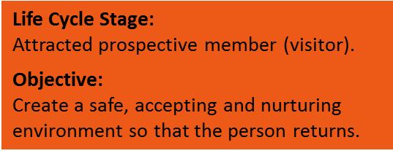
CONNECT

Slide 16
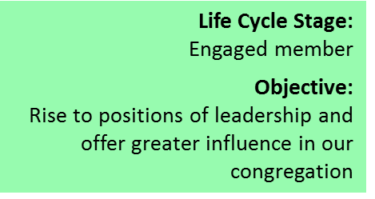
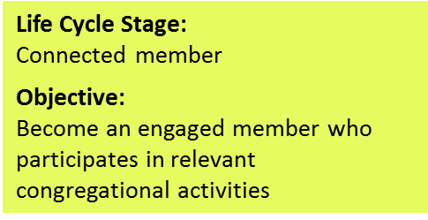
SPREAD THE WORD
INSPIRE
ENGAGE

Slide 17
UUCDC Member Journey A life cycle strategy to grow membership
Note: Member life cycle starts at the bottom of funnel; potential to lose members at any stage of funnel.
Larger #s of committed members are produced who attract more prospective members
Life Cycle Stage:
Inspired member
Objective:
Attract new members
Life Cycle Stage:
Engaged member
Objective:
Rise to positions of leadership and offer greater influence in our congregation
Life Cycle Stage:
Connected member
Objective:
Become an engaged member who participates in relevant congregational activities
Life Cycle Stage:
Welcomed returning visitor.
Objective:
Become a member of the congregation.
<= Every stage is NURTURED =>
Life Cycle Stage: Attracted prospective member (visitor).
Objective: Create a safe, accepting and nurturing environment so that the person returns.
Life Cycle Stage:
Prospective member.
Objective:
Ignite curiosity and interest to the point where a person is motivated to visit us.
WELCOME
ATTRACT
Potential new members feed the funnel

Slide 18
Membership Engagement Lead (Exec Team)
Hospitality
Community/Groups and Activities
Communications
Dinosaurs alive
Young families
Camera club
Book club
Ushers
Greeters
Coffee
Digest
Focus Feed
Social media (Facebook, Twitter, Flickr, YouTube)
Flowers
Webmaster
Church directory
Electronic bulletin board
Sermon Audio/Video
Recurring special events (e.g. Seder dinner)
Women’s group
Quilters
Supply closet
Caring Committee
Congregational hospitality concept project
Membership
Engagement
Committee
Green font = membership engagement committee members
Purple font = new program areas

Slide 19
UU Church of Delaware County Leadership Recruitment Dinner Concept
Provides context for the role
Shows how the position fits into the larger church ecosystem
Demonstrates why the position is important to the success of the church
Clarifies what the area this leadership role oversees is doing to contribute to the health of the congregation
Notes:
When recruiting for leadership roles, we need people to have the context for the role; how it fits into the larger church ecosystem, why it’s important to the success of the church, what the area this leadership role oversees is doing to contribute to the health of the congregation,

Slide 20
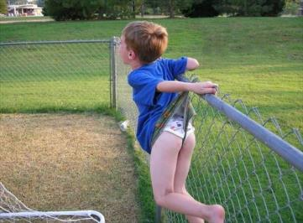
UU Church of Delaware County Leadership Recruitment Dinner Concept
Details what the benefits are to the individual
Elaborates on the people they would be working with
Ensures that they’re not going to get “stuck” in that role for the next ten years
Notes:
most importantly what the benefits are to the individual, the people they’d be working with, and that they’re not going to get “stuck” in this role for the next 10 years.

Slide 21
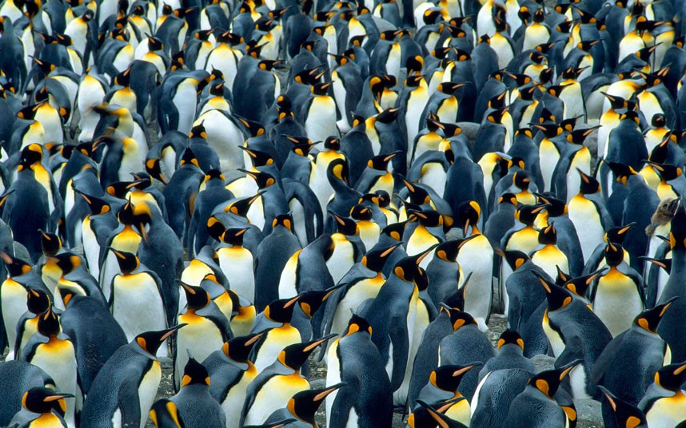
Notes:
So why a dinner? There is also a human connection that happens when people break bread together and connect on a deeper level. And finally, there is a safety in numbers (you’re not being singled out) and a level of competition when others are signing up for roles. This is why we created the concept of a leadership recruitment dinner.

Slide 22
Agenda topic | Speaker | Timing | Impact/Goal
Arrivals, drinks & nibbles | -- | 6:30-7:00pm | Chance to get to know each other. Settle in living room by 7pm.
Start session |  | 7:00pm
Welcome and review agenda | xx | 3 mins | Address our target to close the evening (e.g. 8:30pm)
Highlights of what the board has accomplished | xx | 5 mins | Focus on the top 3 successes only that show meaningful impact so we don’t come across as a hard sell; get people psyched about the impact this role has; Hear from the ministers perspective as to what leaders can bring to our congregation/mission.
What serving on the board means to you | xx | 7 mins | Each volunteer talks about what their board role meant to them personally and professionally; touch people’s hearts and minds & give them ideas about what this experience could mean to them; then summarize common benefits

Slide 23
What it’s like to serve on the board | xx | 5 mins | Cover the basics (time commitment, how mtgs run, etc); Demonstrates this is all in place, the existing board members will welcome you in and it isn’t that big a time commitment
Transition; what happens next | xx | 2 mins | Explain how to get dinner and break into 3 small groups around the house (assign groups before breaking for dinner)
Get dinner | -- | 10 minutes | Allows for more intimate discussion; chance for invited guests to speak
Phase 1 complete |  | 7:30pm
Discuss what they just heard | xx | 30 mins | Give guests time to ask questions about what they heard/didn’t hear that they expected to hear; proactively address potential concern areas (see below)
Get dessert | -- | 5 mins | Regroup in living room

Slide 24
Phase 2 complete |  | 8:15pm
Reactions: ask each person to share thoughts about evening and a board role | xx | 15 mins | This is the time to nail down who is in for a board role now, wait a year, not for them. We should be supportive regardless of what they say.
Thank you for your service & close out | Rev. | 3 mins | Congratulate yourselves
Phase 3 complete | -- |  | Just past 8:30 so slack time to ensure completion by 9:00pm

Slide 25
Notes:
Marie: So in the time remaining we would like to open it up for questions, comments, reactions, additional ideas, requests for refunds, etc.

Slide 27
Resources Link: https://goo.gl/oR7u4D
Notes:
Marie:

