Slide 1
Beyond Contentment: Motivating Members to Do More
Unitarian Universalist Association of Congregations
General Assembly
The Kentucky International Convention Center,
Louisville, KY
June 20, 2013
Facilitated by Mark Bernstein
Regional Growth Development Consultant
Central East Regional Group (CERG)
www.cerguua.org
Notes:
Welcome to this workshop. In this session, I expect that you will find some ideas that will resonate with you immediately, some that you will find irrelevant or unrealistic, and others that will spark a related idea that you feel you can run with. I appreciate your investment of this time and I hope that you will find it time that was worth while. This presentation will be available on the UUA website following General Assembly.
I am Mark Bernstein, Growth Consultant for CERG. I serve the JPD, OMD, STL, and MNY districts of the UUA.
For more information about CERG and to access many other resources, log on to CERGUUA.org where you can also find my e-mail address.

Slide 2



“I believe in the spirit of sharing and I believe we are what we are because of those around us."
"I am what I am because of other people and they are what they are because of me being around."
"One hand cannot clap on its own but it needs the other hand to make a clap."
Notes:
The Massai people are among the best known African ethnic groups who reside primarily in Kenya and Northern Tanzania. I begin our time together with these opening words, a tribal saying from the Massai people.

Slide 3

People do not join a church or fellowship in the hopes that someday they will be blessed to make coffee for other members of the congregation.
Notes:
Let’s begin with a truism. Read slide above. People do not join our faith with the idea of chairing a committee for the next five years…or working in the memorial garden…or helping to build a storage shed behind the sanctuary. Members join our congregations because they are hurting or curious or otherwise in need of a spiritual community. We need to help them to find that first before we ask them to schedule a meeting or pick up a hammer or bring cookies for coffee hour.

Slide 4
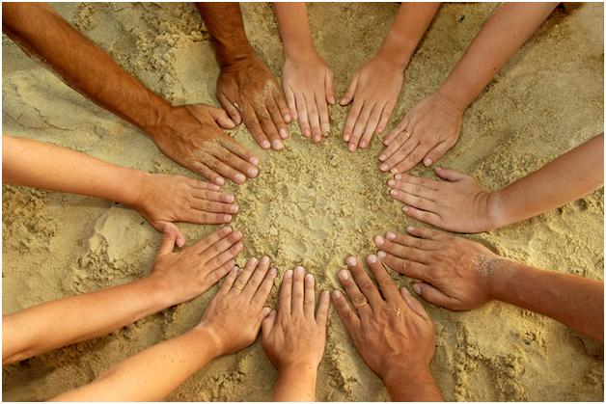

If many hands make light work…
…fewer hands make work more difficult for those who extend them.
Notes:
However, it is also true that a congregation cannot sustain itself for long if it is carried only by a dedicated few. If as the English playwright and poet, John Heywood, wrote, “Many hands make light work”, then fewer hands make work more difficult for those who extend them.
As a consultant, I hear so often the refrain from leaders that we cannot continue to carry the load; that getting people to contribute to congregational life is difficult; that we are burning out.
And for those people, there is in fact a church for them.
Go to next slide.

Slide 5
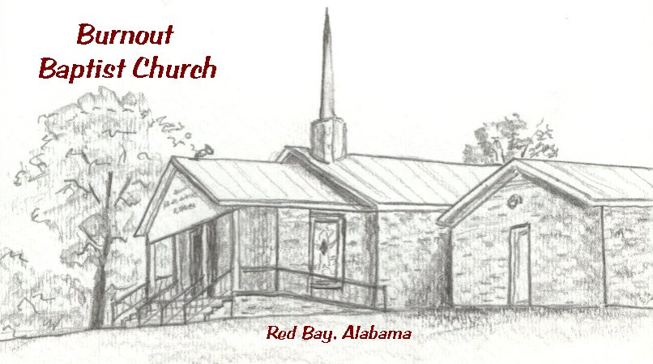
THIS PLACE REALLY EXISTS!!!
Notes:
We know that one of the greatest problems in our congregations is the experience of burnout. Anne Jackson, in her book, Mad Church Disease, even compared it to the symptoms of mad cow disease. The disease lies dormant for a period of time and it may be a period of months or even years before it is found; so too with people in our congregations who get worn down and don’t realize its happening to them.
Mad cow disease causes mental and physical deterioration; so does church burnout.
An entire herd can be infected if they share the same food source, so too the entire congregation can be infected with the disease of non-involvement; and mad cow disease can lead to death if untreated , or in our case can result in the burned out leaders leaving the church.

Slide 6
Why are some people reluctant to volunteer?
Too many other priorities
Fear of getting “stuck” in something from which they cannot escape
Fear of making a deeper commitment to the congregation
Feelings of inadequacy
Lack of ownership in the congregation
A sense of not feeling connected to other members of the congregation
Notes:
Hey, we lead busy lives. There’s a lot going on. I have to prioritize.
If I become immersed in a committee or a project, I may be there for life. I won’t be able to dig my way out. Best not to get involved in the first place.
Its safer if I hedge my bets and stay on the outside of the circle.
What if I take on a role in this congregation and I fail?
Its not really my responsibility to make sure that things get done. Let those who have been here longer or who are in positions of leadership or who are birthright UU’s take the lead in taking on the work of the congregation.
I don’t feel a personal commitment to other members of the congregation. I don’t know them and they don’t know me.

Slide 7
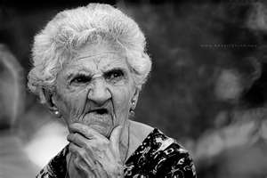
In order to figure out what motivates members to engage in congregational life, we need to first look at management theory.
What the heck is he talking about????
Notes:
Okay, so we know that one of the keys to being a strong vital and growing congregation is getting more people involved in congregational life. And we know that there are a number of barriers to overcome.
So, how do we do it? How do we motivate people to get involved in the life of the congregation?
We turn first to management theory: A collection of ideas which set forth general rules on how to manage a business or organization. Management theory addresses how managers and supervisors relate to their organizations in the knowledge of its goals, the implementation of effective means to get the goals accomplished and how to motivate employees to perform to the highest standard.
If any of you are as puzzled as this lady, hang in there.

Slide 8
What do people need and want?
Leadership
Validation
Pride in their Work
Trusting Relationships
Teamwork
Commitment to Quality
Involvement Personal and Professional Recognition
Notes:
Lets start with what we know people need and want from their work.

Slide 9
Meaningful Work
High Standards
Clear Sense of Purpose and Direction
Balanced “worth-its”
Level Playing Field
To be and Feel Competent
Notes:
In their book, Contented Cows give Better Milk, Bill Catlette and Richard Hadden add their voice to what they think employees want and need:
1. Meaningful work – they want to be proud of what they do.
2. High standards – they want an organization that is committed to quality
3. A clear sense of purpose and direction – this includes timely, relevant and truthful information.
4. Balanced “worth-its” – They must see a commensurate level of interest and investment in them and the freedom to pursue some things that are important to them.
5. A level playing field – reciprocal caring, a sense of justice, an assurance that they won’t be taken advantage of.
6.To be and feel competent
My contention in this session is that the things that people need and want from their work are exactly the same things they want from their congregation.

Slide 10
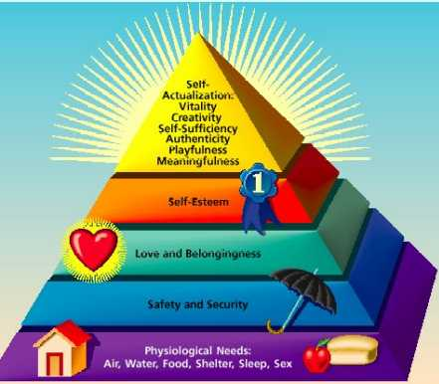
Notes:
Abraham Maslow’s hierarchy of needs.
Humans pursue specific needs in order of importance until satisfied. We start at the most basic and lowest need levels and once they are secured, we move up to different needs. For instance, we need to meet physical needs (food, clothing, shelter) to survive, then satisfy safety and security (financial, emotional) needs before social, self-esteem and personal growth needs become important and of concern.

Slide 11
Herzberg’s Motivation-Hygiene Theory (What?)
Factors for Dissatisfaction
Company policies
Supervision
Relationships
Work conditions
Salary
Security
HYGIENE FACTORS
Factors for Satisfaction
Achievement
Recognition
The work itself
Responsibility
Advancement
Personal Growth
MOTIVATORS
Notes:
Frederick Herzberg found that certain characteristics of a job are consistently related to job satisfaction while other factors are associated with job dissatisfaction. Show factors . He concluded that job satisfaction and job dissatisfaction are not opposites. Eliminating factors that cause dissatisfaction will not necessarily result in job satisfaction. Instead, it will just eliminate job dissatisfaction. Give example. The factors on the left are hygiene factors. They must be present in order to eliminate dissatisfaction. But for an employee to truly be productive and fulfilled in their work, you need the factors on the left or the motivators. So you need to both eliminate the factors causing dissatisfaction and create conditions for job satisfaction.

Slide 12
What are the hygiene factors in our congregations?
Relationships
Covenants
Music
Worship
Pastoral Care
Programming
Coffee
You need to eliminate dissatisfaction with these factors!
Notes:
What challenges do you face in recruiting volunteers to do the work of the congregation?
What are you doing in your congregation to eliminate dissatisfaction?
How well do you think management theory relates to issues in your congregation?

Slide 13
What are the motivators that compel members to immerse themselves in congregational life?
Achievement
Affiliation
Power (authority)
Our Life Saving Faith
Responsibility
Meaning
Affirmation (recognition)
Personal Growth

Slide 14
Creating Highly Motivated Participants in Congregational Life
Ownership
Making a Contribution or Having a Transcendent Purpose
Recognition or Sharing of Gifts
Notes:
Greek autónomos with laws of one's own. Synonymous with independent, free, self-governing, independent. In order to be motivated, a member must feel free to take risks, to explore their own interests, to find their role in the congregation. But in order to feel autonomous, one must feel a sense of ownership. We’ll come back to that.
Strong lives are motivated by dynamic purposes.
Kenneth Hildebrand
3. The opportunity to share my gifts with the congregation, to be acknowledged for sharing those gifts, and to acknowledge the gifts of others.

Slide 15
Powerful questions are those that evoke a choice for accountability and commitment.
Powerful questions are the ones that cause you to become an actor as soon as you answer them. You no longer have the luxury of being a spectator of whatever it is you are concerned about.
Questions that have the power to make a difference are ones that engage people in an intimate way, confront them with their freedom, and invite them to co-create a future possibility.
Notes:
The primary way in which we create a sense of ownership is through the asking of powerful questions.
Go to slide.
A great question has three qualities:
It is ambiguous – there is no attempt to try to precisely define what is meant by the question. Each person brings their own personal meaning into the room.
It is personal –
It evokes anxiety – all that matters makes us anxious. If there is no edge to the question, there is no power.

Slide 16
Questions with Little Power
How do we get people to serve on the Board?
How do we get people to accept the move to two services?
How do we get people to pledge more money?
How do we get more people to attend congregational meetings?
Powerful Questions
What gifts do you hold that you are willing to bring to this congregation?
What are you willing to give up in order to move forward?
What is the commitment that you bring to this congregation?
How valuable do you want this congregational experience to be?
Notes:
Little power: The hidden agenda in these questions is to maintain dominance and to be right. They are returning to what got us here. They have no power, only force. They imply that the one asking knows and other people are a problem to be solved.
Powerful questions give us the means to initiate a community where accountability and commitment are ingrained. In so doing, we also create a sense of belonging.
Powerful questions enable us to move forward. By answering these kinds of questions, we become more accountable, more committed, more vulnerable and more intimate and connected,

Slide 17
Creating a Sense of Ownership
I am, of course, aware that the ultimate solution is the ownership and control of the means of life by the whole of the people; but we are not at that stage of development as yet.
James Larkin
We have to realize that each time people enter a room, they walk in with ambivalence, wondering whether this is the right place to be. This is because they believe that someone else owns the room.
Peter Block
Notes:
As a member of my home congregation, the UU Church of Delaware County, for nearly 20 years, I have held virtually every position imaginable, including two tours on the Board of Trustees, the second time serving as first Vice President and then President of the Board. I’ve also headed the fund drive, taught religious education, served as auctioneer, participated in the adult faith development program, been a worship associate, performed in Gilbert and Sullivan’s Christmas Carol and finally grudgingly finally made and served coffee. Let’s face it, I’m a Big Mahoff in my congregation. But even today, when I approach the door of my congregation on a Sunday morning, I sometimes hesitate for a moment as I wonder whether this is where I belong; am I still needed; is this congregation still mine to create?

Slide 18

The ownership conversation asks us to act as if we are creating what exists in the world.
This requires that we believe in the possibility that our congregation is mine or ours to create.
It stems from the belief that each of us is cause not effect.

Slide 19
Powerful Questions related to Ownership
How valuable an experience do you plan for this to be?
What do you risk by becoming a member of this congregation?

Slide 20

Helping Members to Realize their Contribution or Transcendent Purpose
When you discover your mission, you will feel its demand. It will fill you with enthusiasm and a burning desire to get to work on it.
W. Clement Stone
Notes:
The second way in which we motivate members to get involved in congregational life is by helping them to realize their Contribution or Transcendent Purpose

Slide 21
Powerful Questions related to Contribution and Purpose
How do you want to live out your Unitarian Universalist beliefs?
What are you called to do as a member of this congregation?

Slide 22
Acknowledging Our Gifts
We are not defined by deficiencies or what is missing. We are defined by our gifts and what is present.
We embrace our own destiny when we have the courage to acknowledge our own gifts and choose to bring them into the world.
Notes:
Authentic acknowledgement of our gifts is what it means to be inclusive or to value diversity. Talk about your disabilities work and the focus on a person’s disability or what they’re doing wrong.
Ask participants to think about the gifts that they choose to bring out into the world that benefits their congregation. Ask them to have the courage to share.

Slide 23
Powerful Questions for Acknowledging Our Gifts
What is the gift(s) that you wish to share with other members of this congregation?
How will you acknowledge the gifts that other members bring forth into the congregation?

Slide 24
Strategies for Recruiting and Retaining Volunteers
Test the Waters With a One-Time Commitment (otherwise known as First Serve)
Make sure that the congregation knows that volunteers are needed
Advertise areas that need more volunteers. You can do this verbally, you could have a volunteer fair, you could send emails, or even post needs on your website.
Start a connection desk
Notes:
A first serve is where prospective volunteers are allowed to test drive a service opportunity with no strings attached. Too many times we are so hungry for volunteers that we latch onto anyone who shows interest and never let them out, which makes people more hesitant to express interest. Because a first serve has no strings attached, it encourages people to try out different ministries and find one that fits them. The first rule of a first serve is that there can be no pressure to join the team, and you need to tell your members that this rule is in place. A first serve is just a taste. If the person likes it, they come back. If not, they try something else. No big deal. This low-pressure environment encourages people to explore any ministry that interests them. The more ministries they try out, the more likely they’ll find the perfect place to serve. This makes them happier in their work and more willing to continue volunteering.
Letting members know what you would do if you had more volunteers and more leaders (so they contrast the present situation with your dream, rather assuming that if everything is working there must not be any need for help).
This is a central place where people can get information on small groups, learn about serving opportunities, , and basically do anything else related to connecting into the body of the church. At the end of every service, they invite anyone who’s new and interested in getting connected to stop by. Because they mention the connection desk in every service, people hear about it the first time they come. It’s important to reach first time guests, because there is a small window when people are willing to work at getting connected. Once people find friends in the church, they’ll feel connected enough that they won’t put forth the effort to try something new. But, if a first or second time guest is interested in the church, they’re desperate to get connected and meet more people and will work hard to do so. The connection desk meets that need and channels this desire toward integrating people in to the heart of the church.

Slide 25
More Strategies
Empower members to do their own recruitment
Recruit mini-recruiters
Write and share “job” descriptions
Ask people to take on tasks, not to serve on committees.
If you must have committees, impose term limits. Consider having committee heads elected by the congregation.
If you request that someone take on a leadership role, offer a system of support that is already in place.
Acknowledge the efforts of your volunteers with mentions at worship, in the newsletter or order of service, and celebratory events.
Notes:
Have that "small core" of volunteers extend out a bit into their networks to ask their friends and the people who sit near them during church to participate. Your friend may need to help them develop a rap and an ask, but we've found that the personal ask from a fellow "person in the pew" can work really well.
Recruit mini-recruiters. Get your friendliest, most involved people involved in bringing in new folks- put one of the ushers in finding other ushers, a choir member in charge of recruiting new choir members, etc. They'll be better about spotting those who are interested

Slide 26

It begins with the invitation
Invitation is the means through which hospitality and community are created. It is an act of generosity; a call to create an alternative future, to join in the possibility that we have declared.
In an authentic community, members decide anew every single time whether to show up. If they do not choose to show up, there are no consequences. They are always welcome.
Notes:
The anxiety of invitation is that if we give them a choice, they might not show up. It is difficult to face the reality of their absence, reservations, passivity or indifference. We do not want to face the prospect that we or a few of us may be alone in the future we want to pursue.
Ask participants to share a time when they felt alone in pursuing a future that others were reluctant to embrace or participate in. Use your example of serving on the fund drive and being rejected by many in the congregation in response to a call for help.

Slide 27

Invitation is not only a step in bringing people together. It is also a fundamental way of being in community.
Genuine invitation changes our relationship with others, for we come to them as an equal. I must be willing to take no for an answer, without resorting to various forms of persuasion.
Notes:
For all the agony of a volunteer effort, you are rewarded by being in the room with people who are up to something larger than their immediate self-interest. You are constantly in the room with people who want to be there. The concern we have about the turnout is simply an expression of our own doubts about the possibility that given a free choice, people will choose to create a future distinct from the past.

Slide 28
Making the Invitation
Name the Possibility
The invitation is activated by the possibility we are committed to. The possibility is the future that the convener is committed to.
Example: the possibility of a congregation that is vital, healthy and thriving.
Frame the Choice
The invitation must allow room for a no. We need to be clear that we will not initiate consequences for not attending and that we respect someone’s decision not to attend.
Notes:
1. Ask participants to state possibilities for the following examples: Adult Faith Development Team; Choir; Religious Education for Children; Usher team; building and grounds committee; Annual Fund Drive team. Divide into groups of three and give group five minutes to write a statement of possibility.
2. Let them know that even if they say no now, they will always be welcome in the future.

Slide 29
Name the Hurdle
The invitation is not only an invitation to show up, but to engage. We need to tell people explicitly what is expected of them should they choose to attend.
Reinforce the request
End the invitation by telling people that you want them to come and that if they choose not to attend, they will be missed but not forgotten.
Make it personal
A visit is more personal than a call; a call is more personal than a letter; a letter is more personal than an email.
Notes:
3. What is expected of them is not to take on a specific task at first, but to make a commitment to the process and the outcome; to give their ideas; to accept the ideas of others, to make the time for this to work. Paradoxically, even though there is no cost for refusal, there is a price for coming. Everything that has value has a price.
Ask: What is the price you are paying for being here?
End this section by asking for reactions and to compare with the way they invite (or recruit?) people in their congregations now.
Ask them to consider practicing this process of invitation at SI should the occasion arise.
To 11:00

Slide 30
Sometimes…less is more
GINE
Good Idea No Energy.

Slide 31
Unitarian Universalist Church of Delaware County (UUCDC)
Growth Through Service Project: Statement of Theological Grounding
As Unitarian Universalists, we live out our faith through our service to others. True spiritual growth, in ourselves and in our congregation, arises, in part, through our connectedness with others and through serving a higher purpose that is greater than our own individual needs. In this context, service to our church community becomes a sacred experience, one in which our relationships are defined by a sense of caring, respect, commitment, and responsibility.
As sources for this statement, we draw on our third principle, which encourages spiritual growth in our congregations; our seventh principle, which acknowledges the interdependent web of all existence of which we are a part; and the mission of UUCDC, which calls on us to care deeply about each other, our children, our neighbors and our Earth.

Slide 32
If you want to build a ship, don't drum up people together to collect wood and don't assign them tasks and work, but rather teach them to long for the endless immensity of the sea.
Antoine de Saint-Exupery
Notes:
French writer: Author of The Little Prince. Ant-wan duh san ek-zoo-pay-ree

