Slide 1

Lifelong learning & beyond
General Assembly 2013
Louisville KY
Workshop #2035
Kentucky International Convention Center - 207

Slide 2
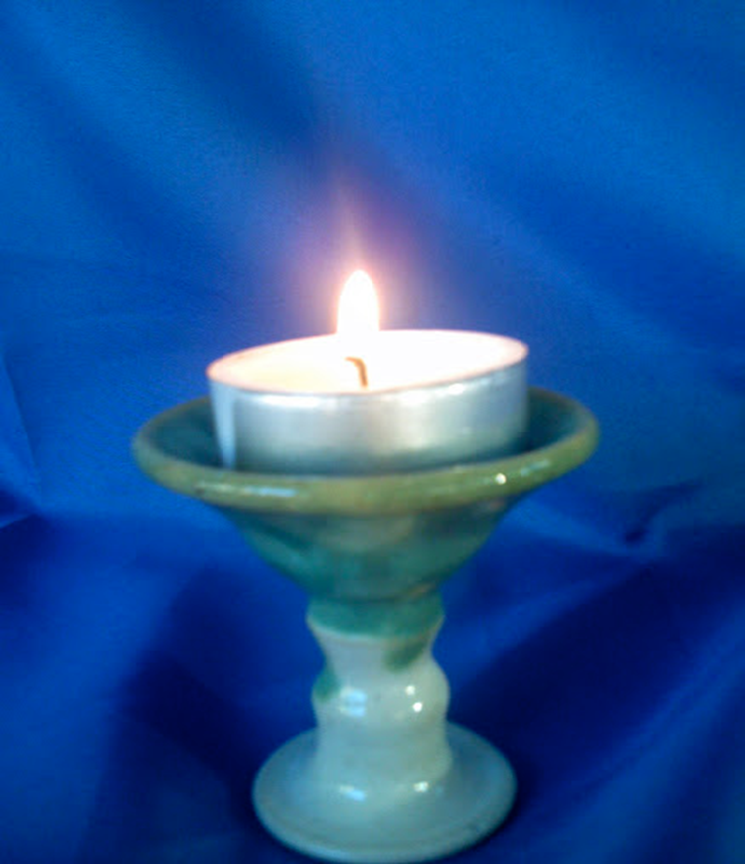
Welcome!

Slide 3

Overview
Introduction to Faith Formation 2020
Faith Formation Networks
Resources

Slide 4
For Video, visit youtu.be/TXD-Uqx6_Wk
© 2013 by Erik Qualman. Used by permission.

Slide 5
The Changing Landscape
No Religious Affiliation
Declining Church Participation
Increasing Diversity & Pluralism
Changing Marriage & Family Life
The Rise of Digital Media & the Internet
Spiritual, not Religious
Declining Religious Socialization
Aging Baby Boomers

Slide 6
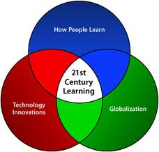
21st Century Faith Formation
What could a 21st century approach to faith formation look like?
How would we address the diversity of people’s religious and spiritual needs today?
How would we engage people? How would we reach people?
What technologies would we use?
What resources would we access?

Slide 7

Envisioning
A Lifelong Faith Formation Network is a way to provide faith formation for everyone, anytime, anywhere, 24x7x365.

Slide 8
Implement the Network with a Wider Audience & Continue Evaluation and Improvements
Create and Test a Network Prototype
Design the Network
Define the Group’s Point of View
Research the Target Audience
Identify a Target Audience
Network
Design
Process

Slide 9
Faith Formation Settings
Face-to-Face
& Virtual
On Your Own
Small Group
Large Group
Mentored
Church Community
Community & World
@Home

Slide 10
A Network Approach
Faith Formation Network
Church Programs
Small Groups & Support Groups
Mentors
Social Media for Connection
User-Generated Content
Community Programs
Online Courses & Activities
Online Resources: Print, Audio, Video
Apps
Blogs
Video Conference

Slide 11

Lifelong Faith Formation Network in your local congregation
Network
Curation
Lifelong Faith Formation
Family Ministry
Technology

Slide 12
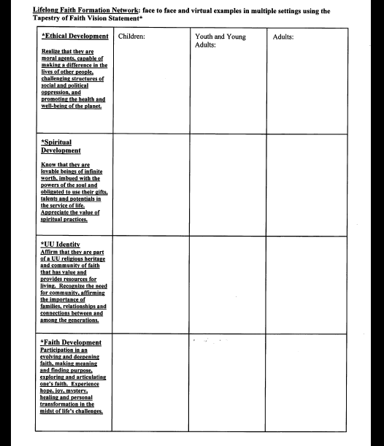

Slide 13
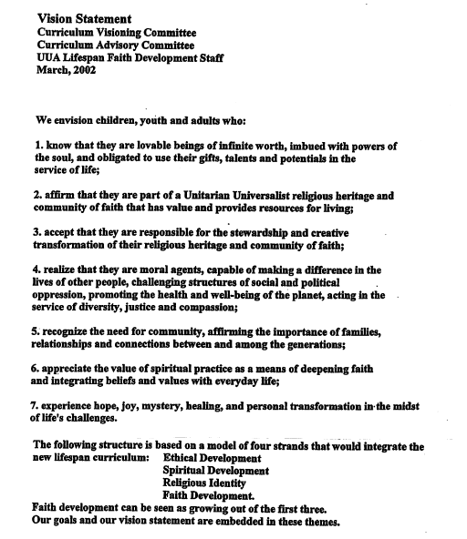

Slide 14









Resources

Slide 15
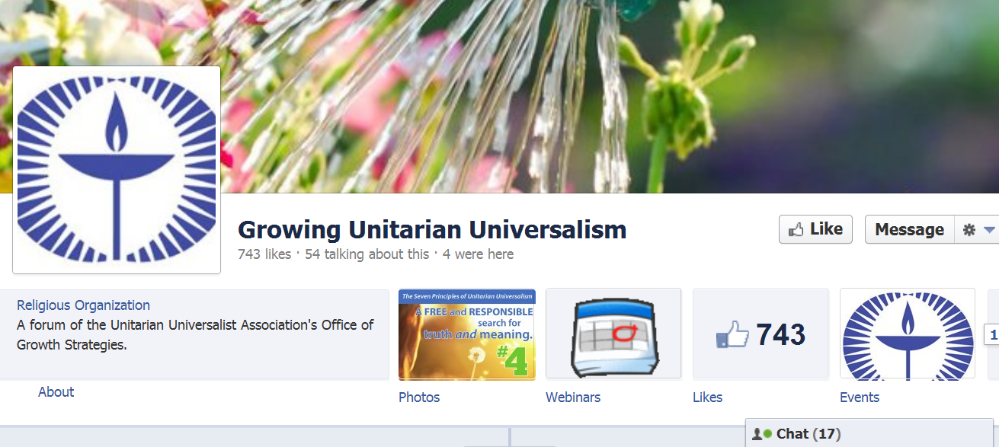
www.facebook.com/GrowingUnitarianUniversalism

Slide 16
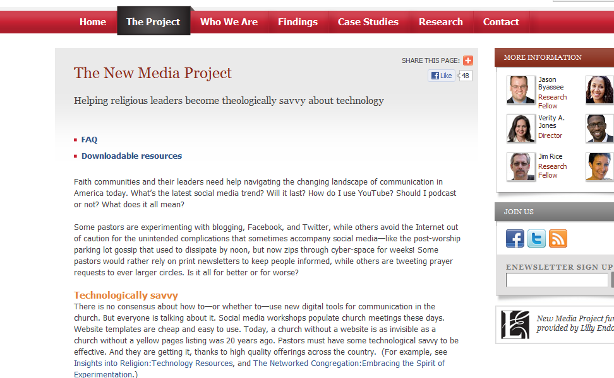
www.newmediaprojectatunion.org/pages/The-Project/default.aspx

Slide 17
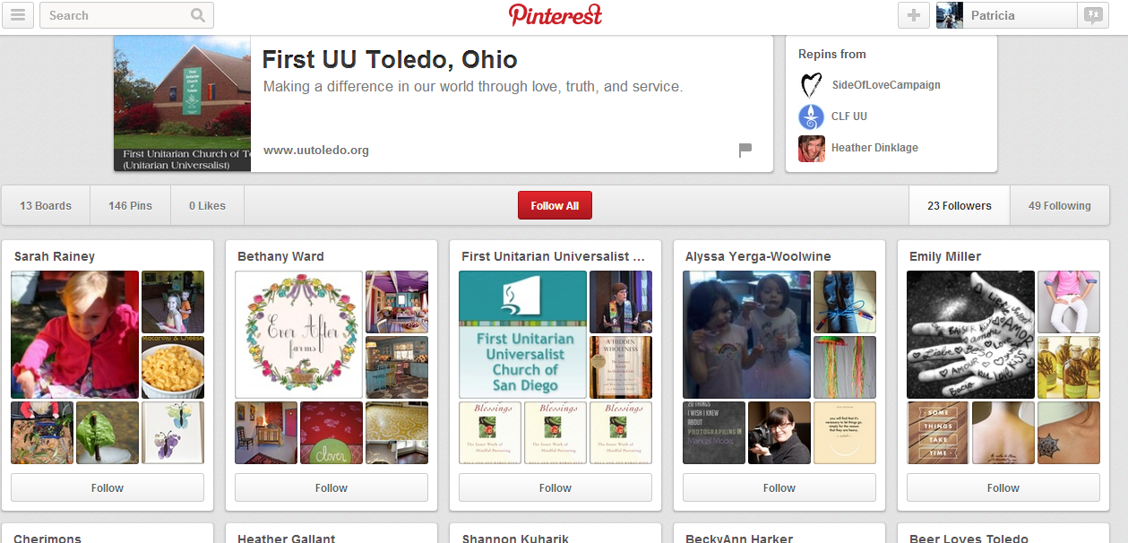
pinterest.com

Slide 18
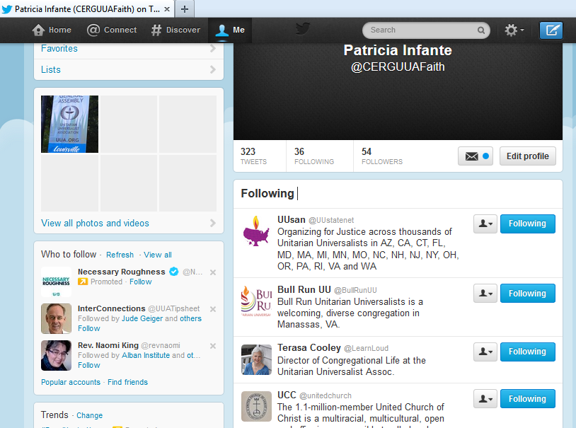
twitter.com

Slide 19
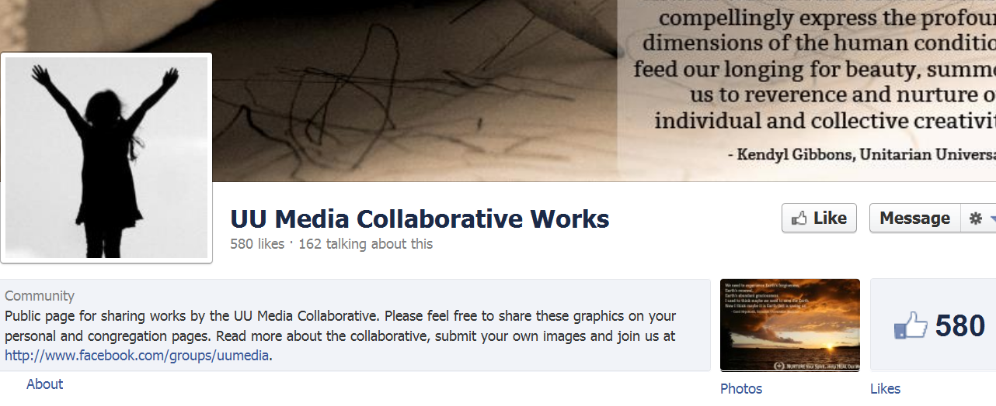
www.facebook.com/UUMedia

Slide 20

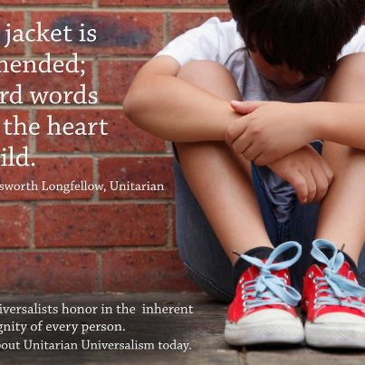
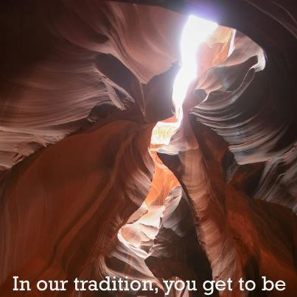

Slide 21
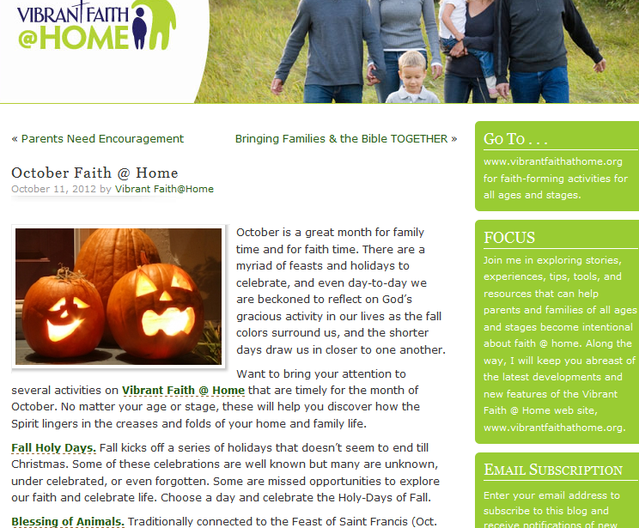
vibrantfaithathomeblog.org/2012/10/11/october-faith-home

Slide 22
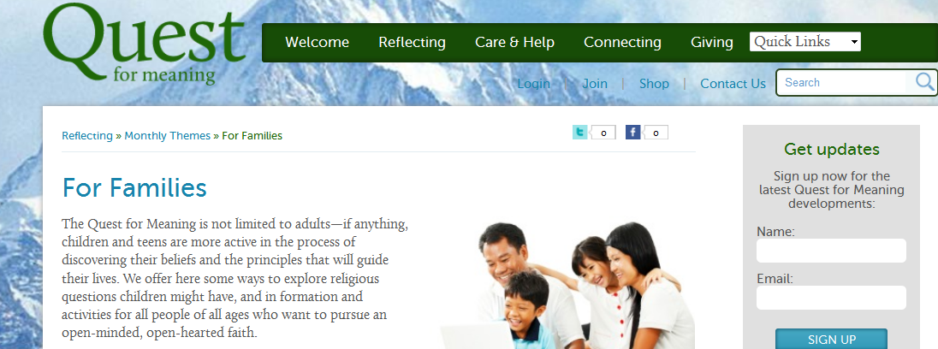
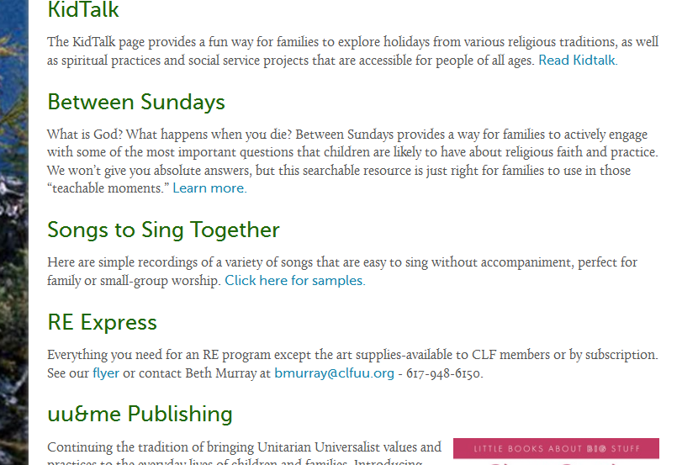
www.questformeaning.org/page/reflecting/for-famillies

Slide 23
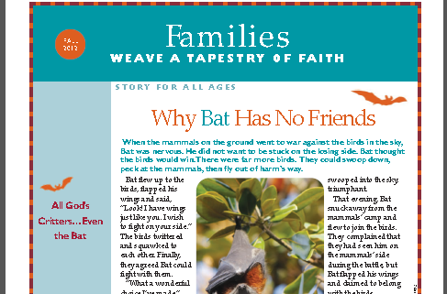
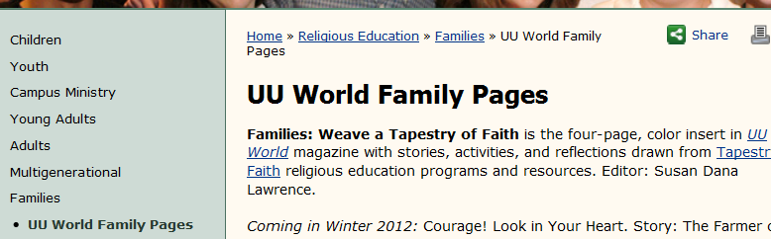
UU World Family Pages

Slide 24
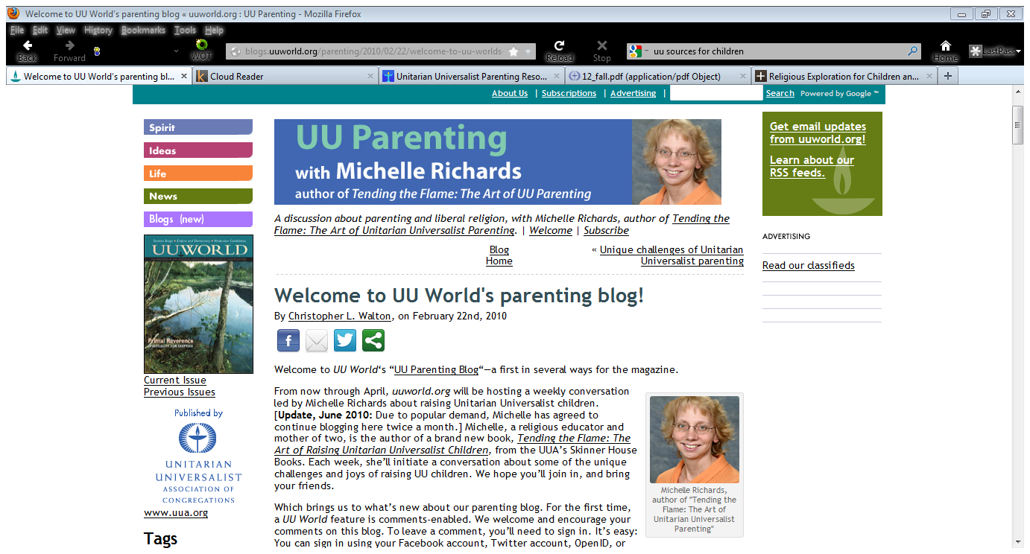
UU Parenting Blog
blogs.uuworld.org/parenting

Slide 25
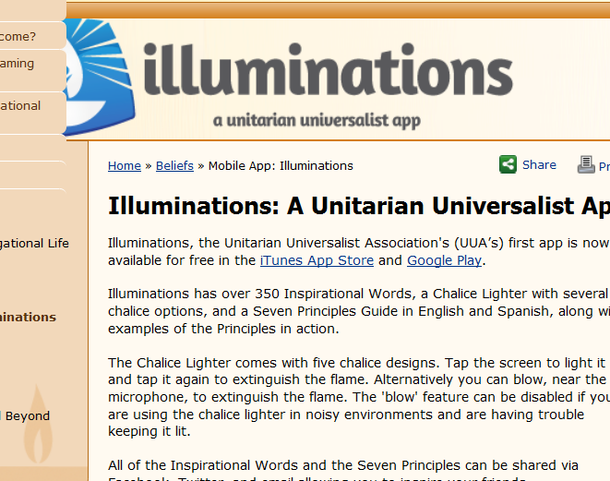
UU Illuminations App
uua.org/beliefs/illuminations

Slide 26
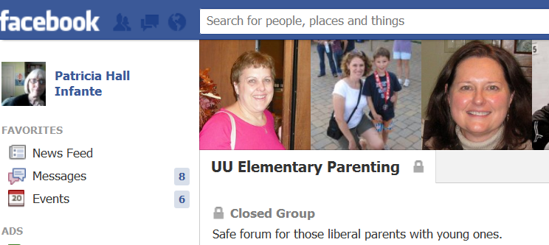
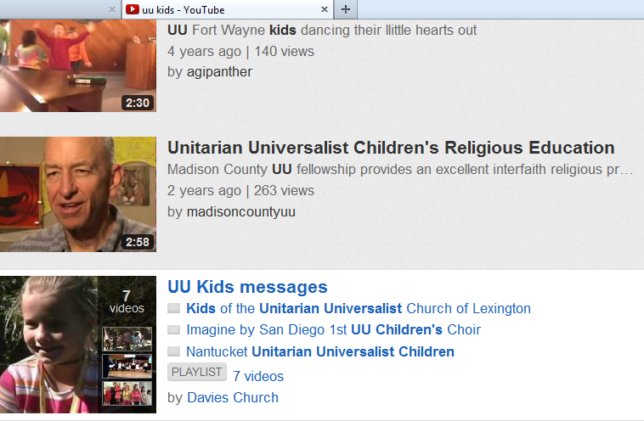
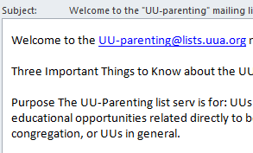
UU Parenting Online

Slide 27
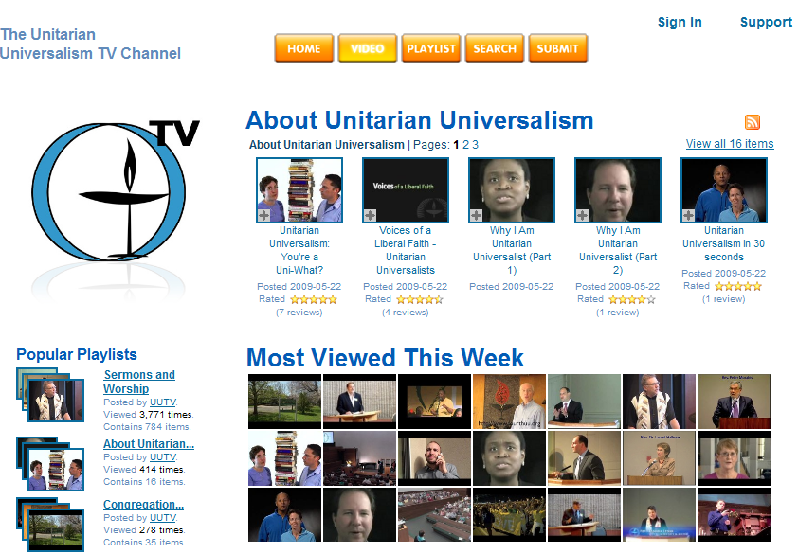
www.unitarianuniversalism.tv

Slide 28

This is our work…

