Slide 1
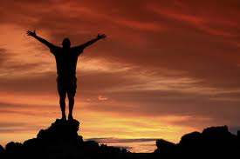
Congregations and Beyond
General Assembly, Louisville, KY
Rev. Dr. Terasa Cooley
June 20, 2013

Slide 2
Because the world is changing…
From passivity to interactivity
From institution to grassroots
From face-to-face to virtual

Slide 3
Spiritual Innovation
Innovation a communal event
Explosive periods of change
Requires adaptive change

Slide 4
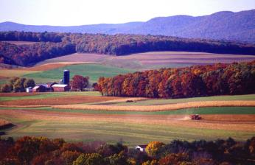
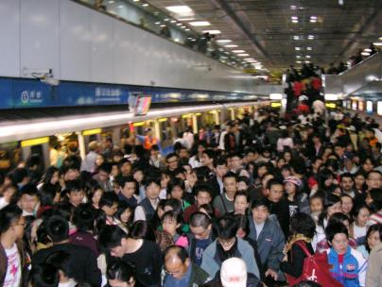
Changes in Living

Slide 5
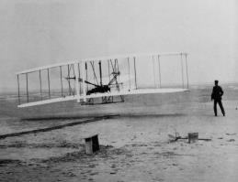
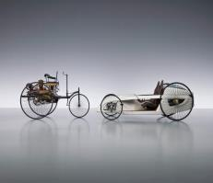
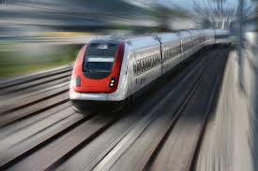
Changes in transportation

Slide 6
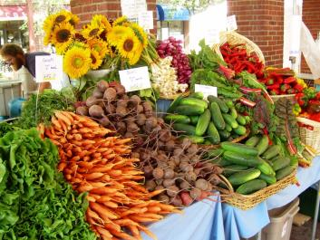
Changes in Food

Slide 7
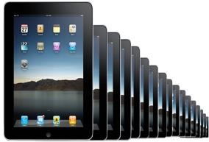
Changes in Communications

Slide 8
Social Media Revolution
Play Video on YouTube

Slide 9
Question
Draw a thread between what you know of your grandparents’ lives, your parents’ lives and yours over time.
What are the significant changes?
How do they impact your life?
How will the next generation live?

Slide 10
Changes in religious life

Slide 11
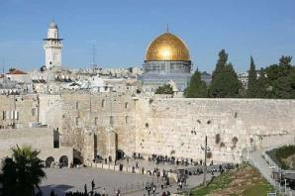
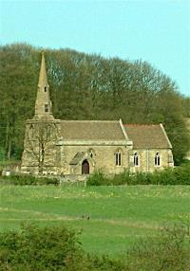
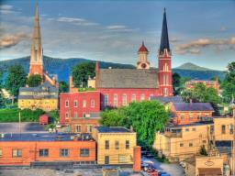
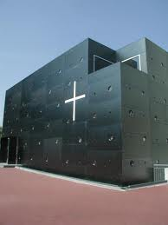
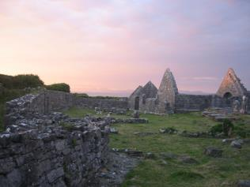

Slide 12
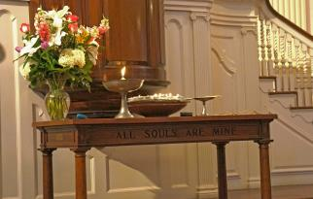
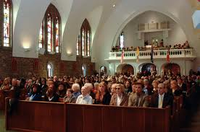
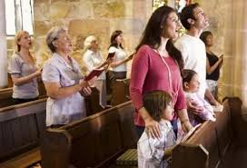
Vital Congregations

Slide 13
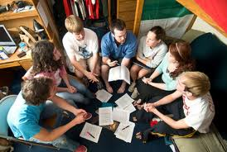
Alternatives to Church

Slide 14
Questions
Do you know people who are “spiritual but not religious”? What do you think they are looking for?
How might congregations help meet these spiritual needs?

Slide 15
Institutional implications

Slide 16
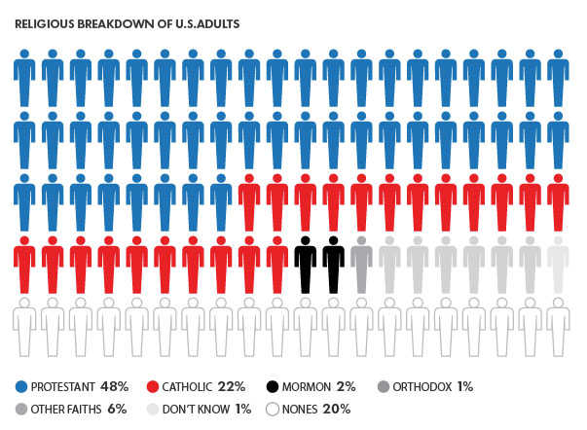

Slide 17
Rethinking Everything….
Play Video on YouTube

Slide 18
Implications for UUA
Moving from
“We can do it” to “Who is doing it”
“We can build it” to “who is building it and how can we partner with them”
“Who owns it” to “how can we work together”

Slide 19
Implications for Congregations
Moving from …
Age segregation to multigenerational
Emphasis on excellence to all to small group experiences
“member programming” to “outside of the church” thinking
Liberating Hope by Michael Piazza

Slide 20
Implications for Congregations
Moving from
“we offer all things to all people” to “what can we curate and interpret for our people”
“how do we serve us” to “whom do we serve?”
Traditional to innovative
Member to participant

Slide 21
Questions
How do you view these institutional transformations?
Where do you see opportunities?
Where do you see challenges?

Slide 22
Opportunities for social transformation

Slide 23
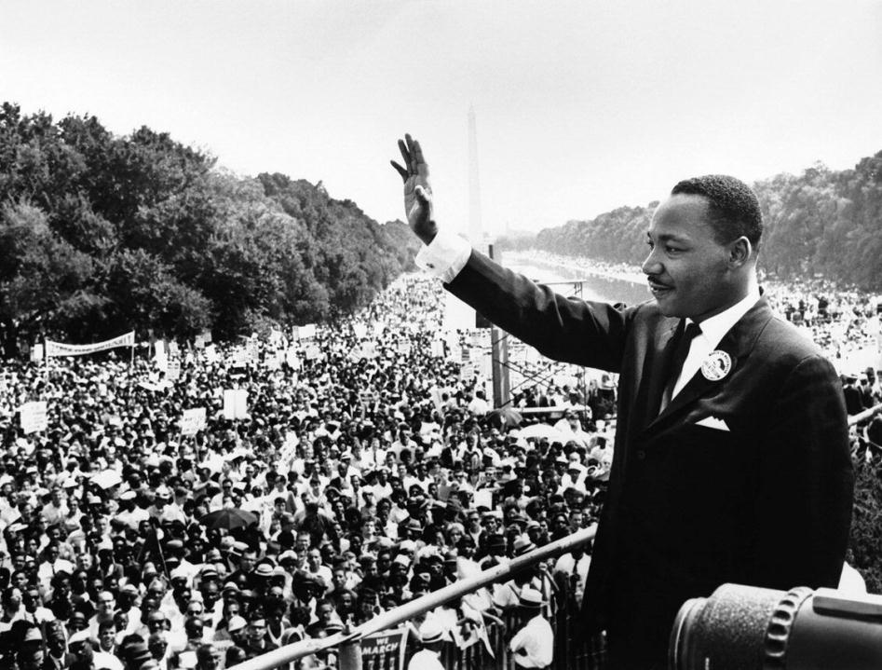

Slide 24
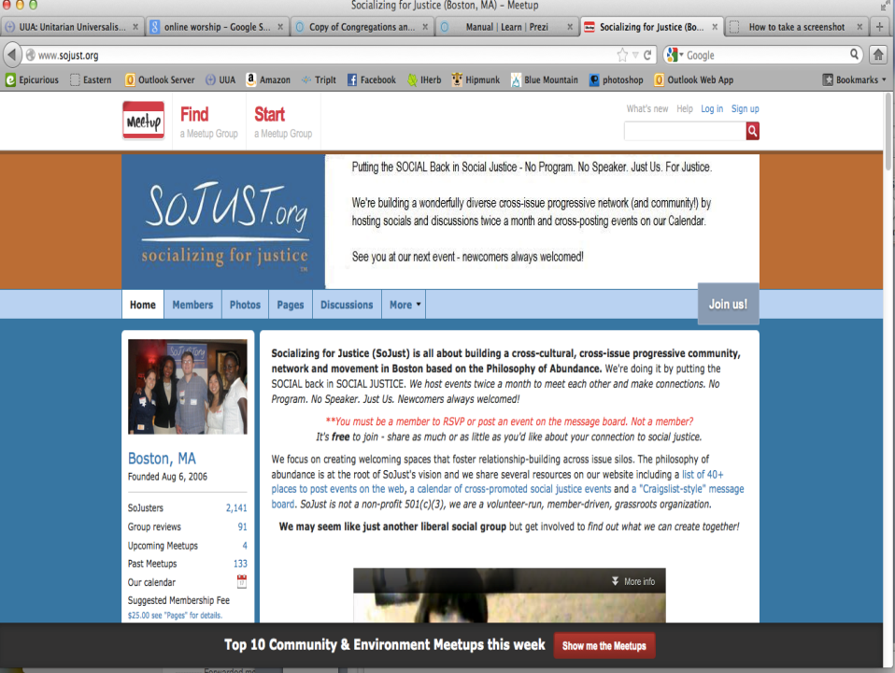

Slide 25
Cognitive Surplus
Opportunities for immediate engagement
Building upon people’s passions
Grassroots
Values based

Slide 26
Use of new technologies
Apps
Games
Meet-ups
Social network sites
Crowd-sourced problem solving

Slide 27
Assumptions
Requires cultural, adaptive change
Congregations still central
Shared ministry
Need collaborative partners
Break down silos
Multitude of models and modes

Slide 28
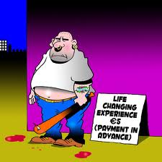
Culture Change

Slide 29
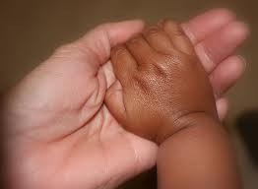
For the future

