Slide 1
FyE26 Forecast 2 update & FY27 PROPOSED CONSOLIDATED OPERATING BUDGET
UUA Board Meeting – April 2026

Slide 2
UUA Board Meeting – April 2026
FYE26 Forecast 2 update
FY27 Proposed Consolidated Operating Budget
Update to the 3-year plan for fiscal sustainability

Slide 3
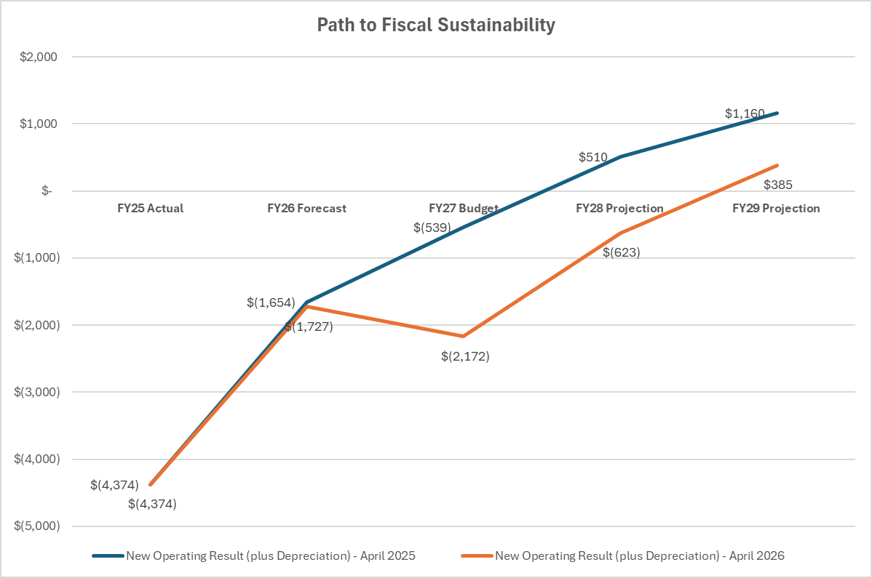
UUA Board Meeting – April 2026
The UUA board approved the 3 Year Plan (Blue Line) in April of 2025
Deficits were approved by the Board through FY27, but we are trending well to the FY26 target
This view includes projected income increases, expense reductions, and eliminates depreciation
As the projections move to actuals, we will highlight the specific drivers of change
The deficit spending is supporting the necessary investments in new staff, systems, and processes needed to move us into fiscal sustainability

Slide 4
UUA Board Meeting – April 2026
FYE26 Forecast 2 Update
FYE gross forecasted deficit ($2.1M) less depreciation ($0.4M) nets to ($1.7M). The gross deficit is currently $0.9M lower than the board approved budget deficit of $3M
The waterfall includes revenue drivers of bequest income (+$1.5M v budget), unrestricted revenue (+$0.2M v budget), and slowing growth in overall expenses (-$0.3M v budget) which offset an overall decline (-$0.5M v budget) across remaining revenue categories
An uptick in closed congregations has resulted in greater revenue contribution
While bequest income significantly outperformed its target ($2.6M vs. $1.1M), this doesn’t replace the need for our daily operations to be covered by more standard and repeatable revenue sources
Now that we are preparing for our Forecast 3 review, we will monitor revenues and expenses more closely as we look to reach the $1M of improvement in our deficit

Slide 5
Total Income is tracking 2.7% higher than original budget primarily due to increases in bequest and unrestricted giving
Total Expense is only up 0.1% primarily due to reduced compensation and holding operating expenses essentially flat versus prior year
Net income is tracking towards a $1M improvement versus the $3M budget deficit; we will push towards that for the remainder of the fiscal year

Slide 6
UUA Board Meeting – April 2026
FY27 Proposed Budget
The proposed budget for Fiscal Year 2027 is a loss of ($2.6M). Eliminate depreciation ($0.4M) and the loss drops to ($2.2M).
The submitted budgets do include the proposed increases in revenue or reductions in expense reflected in the 3-Year Plan. As the proposals move to actual steps the UUA is formally taking, the projected dollars will be rolled into the budget.
This budget reflects the higher costs of the in person general assembly in San Jose, CA.
The retirement incentive program headcount reductions will impact FY27 but will be offset by the approval of new roles that are needed to meet the UUAs strategic objectives. Net savings will be in the ~$300K range.

Slide 7
UUA Board Meeting – April 2026
FY26 – 29 Budget & Projection
Formally started identifying our path towards financial sustainability in three years – In process
A refresh of the strategic plan is viewed as a key element providing clarity of purpose for UUA and allowing for the prioritization of projects and programs – In process, Work will begin in April of 2026
Reaffirmed that multiple channels of revenue growth is part of what will bring a successful, sustainable, financial future – Conversations started; New leadership in StewDev and at the Director levels in Congregational Life and MFD; AFP 2-day retreat in July to map a way forward
Will take strategic approaches to headcount reductions employing several strategies and ensuring appropriate support for affected staff – the first step is completed with the retirement incentive program driving approximately $300K of net savings; Additional steps will need to be taken in FY27
Unrestricted cash balance of $9.M at 3/31/26 (unreconciled) with UUA ($3.5M), UUA loan program ($2.2M) and Beacon Press ($3.3M); $2M of UUAs balance is a transfer from the endowment

Slide 8
The proposed FY27 budget is set at a $2.6M loss. Remove depreciation and we come in at $2.2M
We are moving forward in several revenue channels that will impact our Forecast1 update in October
An overall increase in Fundraising will be due to new leadership and a focus on APF
We are preparing to move more of the top !0 congregations in endowment size ($150M) under our management, increasing our fees
We begin to see the full effect of the retirement incentive plan in FY27

Slide 9
UUA Board Meeting – April 2026
FY26 – 29 Budget & Projection
As a reminder…

Slide 10
UUA Board Meeting – April 2026
Towards Financial Sustainability – 3 Year Plan
Increase UUA’s resource streams
Stewardship & Development
APF congregational giving
Fundraising
Endowment management
Benefit Plan Services (formerly Church Staff Finances)
Reduce our expense footprint
Program prioritization through execution of a strategic plan
Staff reductions from FY26 – 28
Open positions
Retirement incentives
Programmatic prioritization
Target specific operating expenses
Still the Areas of Focus

Slide 11
UUA Board Meeting – April 2026
Towards Financial Sustainability – 3 Year Plan
FY26 Year One – On the revenue side focus on fee structures (APF, Endowment management, Health Care Plan, etc…) to reach the additional $250K in revenue; On the expense side focus on open positions, another retirement incentive program, and specific reductions in certain expense categories; Develop UUAs strategic plan over the course of the fiscal year to go into FY27 with focus and clarity around program goals and objectives
FY27 Year Two – On the revenue side add additional focus on fundraising guided by the strategic plan; On the expense side add stabilizing building rental income; Have a new reporting structure that will enable UUA management to meet its financial sustainability goals
FY28 Year Three – On both revenue and expense ensure execution doesn’t lose traction and that reporting keeps the overall goals and objectives transparent through to completion
No Changes to Strategy
FY25 Loss moves things up one year
Cash management is an issue

Slide 12
*Additional Revenue Growth - in addition to the current budget; we are targeting increased participation across all our development channels, increased growth in endowment participation across congregations, increased growth in endowment dollars under our management
**Additional Expense Reduction - in addition to the current budget; additional retirement incentive programs, and sunsetting of various programs and projects will affect headcount

Slide 13
UUA Board Meeting – April 2026
QUESTIONS & ANSWERS

