Slide 1

Welcome
To Session 4
Administration as Functional Leadership

Slide 2
Opening Words
Spirit of Life, God of Many Names, grant me the serenity to accept the things I cannot change, courage to change the things I can, and the wisdom to know the difference.
~Adaptation of the Serenity Prayer. The Serenity Prayer is attributed to Reinhold Niebuhr.

Slide 3
Agenda
Welcome 5 minutes
Chalice Lighting and Opening Words 5 minutes
Land Acknowledgement 5 minutes
Agenda Sharing 5 minutes
Covenant Review 5 minutes
Check In 10 minutes
Policy 20 minutes
BREAK 5 minutes
Evaluation 20 minutes
Breakout groups: 30 minutes
Closing/Extinguish Chalice/ Looking Ahead 10 minutes
Total Time: 2 hours

Slide 4
Check In Question
Please Share:
Name
Pronouns (if you choose)
How you prefer to receive feedback

Slide 5
Prompt
Think of policies in your congregations. It could be a policy in religious education or a board policy, a building policy.
Raise your hand and unmute if you have policy to add to our list. You can also list them in the chat.

Slide 6
BREAK

Slide 7
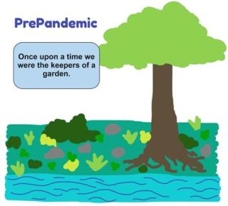
.

Slide 8
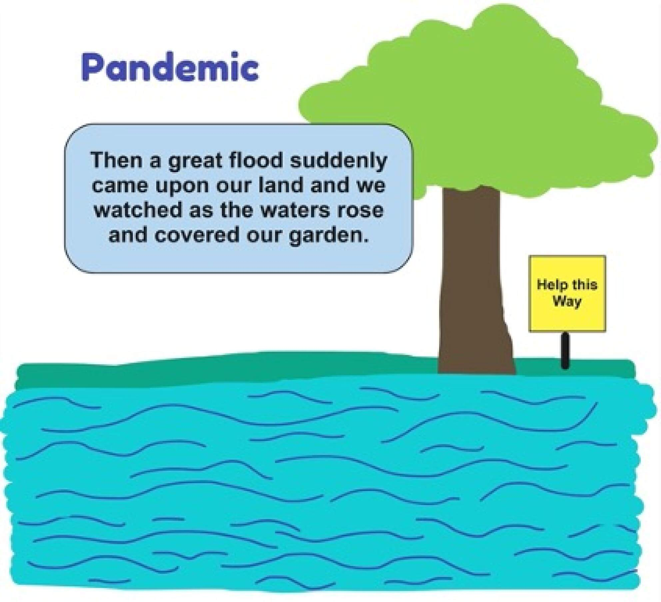

Slide 9
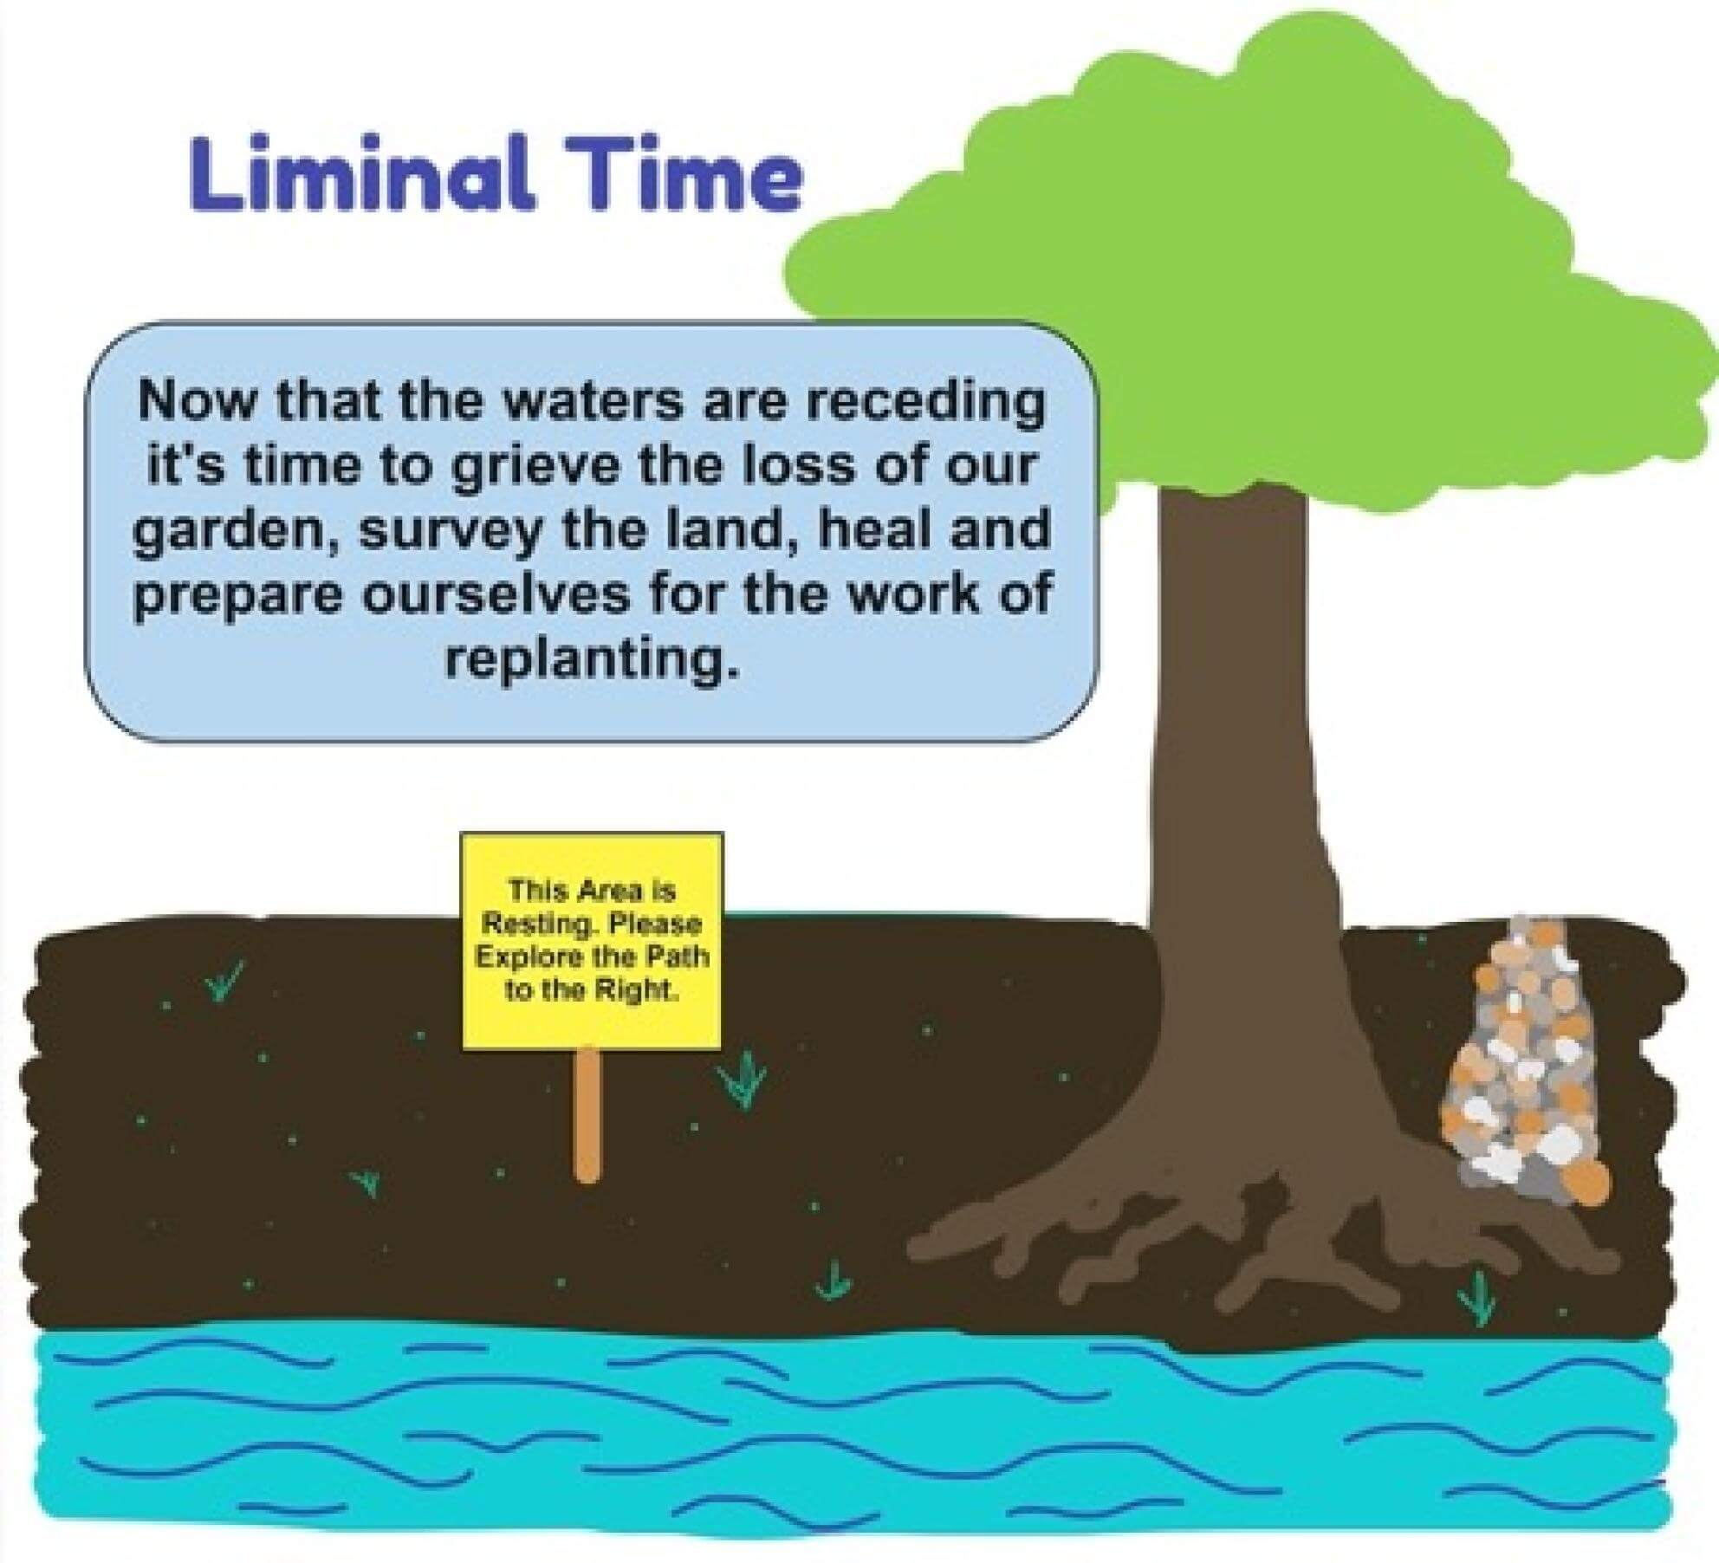

Slide 10
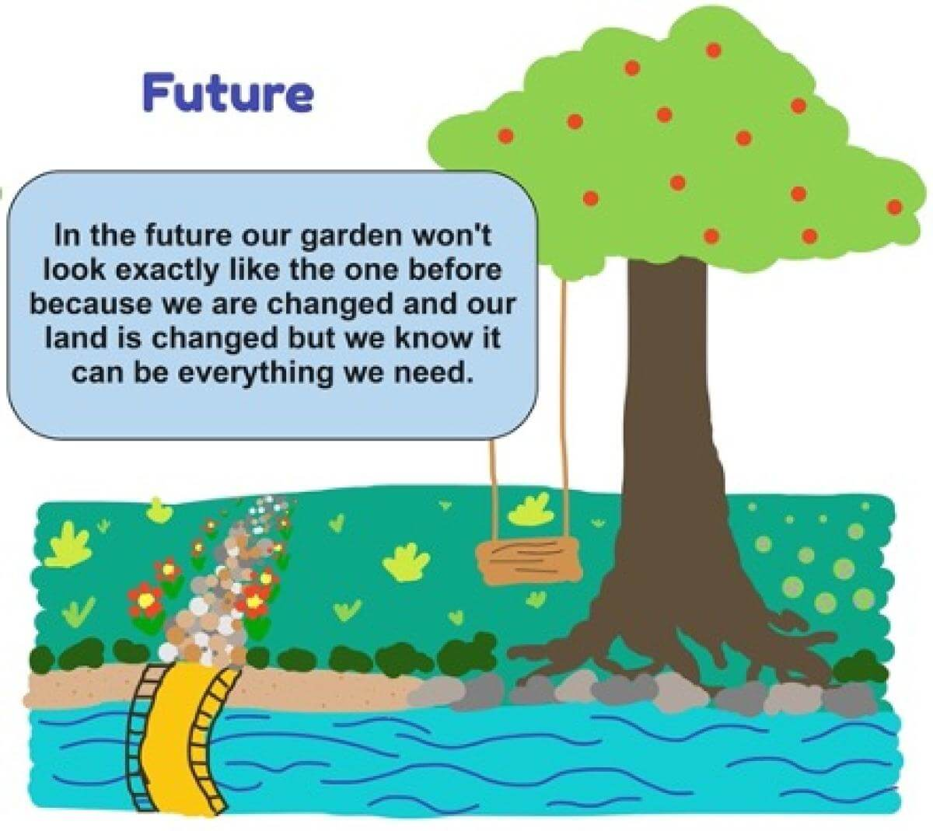

Slide 11
Write, draw, dance, or quietly reflect about a time you received feedback you felt really good about. What was the feedback? How did the delivery impact how you felt about the feedback? Is there anything you noticed about the feedback that you might be able to replicate?
5 minutes

Slide 12
Closing
Excerpt from Pushing Forward
If we believe in the promise of our faith, we must continue pushing forward, even if the reality makes us want to give up. There is no one-size-fits-all solution or model, but there are many paths forward based on context, relationships, and place…Everything comes back to our congregations and covenanted communities. That is where the faith starts and ends. We must embody the changes we wish to see and not just say that we believe in the changes. We must actually live the changes with every fabric of our being. If we believe in the promise of our faith, we must continue pushing forward.
Elandria Williams

