Slide 1

Welcome
To Session 2:
Administration as Welcoming Leadership

Slide 2
Opening Words
“Do you already know that your existence--who and how you are--is in and of itself a contribution to the people and place around you? Not after or because you do some particular thing, but simply the miracle of your life. And that the people around you, and the place(s), have contributions as well? Do you understand that your quality of life and your survival are tied to how authentic and generous the connections are between you and the people and place you live with and in?
Are you actively practicing generosity and vulnerability in order to make the connections between you and others clear, open, available, durable? Generosity here means giving of what you have without strings or expectations attached. Vulnerability means showing your needs.”
― adrienne maree brown, Emergent Strategy: Shaping Change, Changing Worlds

Slide 3
Agenda
Welcome and Introduction 5 minutes
Chalice Lighting and Opening Words 5 minutes
Land Acknowledgement 5 minutes
Agenda Sharing 5 minutes
Covenant Review 5 minutes
Check In 10 minutes
Equity Breakout Groups 20 minutes
BREAK 5 minutes
Technology and Communication as Welcome 10 minutes
Case Studies 45 minutes
Closing/Extinguish Chalice 5 minutes
Total Time: 2 hours

Slide 4
Please Share
Name
Pronouns (if you choose)
Racial Equity Principle you are interested in

Slide 5
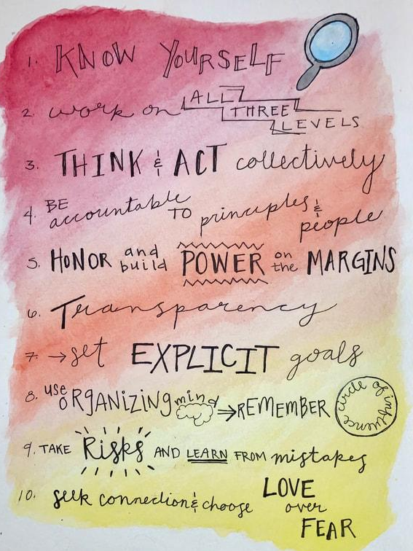
Know Yourself
Work on All Three Levels
Think and Act Collectively
Be accountable to principles and people
Honor and build Power on the Margins
Transparency
Set Explicit Goals
Use Organizing Mind (remember the circle of influence)
Take Risks and Learn from Mistakes
See Connections and choose Love over Fear

Slide 6
Breakout Group Prompt
Discuss how the racial equity principles guide as you widen the circle of welcome and inclusion in your administrative work.
Each participant should share the principle they selected and so thoughts about why they were drawn to that principle.
Why did you select this principle and how does it inform your work of inclusion?
15 minutes

Slide 7
BREAK

Slide 8
Reflection Prompt
Think about a technology you adore or abhor and take a few minutes to reflect about how that technology succeeds or fails by privileging time, wealth or ability. You may choose to journal, voice record, or otherwise reflect.

Slide 9
Case Study Resolution
Level 3: Resolution
Original Poster: Update: For numerous reasons, the team has decided to reply to the parent email as a team with a brief explanation and a "let's solve this together" request, with the parent’s choice of venue. I will take over after their email.

Slide 10
Closing Words
In this community we hold hope close. We don’t
always know what comes next, but that cannot dissuade
us.
We don’t always know just what to do, but that will not
mean
that we are lost in the wilderness. We rely on the
certainty
beneath, the foundation of our values and ethics. We
are the people who return to love like a North Star and
to
the truth that we are greater together than we are alone.
Our hope does not live in some glimmer of an indistinct
future.
Rather, we know the way to the world of which we
dream,
and by covenant and the movement forward of one right
action
and the next, we know that one day we will arrive at
home.
“We Hold Hope Close” by Rev. Julián Jamaica Soto

