Slide 1

Welcome
To Session 1:
Administration as Personal Leadership

Slide 2
Opening Words
The light must spill to shine.
The thing you must be is yourself.
Unadulterated, shedding the willingness
to journey alone, as though you are made of something
hard and unforgivable. You are human. You belong,
right here, right now. And together, we will chase away
the sickness, the secrets, and leave only the open
Possibility that the future is a space for growth.
—Spilling the light, Rev. Julián Jamaica Soto
Some people are used to keeping rules; don’t cross the street when the light is red, only sensible. It turns out that keeping rules isn’t the same as keeping covenant, which asks us, instead of keeping a bright line, to keep our promises. To what have we promised ourselves? To this moment in time and place. To this community and even, tenderly interconnected, this planet. We promise ourselves to the idea that we are each and all human beings. We promise that there is something moving between us that we cannot tame and cannot measure. The chalice is a reminder that what flame we keep inside us cannot light the way.

Slide 3
Agenda
Welcome and Introduction 5 minutes
Chalice Lighting and Opening Words 5 minutes
Land Acknowledgement 5 minutes
Agenda Sharing 5 minutes
Check In 10 minutes
Covenant Making 20 minutes
BREAK 5 minutes
New way to think about Administration 15 minutes
Break out Groups: Sharing Personal Professional Missions 15 minutes
Appreciative Inquiry’s answer to white supremacy culture 10 minutes
Break out Groups: Appreciative Inquiry Sharing Strengths 20 minutes
Closing/Extinguish Chalice 5 minutes
Total Time: 2 hours

Slide 4
Please Share
Name
Pronouns (if you choose)
Place
Role within your organization
1-3 important words from your
Personal Professional Mission

Slide 5
We value_________
so we covenant to _____________________.

Slide 6
BREAK

Slide 7
“In its broadest sense, administration can be defined as the activities of groups co-operating to accomplish common goals.” ~Herbert A. Simon
“the organization and direction of human and material resources to achieve desired ends.”
~J.M. Pfiffner

Slide 8

Root Word: To minister
Administration comes from the same root word
as minister, to serve.
An administrator is one who plans, organizes and manages the activities of an organization to accomplish its goals of the community over the long run.

Slide 9
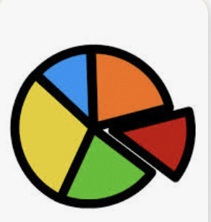

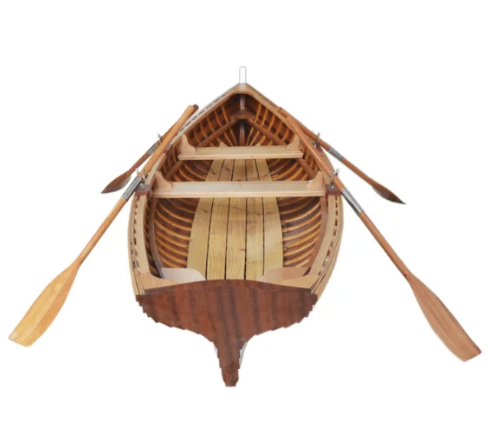
Old Admin Metaphors

Slide 10
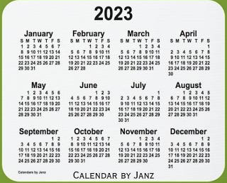
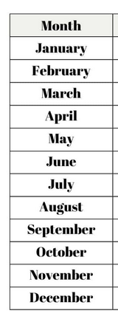
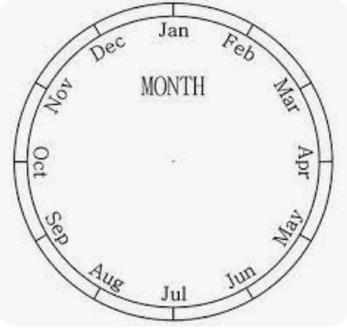
Calendar Conceptualizing

Slide 11
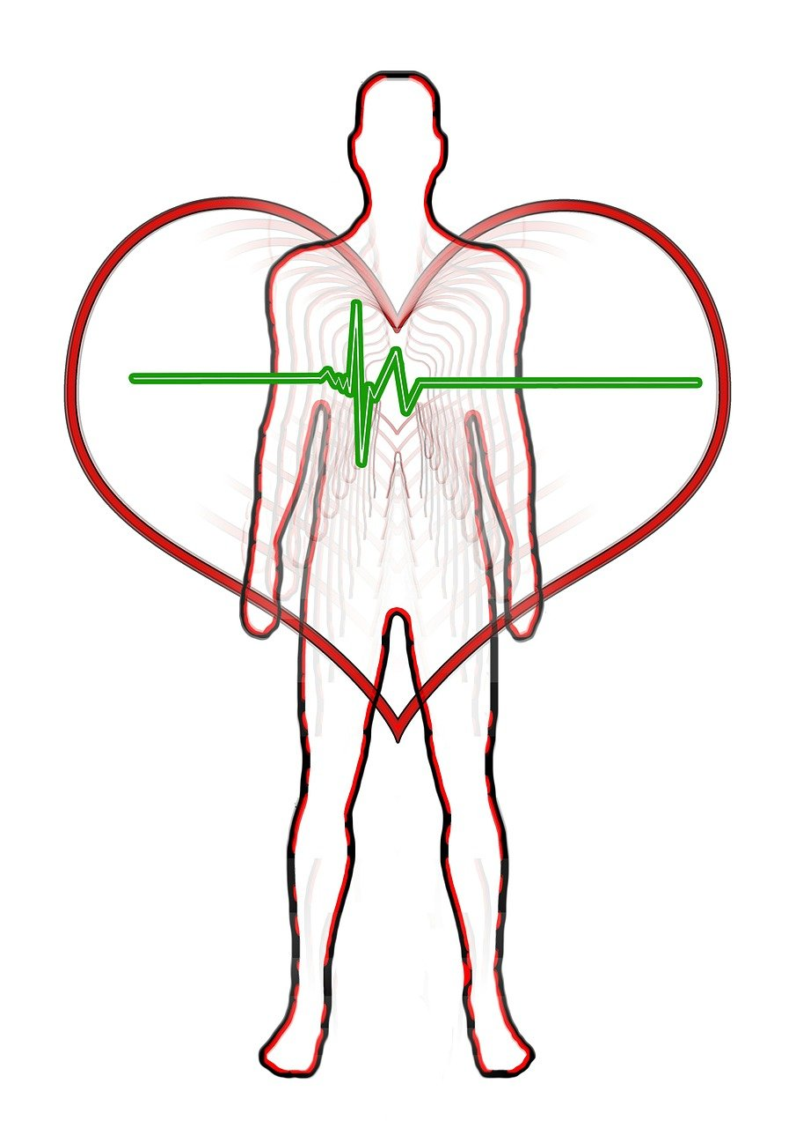
Administration as Circulation of Mission

Slide 12
"Definitions anchor us to principles. This is not a light point: If we don't do the basic work of defining the kind of people we want to be in language that is stable and consistent, we can't work toward stable, consistent goals."
-Ibram X. Kendi notes in How To Be An Antiracist

Slide 13
Breakout Group 1 Prompt
Share some of your personal professional mission statement (your pre-work for session 1). While sharing start to think about the parts that are really resonating and possibly where you might like to explore more to revise.
15 minutes

Slide 14
“The main premise of Appreciative Inquiry is that positive questions, focusing on strengths and assets, tend to yield more effective results.”

Slide 15
Break Out Group 2 Prompt
Share a story, poem or drawing of success and the strengths you uncovered in identifying your story. 3 minutes each
Once everyone has shared their story, poem or drawing, discuss how this exercise helped you think about your strengths differently or identify strengths that you hadn’t noticed or valued before.
15 minutes

Slide 16
Closing Words
Let there be a quiet time among us.
Spirit of life, in us and around us, here is our chance—once again—to live like we wish the world would live. May we find within ourselves the courage to be who we are. May we know when it is time to listen and when it is time to speak. May we trust ourselves to be the ones to find the words that need to be said or to do what needs to be done. May we trust one another and know there are many ways to go through life. May we know that though we cannot change some of what life gives to us, we can choose how we deal with what we are given.
We are coming into our power, and together we can make possible justice and love. We are all connected; we depend upon one another more than we know. We are one body.
So be it. Blessed be. Amen.
–Barbara Hamilton-Holway Worship Web

