Slide 1
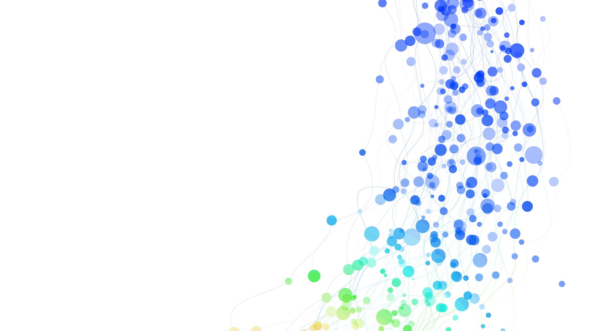
Leading UU Culture Change

Slide 2
Session one

Slide 3
Session one – COVENANT AND CULTURE
Welcome
Opening Words
Chalice Lighting
Naming the Unnamed
Discussion About UU Theology, Culture, Community, and Covenant
Congregations are Communities and Unitarian Universalism as a Community of Communities
Transitional Time (break)
Covenanting as Curriculum for Culture Change
Building the Covenant
Closing

Slide 4
Session one – chalice lighting
We Covenant:
Covenants are intentional.
Covenants are audacious.
Covenants are a promise
that can change our lives
together in this faith.
Together, we will be stronger.
Together, we will be wiser.
Together, we will be gentler.
We promise
to recognize our uniqueness
to treasure our faith
to honor our neighbors with
holiness.
We covenant to be committed to each other
to consider each as significant
to consider each as valuable.
We covenant
to be invitational
to be accepting
to speak grace-filled truth
to forgive each other
over and over again.
And yes,
to love.
Our Covenant stands firm.
It is our embodiment of faith in each other.
It is our blessing of each other.
It is our commitment to each other.
May we hold this community as a precious gift.
May we hold our relationships as gifts that transcend borders.
May we carry forth
the intention of our Covenant
the audacity of our Covenant
the promise of our Covenant
now and in years to come.
May it be so.

Slide 5
Session one – naming the unnamed
We take this time, each session, to name what is often left unspoken. We acknowledge that in our faith there is additional labor on our members, colleagues, and friends who hold marginalized identities as they are often placed in situations where the expectation is on them to teach when they are seeking spiritual renewal and community. We acknowledge that this expectation causes harm. We affirm to root out the systems that allow this behavior to continue in our community so that we can fully live our Unitarian Universalist values in Beloved Community. We acknowledge that this is not easy work and by showing up in this space together, we are affirming our commitment to ourselves, each other, and this faith to continue working and building for our Beloved Community.

Slide 6
Explicit, Implicit, & Null Curricula
Explicit - Who we say we are and what we say we do
Implicit - What we do, but don’t deliberately speak about
Null - What we don’t say or do

Slide 7
Phrases to Renew Relationship
“Here is what I observed, [share what you observed]”
“I felt something in my [insert the part of your body where you physically felt discomfort]”
“I noticed a power imbalance/microaggression/or behavior that occurred. Our covenant calls on us to name, discuss, and learn from what has happened.”

Slide 8
Session one – closing
Our Work Has Just Begun
Our work here tonight* is at an end
And our work has just begun:
The work of holding one another and this community in love.
The work of trusting that we are on the right path.
The work of believing that what connects us is stronger than what separates us
The work of engaging in that which makes us whole.
The work of deeper understanding and commitment.
The work of letting go of that which does not serve us.

Slide 9
Session one - closing continued
The work of radical inclusion.
The work of collective liberation.
The work of this beloved community.
A beloved community of which we are all part.
A place where we are welcomed, respected, valued, cherished.
A place where we belong.
Go in peace. Amen. And blessed be.
*This can be adjusted to whatever time best suits your needs.

Slide 10
Session two

Slide 11
Session two – comfort with the discomfort
Welcome
Sharing the Covenant
Opening Words
Chalice Lighting
Naming the Unnamed
Prior Lesson Discussion
Transitional Time (break)
Naming Our Emotions
Acknowledgement and Forgiveness: An Antidote to Fear
Forging a Path Forward in Faith – Action Board Activity
Closing

Slide 12
Session two – chalice lighting
“For Our Collective Liberation” by Deanna Vandiver:
We light this chalice—symbol of our faith alive in this world—naming our vision of collective liberation and daring to re-member each other into beloved community.

Slide 13
Session two – naming the unnamed
We take this time, each session, to name what is often left unspoken. We acknowledge that in our faith there is additional labor on our members, colleagues, and friends who hold marginalized identities as they are often placed in situations where the expectation is on them to teach when they are seeking spiritual renewal and community. We acknowledge that this expectation causes harm. We affirm to root out the systems that allow this behavior to continue in our community so that we can fully live our Unitarian Universalist values in Beloved Community. We acknowledge that this is not easy work and by showing up in this space together we are affirming our commitment to ourselves, each other, and this faith to continue working and building for our Beloved Community.

Slide 14
Session two – closing
Our Work Has Just Begun
Our work here tonight* is at an end
And our work has just begun:
The work of holding one another and this community in love.
The work of trusting that we are on the right path.
The work of believing that what connects us is stronger than what separates us
The work of engaging in that which makes us whole.
The work of deeper understanding and commitment.
The work of letting go of that which does not serve us.

Slide 15
Session two - closing continued
The work of radical inclusion.
The work of collective liberation.
The work of this beloved community.
A beloved community of which we are all part.
A place where we are welcomed, respected, valued, cherished.
A place where we belong.
Go in peace. Amen. And blessed be.
*This can be adjusted to whatever time best suits your needs.

Slide 16
Session three

Slide 17
Session three – power in congregations
Welcome
Sharing the Covenant
Opening Words
Chalice Lighting
Naming the Unnamed
Prior Lesson Discussion
Transitional Time
Naming Our Identities and Privileges
Exploring Language
Analyzing Privilege and The Role of Polity in Our Congregations
Forging a Path Forward in Faith – Action Board Activity
Closing

Slide 18
Session three – chalice lighting
Bold and Courageous Together -
Reader 1:
The word courage comes from the Latin cor, which means heart. According to poet Mark Nepo, the original use of the word courage meant to stand by one’s core: a “striking concept that reinforces the belief found in almost all traditions that living from the Center is what enables us to face whatever life has to offer.”
Reader 2:
To “encourage” means to hearten; to impart strength and confidence. This is our work, as a religious community: to encourage one another; to be bold in engaging the world around us, as well as what scares us internally; to give one another the confidence and heart to live as fully as possible.
Congregation:
With full hearts,
we affirm our relationships with one another;
we recognize our agency and our connective power;
and we accept our responsibility to be bold and courageous.
We light this chalice,
symbol of all that we are, all that we have done together,
and all that we will be as our shared ministry encourages those within, and beyond, our walls.

Slide 19
Session three – naming the unnamed
We take this time, each session, to name what is often left unspoken. We acknowledge that in our faith there is additional labor on our members, colleagues, and friends who hold marginalized identities as they are often placed in situations where the expectation is on them to teach when they are seeking spiritual renewal and community. We acknowledge that this expectation causes harm. We affirm to root out the systems that allow this behavior to continue in our community so that we can fully live our Unitarian Universalist values in Beloved Community. We acknowledge that this is not easy work and by showing up in this space together we are affirming our commitment to ourselves, each other, and this faith to continue working and building for our Beloved Community.

Slide 20
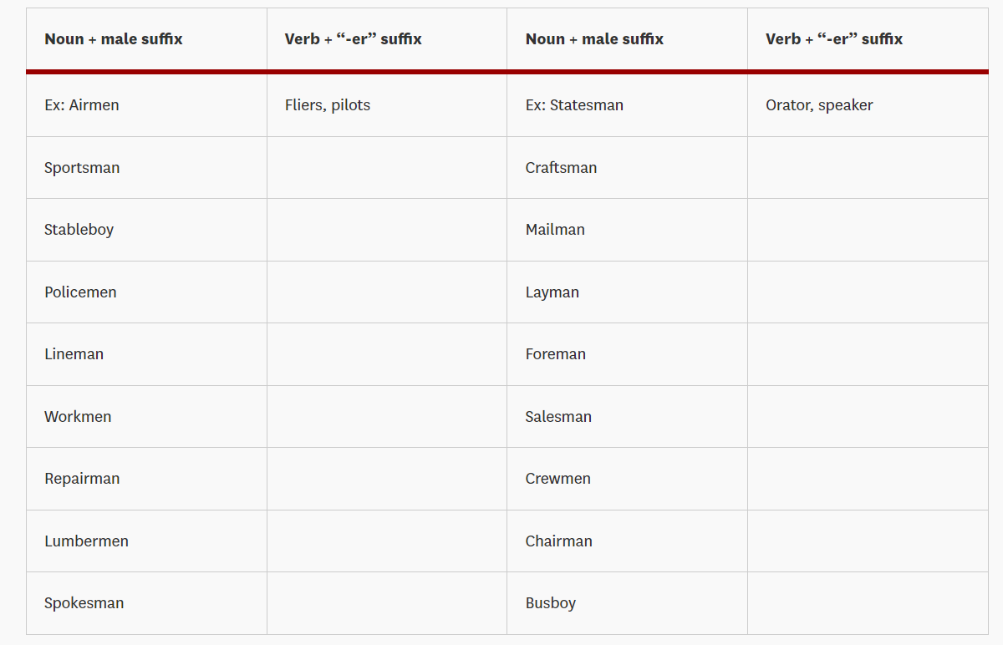
Session three – writing for change
Graph from the University of Southern California’s
Diversity Toolkit: A Guide to Discussing Identity, Power and Privilege

Slide 21
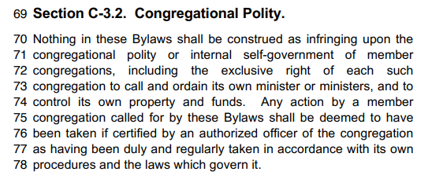
Session 3 - UUA Bylaws Article iii section c-3.2 Congregational polity

Slide 22
Session 3 - Privilege in Congregations Questions
You can answer aloud or place your answers in the chat for us to read.
What are some observations you made about the dominant identities present in your congregation?
Do these identities carry privilege?
Do these dominant identities impact the culture change work in your congregation positively, negatively, or not at all?
Do you have areas of overlapping identities with the dominant identities in your congregation?
If you do, what are some ways you can build a bridge between your shared identities to gain partners in the work you’re doing?

Slide 23
Session three – closing
Our Work Has Just Begun
Our work here tonight* is at an end
And our work has just begun:
The work of holding one another and this community in love.
The work of trusting that we are on the right path.
The work of believing that what connects us is stronger than what separates us
The work of engaging in that which makes us whole.
The work of deeper understanding and commitment.
The work of letting go of that which does not serve us.

Slide 24
Session three - closing continued
The work of radical inclusion.
The work of collective liberation.
The work of this beloved community.
A beloved community of which we are all part.
A place where we are welcomed, respected, valued, cherished.
A place where we belong.
Go in peace. Amen. And blessed be.
*This can be adjusted to whatever time best suits your needs.

Slide 25
Session four

Slide 26
Session four – patterns and phases of equity work
Welcome
Sharing the Covenant
Opening Words
Chalice Lighting
Naming the Unnamed
Prior Lesson Discussion
Transitional Time
Exploring Phases and Naming Roadblocks
Forging a Path Forward in Faith – Action Board Activity

Slide 27
Session four – chalice lighting
Afraid of the Dark by Andrew Pakula
In sightless night, terrors draw near
Nameless fears of talon and tooth
Hopelessness yawns before us—an abyss
Alone and unknown in the gloom, longing for the dawn
O sacred flame blaze forth—wisdom brought to life
Guide us—
With the light of hope
The warmth of love
The beacon of purpose and meaning
Because we are all afraid of the dark
Let there be light

Slide 28
Session four – naming the unnamed
We take this time, each session, to name what is often left unspoken. We acknowledge that in our faith there is additional labor on our members, colleagues, and friends who hold marginalized identities as they are often placed in situations where the expectation is on them to teach when they are seeking spiritual renewal and community. We acknowledge that this expectation causes harm. We affirm to root out the systems that allow this behavior to continue in our community so that we can fully live our Unitarian Universalist values in Beloved Community. We acknowledge that this is not easy work and by showing up in this space together we are affirming our commitment to ourselves, each other, and this faith to continue working and building for our Beloved Community.

Slide 29
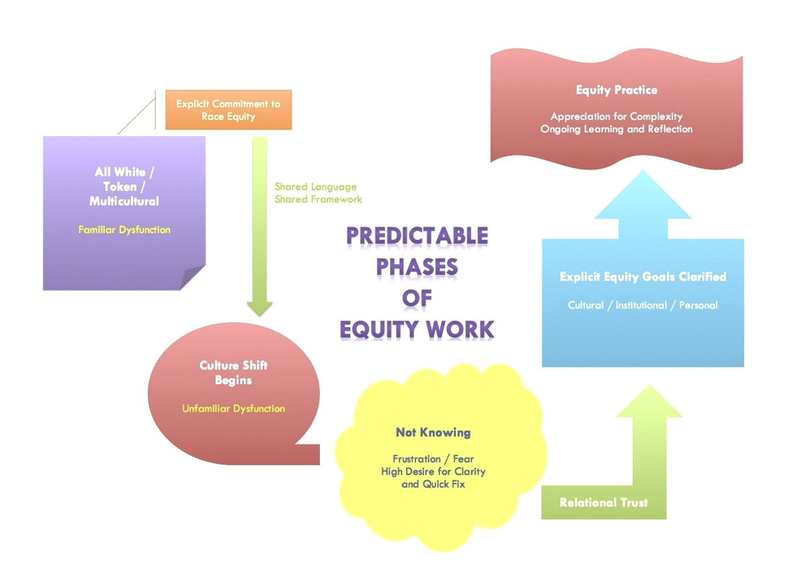
Session four – predictable phases of equity work
Graph from www.dismantlingracism.org

Slide 30
Session four – closing
Our Work Has Just Begun
Our work here tonight* is at an end
And our work has just begun:
The work of holding one another and this community in love.
The work of trusting that we are on the right path.
The work of believing that what connects us is stronger than what separates us
The work of engaging in that which makes us whole.
The work of deeper understanding and commitment.
The work of letting go of that which does not serve us.

Slide 31
Session four - closing continued
The work of radical inclusion.
The work of collective liberation.
The work of this beloved community.
A beloved community of which we are all part.
A place where we are welcomed, respected, valued, cherished.
A place where we belong.
Go in peace. Amen. And blessed be.
*This can be adjusted to whatever time best suits your needs.

Slide 32
Session five

Slide 33
Session five – applying the antidotes
Welcome
Sharing the Covenant
Opening Words
Chalice Lighting
Naming the Unnamed
Prior Lesson Discussion
Transitional Time
Exploring White Supremacy-Based Values and Their Multicultural-Based Values Antidote
Small Group Conversation: Applying the Antidotes
Forging a Path Forward in Faith: Project Focus Time
Closing

Slide 34
Session five – chalice lighting
We Prepare for the Future
by Robin F. Gray
By the light of this chalice
we prepare for the future.
We prepare ourselves
for the times of triumph
and times of trial that might come.
We prepare ourselves to be present
to one another with loving hearts
even in the most difficult of times.
We prepare ourselves
to make the connections
that will lift us out of isolation
and prepare the path of justice and equality.

Slide 35
Session five – naming the unnamed
We take this time, each session, to name what is often left unspoken. We acknowledge that in our faith there is additional labor on our members, colleagues, and friends who hold marginalized identities as they are often placed in situations where the expectation is on them to teach when they are seeking spiritual renewal and community. We acknowledge that this expectation causes harm. We affirm to root out the systems that allow this behavior to continue in our community so that we can fully live our Unitarian Universalist values in Beloved Community. We acknowledge that this is not easy work and by showing up in this space together we are affirming our commitment to ourselves, each other, and this faith to continue working and building for our Beloved Community.

Slide 36
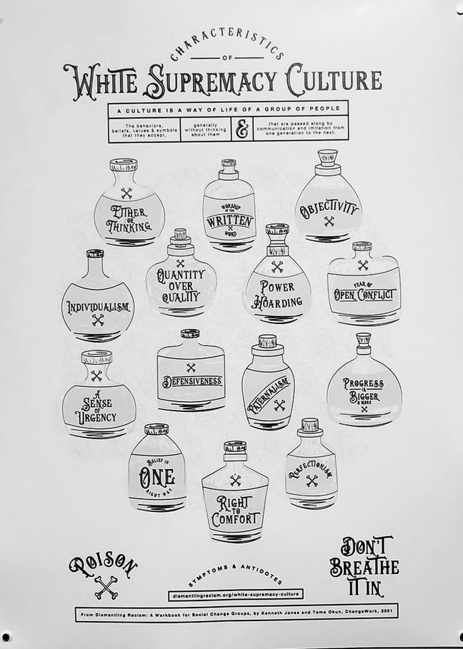
Session five – characteristics of white supremacy culture
Graphic from whitesupremacyculture.info

Slide 37
Session five – closing
Our Work Has Just Begun
Our work here tonight* is at an end
And our work has just begun:
The work of holding one another and this community in love.
The work of trusting that we are on the right path.
The work of believing that what connects us is stronger than what separates us
The work of engaging in that which makes us whole.
The work of deeper understanding and commitment.
The work of letting go of that which does not serve us.

Slide 38
Session five – closing continued
The work of radical inclusion.
The work of collective liberation.
The work of this beloved community.
A beloved community of which we are all part.
A place where we are welcomed, respected, valued, cherished.
A place where we belong.
Go in peace. Amen. And blessed be.
*This can be adjusted to whatever time best suits your needs.

Slide 39
Session six

Slide 40
Session six – the toolbox
Welcome
Sharing the Covenant
Opening Words
Chalice Lighting
Naming the Unnamed
Prior Lesson Discussion
Transitional Time
Presentations
Closing

Slide 41
Session six – chalice lighting
Toward a Place of Wholeness by Rev. Viola Abbitt
We are Unitarian Universalists.
When we lift up our Seven Principles, some of us think of them as a form of theology – but they are more important to our collective than that: they do not tell us what we should believe; they tell us how we should be.
They tell us how we should act in the larger world and with each other.
We are brought here today by the fact that Unitarian Universalism has fallen short of the image that was presented to the world and to many of those who embraced this religion.
But we are also brought here today by the truth that Unitarian Universalism has shifted course to move toward a place of wholeness: a place that has perhaps never existed for us as a denomination.
It has been a long and sometimes unforgiving road to today. But we are here today because we are mindful of that past and because we have hope for the future. We want the practice of this faith to be fulfilling manifestation of its promise.
Open your hearts. Seek new ways of understanding.
Come, let us worship together.

Slide 42
Session six – naming the unnamed
We take this time, each session, to name what is often left unspoken. We acknowledge that in our faith there is additional labor on our members, colleagues, and friends who hold marginalized identities as they are often placed in situations where the expectation is on them to teach when they are seeking spiritual renewal and community. We acknowledge that this expectation causes harm. We affirm to root out the systems that allow this behavior to continue in our community so that we can fully live our Unitarian Universalist values in Beloved Community. We acknowledge that this is not easy work and by showing up in this space together we are affirming our commitment to ourselves, each other, and this faith to continue working and building for our Beloved Community.

Slide 43
Session six – closing
Our Work Has Just Begun
Our work here tonight* is at an end
And our work has just begun:
The work of holding one another and this community in love.
The work of trusting that we are on the right path.
The work of believing that what connects us is stronger than what separates us
The work of engaging in that which makes us whole.
The work of deeper understanding and commitment.
The work of letting go of that which does not serve us.

Slide 44
Session six - closing continued
The work of radical inclusion.
The work of collective liberation.
The work of this beloved community.
A beloved community of which we are all part.
A place where we are welcomed, respected, valued, cherished.
A place where we belong.
Go in peace. Amen. And blessed be.
*This can be adjusted to whatever time best suits your needs.

