Slide 1
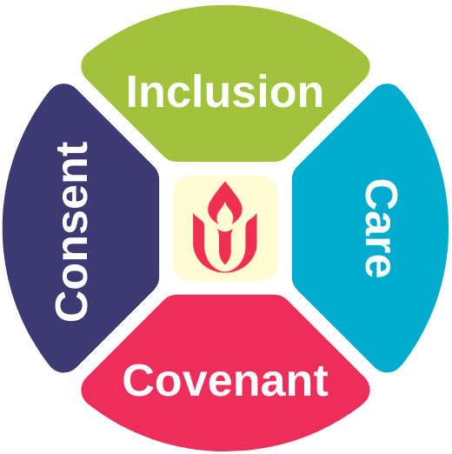
Guidance for Gathering in Covenantal Community
As part of our covenantal commitment to care for all, we encourage congregations to maintain a culture of masking while indoors regardless of vaccination status, and to take time to listen deeply to one another’s concerns and fears before making any decisions that might put members of the community at risk, either physically or mentally, with a continued practice of inclusion, covenant, consent, and care for each other.
Congregational Activity | Guidance
Small Groups Outside Religious education, childcare, youth group, OWL, Coming of Age, Committee/team meetings, bell choir, small group ministry, playground meetup, games, hiking, bonfire | OR
Large Groups Outside Worship, rites of passage, lawn concert, poetry/play readings, coffee hour, “bring your own food” picnic, camping trips, vigils, protests, community gardening | OR
Small Groups Inside Religious education, childcare, youth group, OWL, Coming of Age, committee/team meetings, bell choir, small group ministry | OR
Large Groups Inside Worship, rites of passage, poetry/play readings, concerts, art shows
Small Groups Inside (with food/ drink/ singing/ deep breathing) Retirees’ lunch, lunch bunch, choir, yoga, strenuous activity | OR
Large Groups Inside (with food/ drink/ singing/ deep breathing) Coffee hour, “bring your own food” meals, catered dinners/receptions, sing-a-longs, strenuous activity
Safest
Less Safe
Least Safe
=
Take prevention measures to protect self and others
=
Take time to listen deeply to one another’s concerns and fears before making any decisions, even if everyone is vaccinated

