Slide 2
Standing on the Side of Love began at General Assembly 2009 as an opportunity for Unitarian Universalists to conduct creative public witness and advocacy work while building relationships and collaborations with like-minded allies.
The campaign’s success is closely linked to our use of various forms of new media, including social media. Social media has created opportunities for information sharing, online advocacy and connecting to the work happening in congregations all over the country and world.

Slide 3
Standing on the Side of Love has primarily relied upon Facebook and Twitter as our social media platforms.
Facebook and Twitter have helped us successfully connect to many of our constituents. We have also explored other social media platforms (Flickr, YouTube, Pinterest & Instagram). Because social media requires ongoing monitoring, be sure to find out the best platforms for your constituents as you create accounts.
Notes:
-primarily use Facebook and Twitter; have also explored Flickr, YouTube, Pinterest and Instagram. We have chosen FB and twitter because they've successfully helped us reach so many do our constituents. This does not mean the others aren't important or couldn't be used; we haven't prioritized them but they, particularly Instagram, are attractive as we attempt to connect with younger people. (See flyer for more info)

Slide 4
What has worked for Standing on the Side of Love
Positive and Affirmative
Timely
Re-share content from collaborators and allies
Use images and video
There is room for everyone!
Notes:
Positive and Affirmative- people want to ‘like’ what they are sharing. Though in our times, many of the issues we work on make the world feel like a hard and dire place, we’ve seen posts that are positively framed (even a positive response to something negative) are more widely shared.
Timely- after five years of the campaign, we now know that many people ‘look’ to SSL, much like they did the UUA, when justice issues appear in national news. We’ve worked to be responsive to important issues and found that many people are seeking a UU voice in these times. We work closely with Rachel at the UUA as well as Skinner House and UU World for content around many of these big issues.
Re-share- people want to be affirmed and re-sharing/re-tweeting is an awesome opportunity to share information and some love.
Use images- images and video consistently get the most engagement. Though the FB algorithm is always changing, particularly as people compete with paid posts, photos still perform highest, followed by a generic link, followed by just text.
There is room for everyone- SSL has been so successful in part because it relies on the contributions of all people involved. The campaign is adaptable enough to be relevant to the interests of many people without being exclusive. As you consider your upcoming issue areas, how will people who are not ‘activists’ participate?

Slide 5
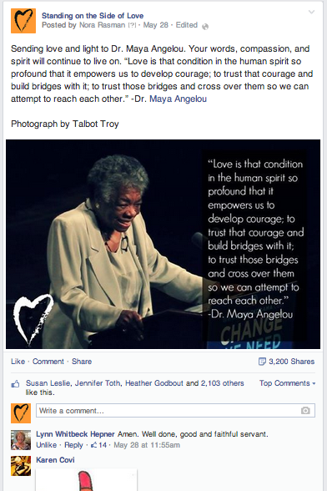
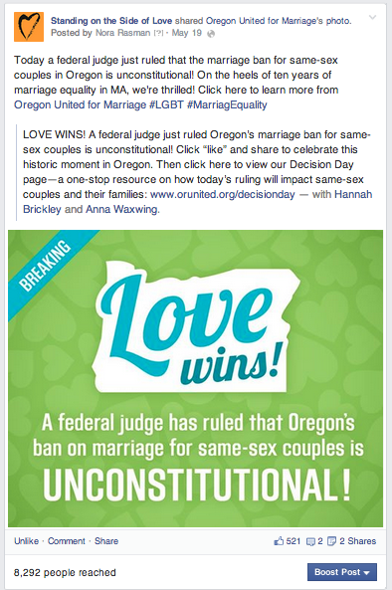

Slide 6
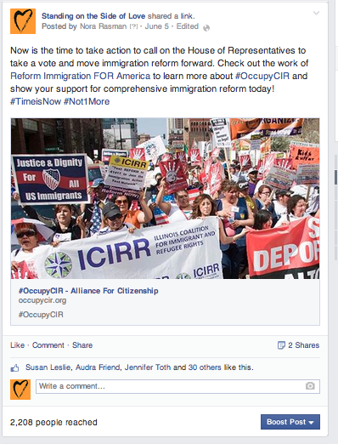
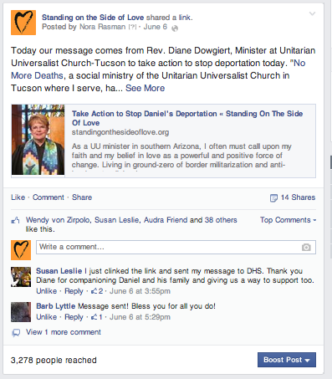

Slide 7
How Standing on the Side of Love Messages
Name anti-oppression as the lens informs and guides our work
Manage expectations of partner coalition groups
Mindful of identities of various messengers
Make messages actionable
Notes:
-clearly name our anti-oppression framework as guiding our work
-managing the expectations of partner coalition groups; from LGBTQ to immigration reform we have tried to maintain a both/and approach to many of the advocacy groups. Unlike monolithic advocacy campaigns, SSL has the privilege of holding space for many nuanced issues at the same time.
-monitoring who we give space to important: make sure we provide support to a balanced number of messengers
-messages should be actionable: we often are sharing information about pressing, exciting and important campaigns. We try to include something for people to do, even if it is just to get more informed about X issue

Slide 8
Our Standing on the Side of Love Strategy
Connect with UUs (Congregants, Nones, Seekers and more)
Support and celebrate work of UU Congregations
Call attention to related justice issues
Connect with folks engaged in social justice work across faith traditions
Notes:
-connecting with congregants
Celebrating the work within UU congregations
Calling attention to related justice issues that folks may find of interest
Connect with folks engaged in social justice work across faith traditions

Slide 9
Lessons Learned from Standing on the Side of Love
Reach out in love: building with people takes time, diligence and trust. Do research about who is already doing work, if anyone, that you find of interest.
Share the love: to gain followers, build relationships and reach some policy goals, we need to share the content of our partners and allies. They’ll likely do the same!
Find your voice: social media can be vast and time consuming. Get clear about your purpose before taking on a new social media campaign and you’ll have more success
Notes:
Take time as you get to know an issue area or campaign. Spend time getting to know folks who may already be working on this, or similar issues
Share some love to folks as an opportunity to build relationships.
Have clarity about your intented purpose and outcomes before you begin: Who do you want to engage? What are your end goals? Who do you need to be in partnership with to be successful? How can p

Slide 10
STAY CONNECTED!
For more information or with questions, feel free to reach out!
Nora Rasman Campaign Coordinator Standing on the Side of Love
nrasman@uua.org
202-393-2255 ext. 17

