Slide 1
#UUsGetSocial
How Congregations Can Deepen Engagement Online
Notes:
Hello everyone and welcome to #UUsGetSocial: How Congregations Can Deepen Engagement Online

Slide 2
#UUsGetSocial Workshop Series
#UUsGetSocial: How Congregations Can Deepen Engagement Online
You are here. ☺
#UUsGetSocial: Updating Your Web Presence: Tools & Tips
Thursday 4:00pm–5:15pm RICC Ballroom BC
#UUsGetSocial: Reaching “Nones,” Activists, and Spiritual Seekers
Friday 10:15am—11:30am RICC Ballroom BC
#UUsGetSocial: Digging into Facebook, Twitter, Video-Making/Sharing
Saturday 10:15am—11:30am
RICC Ballroom BC
This info is also at www.uua.org/communications/ga/social
Notes:
This workshop is the first in a series focusing on reaching out online. Each workshop has been organized by UUA staff doing work directly in these areas. They include wonderful guest presenters from across our UU universe who are also doing great work in these areas.
We hope you can attend them all. If you do, be sure to check in with each through the GA app and you can get a #Hashtag badge.
If you can’t, you’ll be able to access their content through UUA.org after GA. We’ll post our presentations online for your use and sharing.

Slide 3
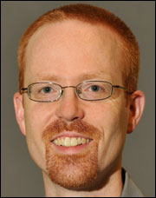
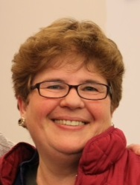
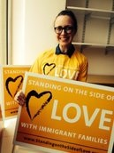
Guest Presenters for this Workshop
Chris Walton Executive Editor UU World cwalton@uua.org
Nora Rasman Campaign Coordinator Standing on the Side of Love nrasman@uua.org
Meg Riley
Senior Minister
Church of the Larger Fellowship
megriley@clfuu.org
Notes:
We have three wonderful guest presenters today. After I go through some introductory material, Meg, Chris, and Nora will each talk with you about the social media work that they do. More on these presenters later.

Slide 4
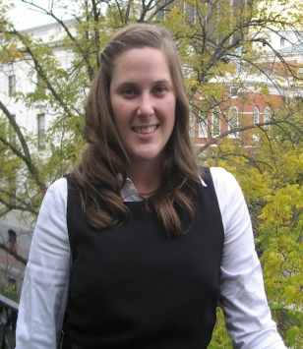
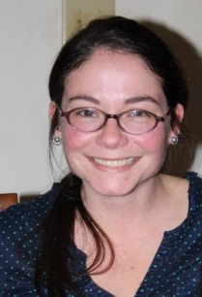
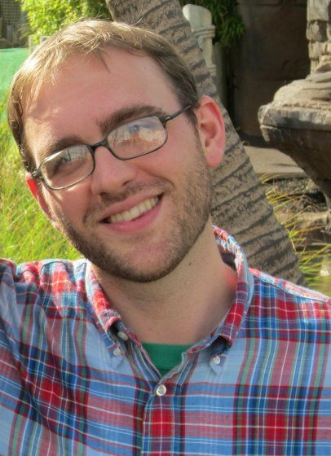
UUA Office of Information & Public Witness - Get in touch with us!
Jill Goddard Public Relations Director (617) 948-4386 jgoddard@uua.org
Mike McGlone Public Information Assistant (617) 948-6103 mmcglone@uua.org
Rachel Walden Communications Specialist (617) 948-4652 rwalden@uua.org
Notes:
A little bit about me:
I work for the UUA’s Office of Information and Public Witness. We do a variety of things in this office, from helping newcomers find congregations, to answering questions about the faith, to sharing news and resources across the movement, handling media inquiries, advising congregations on media and outreach… A lot of different things.
A big focus of our office’s work is social media. It is worth nothing that no one at the UUA, nor any of our presenters, focus solely on social media in their work.

Slide 5
Notes:
We manage the UUA’s presence on various social media platforms. These are the primary ones we’re involved with. Because it takes so much time to provide high quality content on a regular basis, we mainly focus on Facebook and Twitter.
Most of my comments and advice are related to using Facebook and Twitter, but they can also apply to other platforms.

Slide 6
What Are We Doing Here?
Taking engagement to the next level
Making it sustainable for the long-term
Lateral learning
Being strategic
Notes:
So, what’s the goal of this workshop?
To help you do social media better—grow your audience and become a sought-after online space for Unitarian Universalism—all without having to hire a full-time social media staff person.
You’ll note that no one in our workshop today has such a title. We all do this work while completing other duties.
One important part is something I call lateral learning. Learning from your friends, colleagues, children, etc.
If you see a great piece of social media content and you want to try to do something similar, ask the creator about it. Join online labs and forums and share knowledge (more on this at the end).
We all stay up-to-date on this work by staying in touch with each other.
Being strategic: Having goals and a plan to meet those goals is the only way to identify success and make it possible. We’ll talk about specific steps for this after we hear from our presenters.

Slide 7
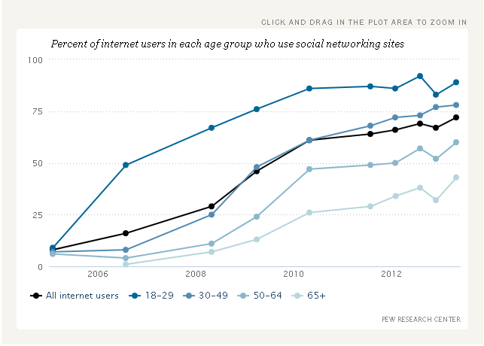
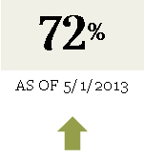
Who Uses Social Media?
As of May 2013, 72% of online adults use social networking sites.
www.pewresearch.org/data-trend/media-and-technology/social-networking-use
Notes:
So…who uses social media anyway?
This is from the Pew Research Center—the most up-to-date high quality information we have right now. The graph indicates that 18-29 year olds use social media at a higher rate than people over 30. Also, as of last year, nearly 3/4s of the American online population were using social media.
So if we’re online, we’re likely already using social media. That’s us UUs and everybody else.

Slide 8
Who Uses UUA Social Media?
Notes:
We don’t have any systematic data for how UUs use social media, so I pulled some easy data from the UUA’s Facebook page, which I manage with my IPW colleagues.
The UUA’s Facebook page has the largest following of any UU presence on Facebook, with over 41,000 page likes. We have never paid for advertising or to otherwise promote our content. We strive to be relevant and work hard to provide high quality, timely content on a consistent basis. We believe that this is the basis of our success.
Facebook is the most popular social media platform for online adults and this is true of UUs as well. Given that, data about our audience offers some insight into who uses UUA social media (though not complete by any means).
As the graph shows, we are overrepresented for female users aged 35 and up and among male users aged 45 and up. We are underrepresented in FB’s biggest user category, those aged 18-24. This somewhat reflects the age and gender make-up of our membership more broadly.

Slide 9
How Unitarian Universalists Currently Use Social Media
A wide range of social media platforms
Some teaching or explaining Unitarian Universalism
Some connecting with fellow UUs
Notes:
So here are some basic generalizations we can make about UUs on social media:
We use a wide range of platforms, but Facebook and Twitter are probably the most popular.
Teaching or explanatory: less true with certain platforms, where we are primarily connecting with our fellow UUs. Facebook is a good example of this.
We seem to mostly talk to each other on Facebook. Given that this is the popular platform used by any online adult, we’re missing an opportunity to reach out to new audiences there.

Slide 10
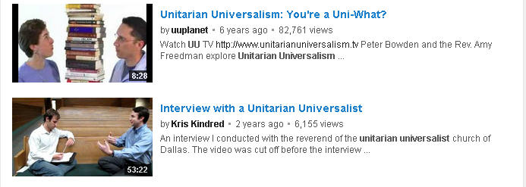
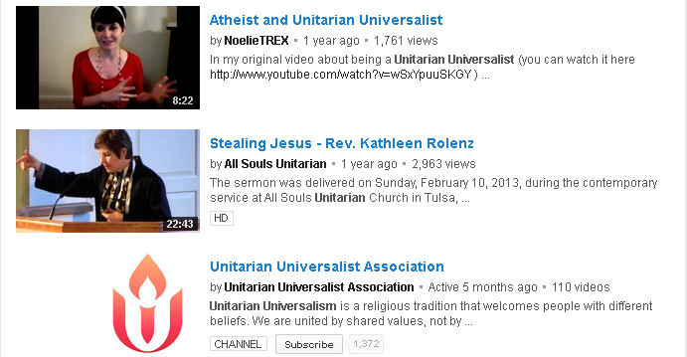
UUism on YouTube
Notes:
I’ll go very quickly through several different social media platforms and share some thoughts about the use I’ve seen.
Just to give you some broad context for the rest of our workshop.
If you’d like to explore details, check out these slides once they are posted online.
YouTube videos oriented towards explaining to faith to those unfamiliar. Explanatory videos may be one of the most popular kind people make aside from recording congregational life and sermons.

Slide 11
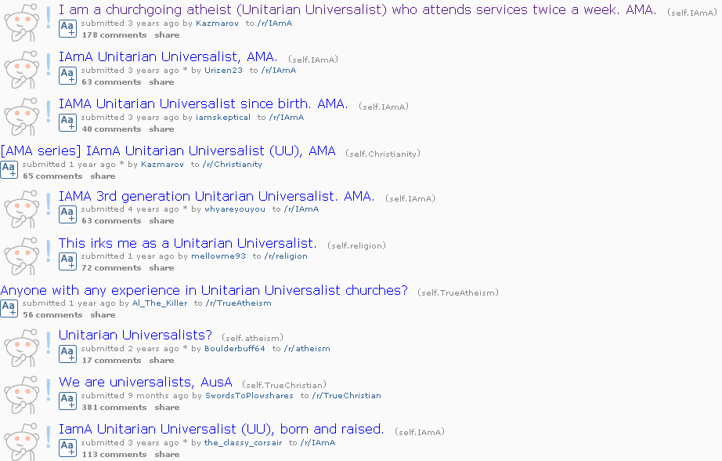
UUism on Reddit
Notes:
Again, the content is oriented toward explaining the faith to those unfamiliar. The question/answer style is very common on this platform.

Slide 12
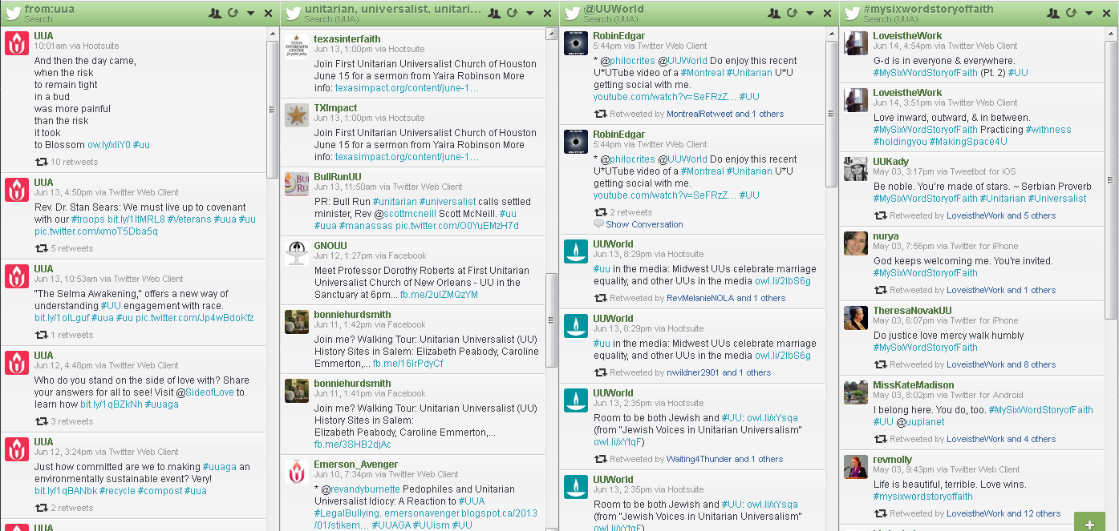
UUism on Twitter
Notes:
Twitter is used in a variety of ways in connection with UUism. Sharing news and resources is the most popular. Sharing pictures and videos is also popular.
Some theological conversations happen on Twitter, where people ask opening questions seeking a variety of responses, or share different theological perspectives. Twitter memes work nicely for this, such as #MySixWordStoryofFaith…

Slide 13
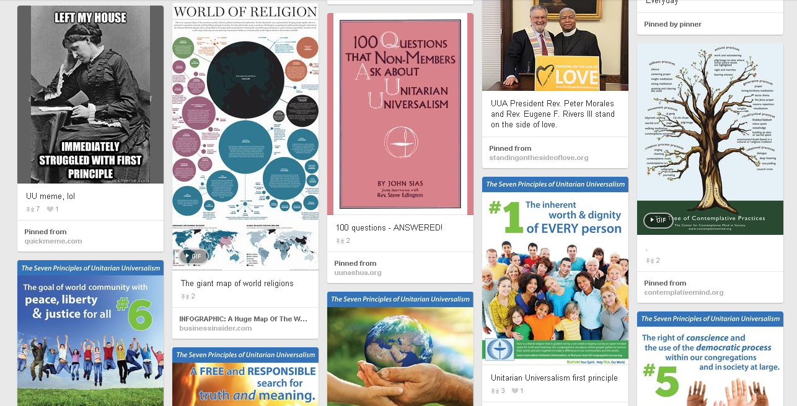
UUism on Pinterest
Notes:
More content that explains the faith, but through a visual medium. Some humor, some documenting of events, etc.

Slide 14
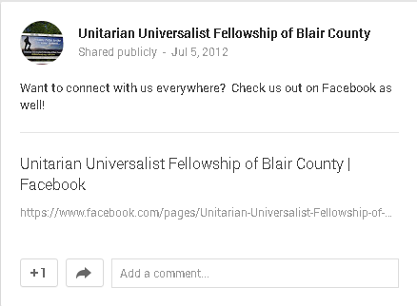
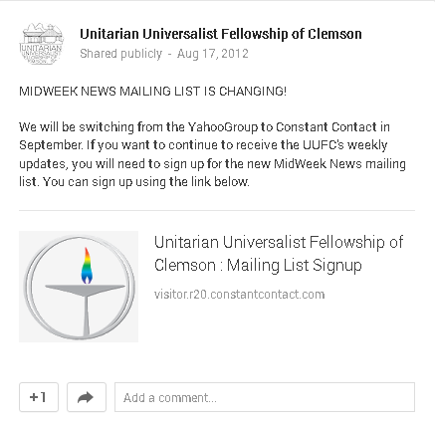
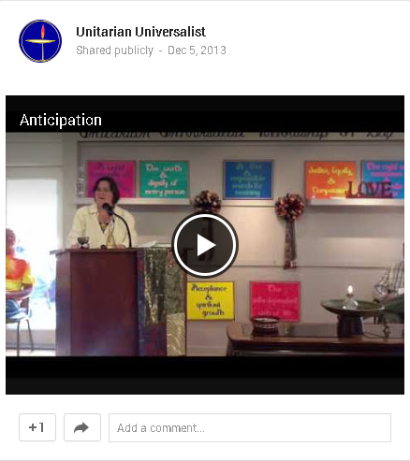
UUism on Google+
Notes:
I find Google+ usage to be a less popular version of Facebook. The kind of content shared here is similar to, if not the same, as with Facebook.
Text-heavy posts; little description—missed opportunities for newcomers.

Slide 15
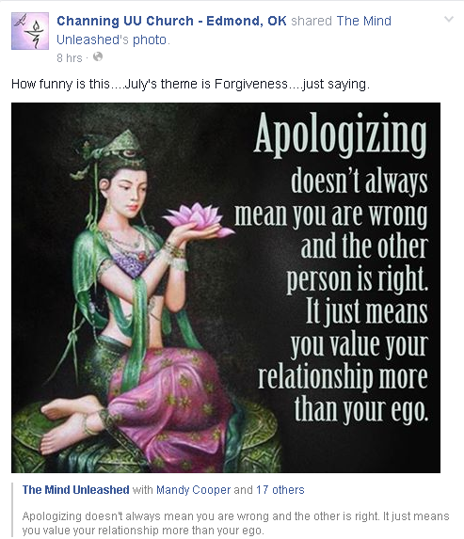
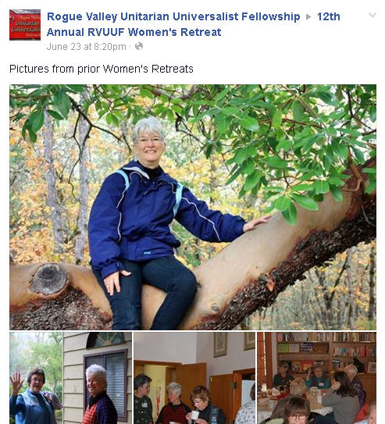
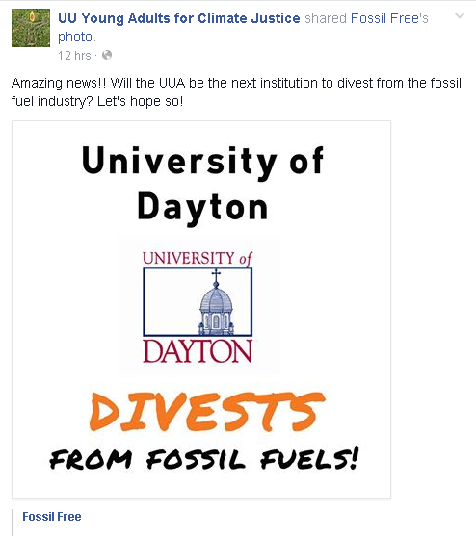
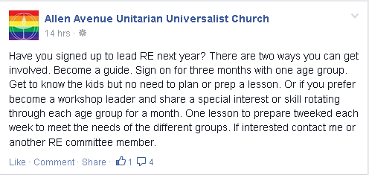
UUism on Facebook
Notes:
The most popular platform for UUs. We are very informal and familiar with each other on Facebook. I’ve described it before as the new way to do congregational newsletters—with the closed audience that this suggests.
But FB audiences are not closed, so we’re often missing opportunities to reach new people.
UU Young Adults post is a great example of value added content. Other posts, not so great.

Slide 16
Guest Presenters for this Workshop
Chris Walton Executive Editor UU World cwalton@uua.org
Nora Rasman Campaign Coordinator Standing on the Side of Love nrasman@uua.org
Meg Riley
Senior Minister
Church of the Larger Fellowship
megriley@clfuu.org
Notes:
Meg Riley is Senior Minister of the Church of the Larger Fellowship. She’s had that position for four years now. For Meg, social media offers her a chance to extend her ministry worldwide and connect with people in new and surprising ways.
Chris Walton is the editor of UU World, the UUA's quarterly magazine. He led the staff in launching uuworld.org, its weekly web magazine, in 2005, which extended the reach of the magazine far beyond members of congregations who receive a print subscription as a benefit of membership. He manages the magazine's Facebook Page, which reached 22,222 likes last week. And, from 2003 to 2008, he was the author of one of the first widely read UU blogs, "Philocrites" [fill-AH-kruh-teez], which Beliefnet featured on its "Blog Heaven" page and which "The Daily Show with Jon Stewart" featured as an example of how liberal blogs have names that are "obscure and literary" to show how smart they are.
Nora Rasman is the Campaign Coordinator with Standing on the Side of Love, a campaign housed within the UUA’s Multucultural Growth & Witness Staff Group. She joined the campaign this February. For Nora, social media provides an opportunity to highlight the innovative and exciting work being led by UU congregations and individuals involved with the campaign throughout the country.

Slide 17
How do we deepen our engagement online?
Content, content, content
Curation, not creation
Notes:
What are the three most important points to remember to be successful on social media? Content, content, content.
Tricks, gimmicks, automation across platforms, and even paid advertising cannot do more for you than providing consistently high-quality content THAT PEOPLE WANT.
The good news is that you need not create all of this content yourself. All social media users (content providers) should be expert content curators—finding great content that already exists online and sharing it with your audience in a way that adds value. Adding value is vital to why people want to get this content from you and not find it themselves elsewhere.

Slide 18
Getting Strategic to Deepen Engagement
Organizational use is not the same as personal use of social media.
Planning
Patience
Transparency

Slide 19
Planning
Set goals and say them out loud.
Better yet, write them down.
Designate multiple administrators for each platform.
Notes:
Set goals and say them out loud. Do you know why your congregation is on Facebook and not Google+?
Multiple administrators—I suggest 3 for any given platform
Create a schedule for posting content regularly.

Slide 20
Planning
What makes good content?
Hearts, not heads
Anger, anxiety, and awe
Spiritual content
Meditations, poetry, personal stories, theological guidance, pastoral messages, tough questions, miracles great and small
Notes:
What makes good content?
Hearts, not heads. Good content elicits an emotional response.
At a social media conference a while back, they said most people who shared a post on Facebook did so out of three emotions: anger, anxiety, or awe. (In my work at the UUA, I try mostly to tap into the awe factor. ☺)
Show people what Unitarian Universalism looks like, don’t tell them. Use some text, but use lots of images.
Share spiritual content!

Slide 21
Planning
Did I mention images?
UU Stock Photo www.flickr.com/groups/uustockphoto
UU World’s Flickr account www.flickr.com/photos/uuworld
SSL’s Flickr account www.flickr.com/photos/standonthesideoflove
Permissions!
www.uua.org/communications/video/192275.shtml
Notes:
Did I mention images? Pair your text content with evocative images.
UU Stock Photo, UU World’s Flickr account, SSL’s Flickr account offer a wealth of images of actual UUs and others that you can use, depending on the permissions information included with the images.
It is essential that you have permission to use any image you share. For images with people in them, you must have permission from each individual in the image.

Slide 22
Patience
Get to know your audience
Well-timed and timely content
Grow your audience by reaching out to newcomers
All social media platforms are public
We are all ambassadors for our faith
Notes:
Get to know your audience. Then you can share content that is:
Well-timed (know when your audience is using your platform)
Timely (know what matters to your audience and connect with the larger world)
All online audiences are to some degree public:
All content should work for BOTH newcomers and insiders.
Avoid jargon, acronyms, and insider language. Explain it when you can’t avoid it.
We are always ambassadors for our faith. How you behave online—not just sharing content but engaging with others online—can be seen by nearly anyone. How do you want our faith represented to those who may be considering joining?

Slide 23
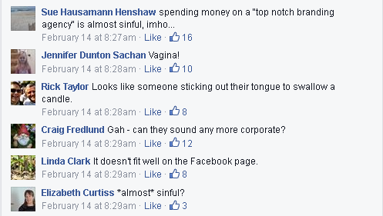
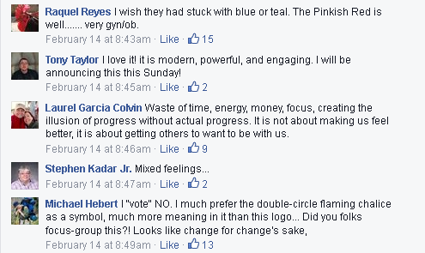
Notes:
(Explore the ambassadors issue more if you have time)
Close your eyes for a moment and conjure in your imagination your version of a “potential UU.” Not just someone unfamiliar with UUism, but someone who might be shopping around for a faith and interested in ours.
This person could be wary of replicating previous experiences with church, either the dogma or the people, they might live in a different country without established UU churches and no American cultural context, they might lurk a long time on social media, trying to get to know us through our interaction on a particular platform.
Do you think we UUs are well-represented by the comments on this post on the UUA’s Facebook page?

Slide 24
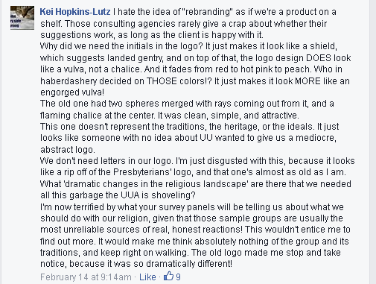
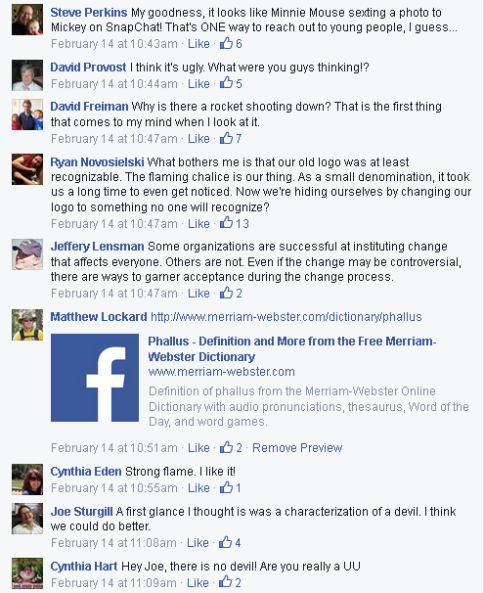

Slide 25
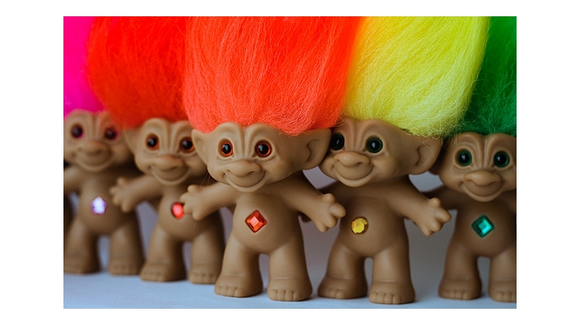
Transparency
The whole organization should know when you adopt a new tool.
Have a content management policy that is public
Feel empowered to delete!
Feel empowered to ban people!
Trolls are real!
Notes:
The whole organization should know when you adopt a new tool.
If you can’t get your congregation/team/group on board with your social media presence, how can you expect others to get involved?
These will be your early adopters.
Have a content management policy that is public
Feel empowered to delete! Some topics that make deleting a good choice:
Non-profit status
Civil language
Privacy and safety concerns
Feel empowered to ban people! Why? Because trolls are real! Does everyone know what I mean by “troll”?
One of the most common things I hear from UUs using social media is that they don’t want to infringe upon people’s right to free speech. There are myriad places for people to express their opinions. It need not occur on your FB page, Twitter feed, etc.

Slide 26
Transparency
The UUA’s content moderation policy is included in the About section of our Facebook page. You may adapt our policy for your own use, or see other examples:
www.uua.org/communications/facebook/192278.shtml
Our blog commenting policy: www.uua.org/communications/blogs/189409.shtml
Tips for engaging in civil discourse online, based on our 7 Principles: www.uua.org/communications/199425.shtml

Slide 27
Lateral Learning/Continuing Education
UU Facebook Labs & Groups
UU Media Collaborative
UU Blogger’s Workshop
UU Social Media Lab
UU Growth Lab
UU Stewardship Lab
UU Website Lab
UU Evangelists Lab
UU Communications Lab
Resources from uuplanet.org:
UU Gotta Tweet at #UUAGA Video Crash Course
Directory of UU Labs on Facebook
UU Twitter Hashtag Directory

Slide 28
QUESTIONS? COMMENTS?

