Slide 1
Committing Time and Treasure in the “Beyond” Community
General Assembly
The Unitarian Universalist Association
Providence, Rhode Island
June 26, 2014
Bill Clontz, UUA Stewardship Network Consultant
Mark Bernstein, Central East Regional Group Growth Consultant

Slide 2
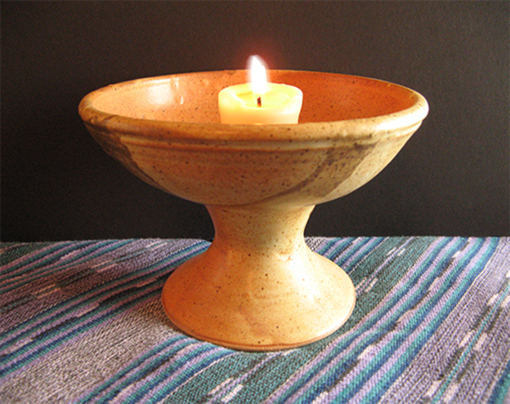
Because our faith cannot be found in any book, or any temple, held deep, it is most visible in the spaces between us, when our hands touch in greeting, when our voices interweave.
So much a part of daily living, we forget there are people who had never imagined this is possible; who sit in the corner of a service with eyes filled with tears and dream of belonging here. What a tragedy if even one melts away unwelcomed, only because we could not hear their dreams.
Liz James Handwoven (The Newcomer Poem)

Slide 3
What does membership mean in our Unitarian Universalist Congregations?
Notes:
In our Unitarian Universalist congregations, the definition and requirements of membership have become as much of a debate as what to do with joys and concerns or where to put the announcements in the order of service.
Unitarian Universalism is organized on the congregational polity model, which gives greatest authority to individual congregations to determine their own affairs. This includes setting their own membership requirements. There is no single or “official” definition of membership.
Most congregations require that a signing of the membership book and making a contribution of record.
Attend church regularly, give of your time and resources, and share in community

Slide 4
Many visitors resist membership…
Religious guilt
Fear of being overrun with tasks and responsibilities
Resistance to authority
Lack of investment in institutions
Uncertainty about the future
Lack of a rationale for joining
Notes:
People who are not interested in nor inclined to invest in institutions, as compared to specific programs or projects

Slide 5
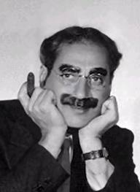
I sent the club a wire stating, PLEASE ACCEPT MY RESIGNATION. I DON'T WANT TO BELONG TO ANY CLUB THAT WILL ACCEPT ME AS A MEMBER.
Groucho Marx
Notes:
And then there’s the old Groucho Marx line. Some people just aren’t joiners.

Slide 6
OR DOES IT???
Notes:
So…just how necessary is membership in our UU congregations? What do we risk by not compelling or even requiring that people involved in congregational life become members?

Slide 7
Rev. Barbara Wells ten Hove:
"Growing churches are churches where high expectations and serious commitment are the norm. If we are to grow our UU churches for the future of our movement, we need to heed this call...In my experience, casual commitment to membership translates into indifferent support for the church in all areas from volunteerism to financial support.
Notes:
Writing in the book Salted with Fire, the Rev Barbara Wells Ten Hove says;
This workshop, then, provides us with an opportunity to examine this contention…that congregations must have members in order to have engaged and active people who give of their time and treasure. But if our conversation today refutes this, then how do we encourage those who are not members to become involved…and what are some success stories out there of congregations who have done so.

Slide 8
Defining the Environment
I’m lost, but I’m making record time!
What Has Changed?
The proportion of un-churched people is on the rise.
We have much more competition from worthy causes
People are busier and have more distractions
People expect information and stimulation in more ways
What Remains Constant?
The basic functions of a congregation remain – just added to
A certain level of stability and organization is usually necessary
Sunday morning remains key – just not the only key
Churches are still primary charitable fund raisers
How Much of This Is About Forecasting and Managing Change, Rather than the Specific Changes?
Notes:
Let’s start with clarifying where we are and what our environment consists of. It’s difficult to know where you are going if you don’t know where you are or where you started from. So let’s think about what has changes and what is constant.
A lot of this really is more about change management than about any specific changes themselves. We can choose to look at change as a constant, unpredictable threat and a disruptive influence, or we can choose to look at it as a normal and constant part of our background – and a source of new opportunities. Still disruptive, but not necsarrily in a bad way.

Slide 9
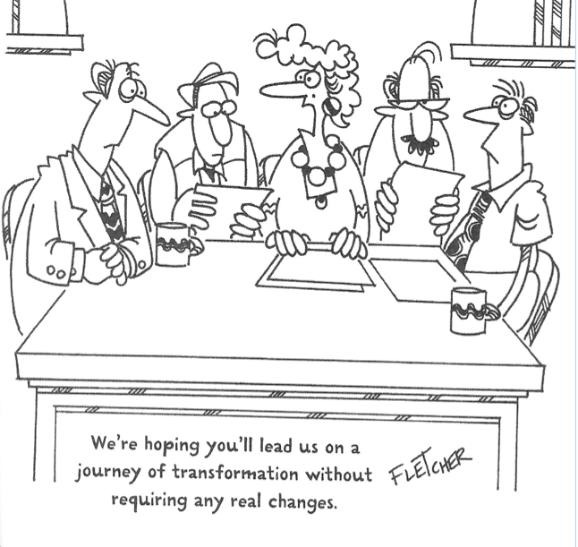

Slide 10
Who Are We Looking to Attract?
Nones
Those looking for an intellectual and spiritual base
Those principally walking away from something
Those looking for community
Those looking to give back, pay it forward
The curious
Families in search of Religious Education for children
Transferred UUs
Recycled UUs (!)
What Makes Us Think We May be a Match?
Notes:
Interestingly, this list (and it’s surely not a complete list) matches up pretty well with that large variety of people we saw in the adaptive organization slide, and yet, not much is new here. With the possible exception of the NONEs, these are the people who have been coming through our doors for years. The interesting question is the one on the bottom of this slide: What makes us a match? What are we doing to connect with these different motivations to encourage repeat engagements, a deeper and broader connection, and for many, eventually a commitment to membership.

Slide 11
Who Else, Churches or Others, Is Doing This Well?
Everything I needed to know about Congregations and Beyond, I learned from…
Gene Roddenberry!
Notes:
OK, let’s date ourselves a bit, and see who the original geeks in the room are. Let’s see who remembers this program variant of the Star Trek franchise?
(Cue the clip)

Slide 12
What Constituted Deep Space 9 and What Made it Work?
It was an outpost of civilization, full of diversity
It offered comfort, community, entertainment, stimulation, and other valued elements not readily available elsewhere
It functioned as a stand alone entity, but had ties to other places and institutions, often working together for shared goals
It had a core, resident community that was cohesive (sort of...) in and of itself, BUT:
One that also reached out to new arrivals and
One that figured out what connection worked with each
It had many people just passing through BUT:
Even those passing through made 3T contributions (KEY)
It was not hard to transition from visitor, to regular, to resident

Slide 13
How Congregations Traditionally See the World
MEMBERS
EVERYBODY ELSE
Notes:
We have talked a bit about our environment in general. How do we translate that into information for our congregations? In truth, this is pretty much how most congregations have viewed the world in the past, and many of us still do. There are basically two kinds of people in the world – our members and everyone else – and the expectaion, goal, assumption is that everyone else will, eventually move over into the Members tent.

Slide 14
Who Else?
Charities and Non Profits
Universities/Alumni Associations
Interest Groups
Political Parties
Other Denominations
Your Congregation?
Notes:
Who else, what other types of organizations might think about members and visitors in ways that might offer us lessons to learn?
Surly charities and non profits do. Educational institutions are masters at keeping the ties that bind – for years, no matter where one might reside.
Interest groups and poliitical parties work this kind of analysis and follw up very thoroughly
And no doubt, some denominations and individual congregations (perhaps yours?) see beyond the obisous as well. You might have a story to share about how your congregation thinks about working with differnt groups of people

Slide 15
How Adaptive Organizations See the World
Developing Members
Vendors, Suppliers, In Kind Donors
Shoppers
Staff
Potential Members
Core Members
Alumni/
Snowbirds
Tourists
Volunteers/Workers
Donors
Special Skill/
In Kind Volunteers
Notes:
THIS is how adaptive organizations think about people who walk through thier door – or click on their web site or Facebook page. Naturally they think about traditional members (core, developing, potential). But they also pay attention to the shoppers and tourists (those just passing through) for their unique contributions and needs.
They also think about people who may have potential to be donors, of money or skill, but are not (at least yet) inclined to actually join. Most congregations have a number of these folks. And note that there is no real center of mass for this diagram, and the connections are not just to the institution, but to various other subgroups. Its a creature of the Internet Age.
What about those who voluntter so much, they seem more like workers than members? They may be really focused on one particular area of congregational life, but make a real differnce in that area. And your alumni (those with long ties but have moved elsewhere) or your Snowbirds, who are present only part o fthe year (and may be contributing to thier other home church but not yours).

Slide 16
Best Practices from Others
OUTREACH
Everyone has an outreach and relationship building mission.
Someone has oversight and QC responsibility for this.
Development (growth) and communication are integrative functions that require focus and specific responsibilities.
Every time you touch someone, its an opportunity to inform and to invite to come deeper into the circle.
Everyone is consciously treated the way we want to be treated
Develop and practice scenarios. How can we be helpful?
Polish greeting & engagement skills – competence and confidence.
A warm handoff is a mission – practiced and taught.
Notes:
So, the next three slides provide a quick overview – a checklist, almost- of what we learned from other organizations that share our desire to develop members, commitment, and community. Most of these are self explanatory. We have highlighted with Red arrows those that bear a bit of empahsis.

Slide 17
Best Practices from Others
Engagement
Conflict may seem sharper edged to the new comer.
Have a conflict management (not avoidance) plan for various settings.
People give of themselves (3 T’s) when: (1) They understand what you are, your priorities, and what you do. (2) They are clear how their gift specifically makes a difference.
Reengage periodically. Not everyone catches the first pass, and not everyone stays without encouragement.

Slide 18
Best Practices from Others
Development
Development (growth) is relationship building.
Have a plan for each group
Contact, engage, develop, cross attach.
It’s a constant cycle: Ask – Inform – Thank.
Consider mentor members.

Slide 19
Best Practices from Others
Leadership and Training
Leaders need to be present in the moment, in the group but not of the group, manage by walking around.
Short yourself on outreach training and resources -- pay the price.
Place a high value on training and recognition.
“Catch them doing right.”
We are a team, doing something important, a joy to perform.
VALUABLE assets: Volunteer Coordinator & Grant Writer/Seeker.

Slide 20
Best Practices from Others
Other Factors
Cannot be everything to everyone.
That seems shallow and grasping.
People prefer local and personal to large and institutional.
Provide LOTS of opportunities to volunteer, mostly short ones
But do so with care
Do NOT waste their time, skills, or money.
Know Your Competition!
Technology is empowering, but Face to Face still rules.

Slide 21
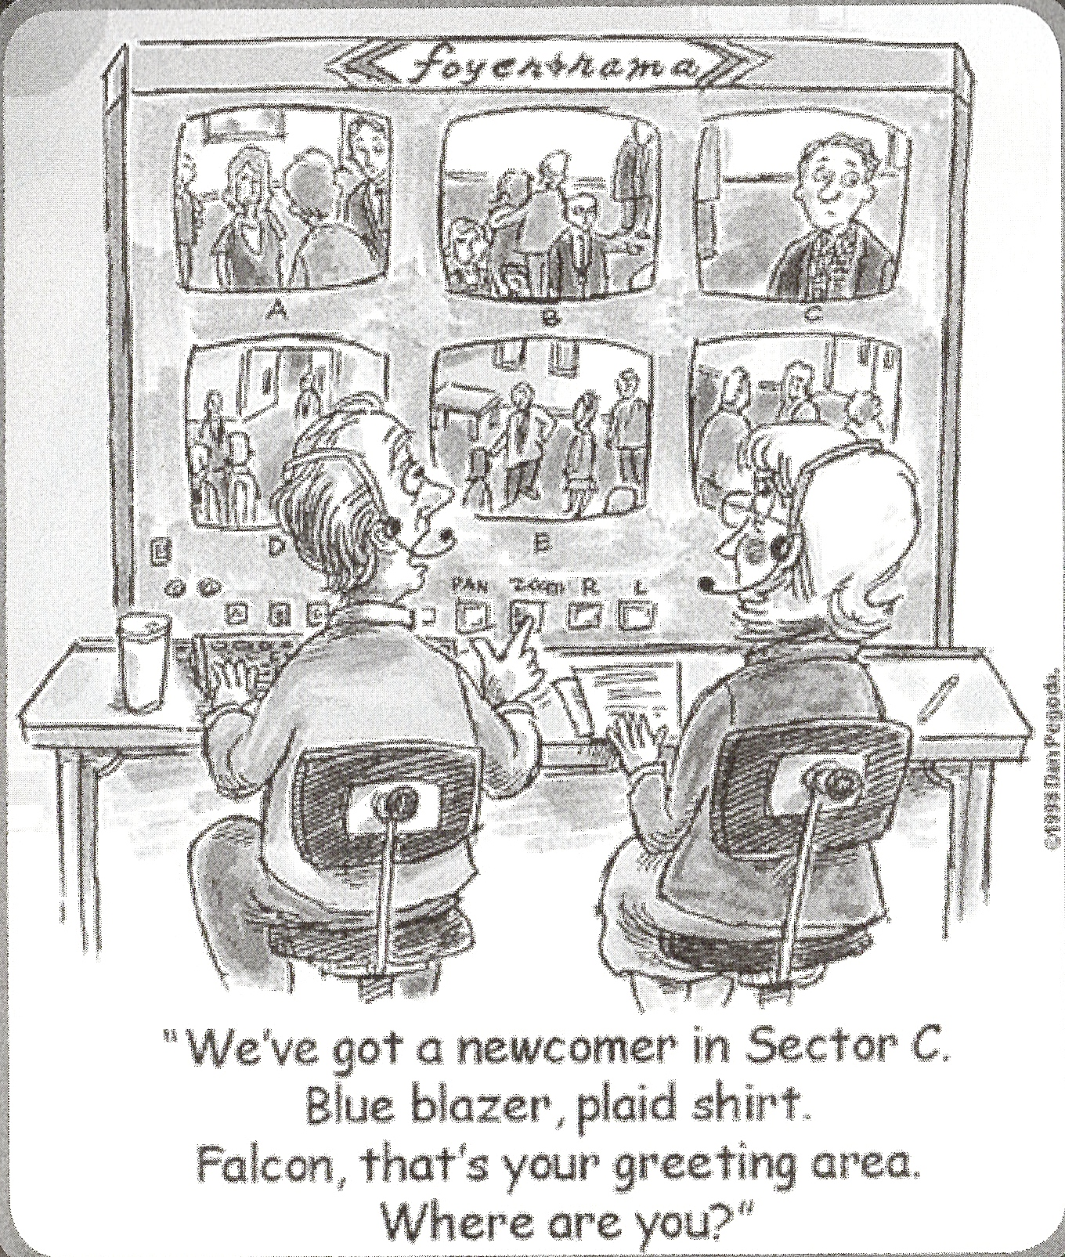
We CAN focus without getting carried away

Slide 22
Friends are defined as “persons wishing to participate regularly in the Church, which includes making an identifiable financial contribution, but who specifically wish not to be members of the church.”
By-Laws of the First Unitarian Church of Philadelphia

Slide 23
Best Practices from UU Congregations
Require a pledge in order to be a “friend”
Friends have access to all communications; are included in Directory
Cannot vote or hold “high” office
Friends are periodically encouraged to become members
“What’s important is not how many members we have, but how many lives are we touching?”
Notes:
What comprises the category of friends?
People who were members and became friends. For members who are in transition: moving to another church and remaining a friend at first u; gave a lot of money. Another person resigned membership but transitioned to be a friend. Continued to pledge at the same rate. Children continued to attend RE.
couples or families with multiple levels of commitment; one person who has a spiritual need or take kids to RE; while the other person has an aversion to UU. By signing as friend, partner can retain Lutheran identity. Mother joined as a friend and daughter joined as a member. People wouldn’t be included without that status. Act of hospitality to include them.
professionals who cannot join a church, but want to be part of a community. Wife of an episcopal priest. Taught philosophy. Taught religion. Would be perceived as biased if they joined the church as members. Ethics.
In one congregation, the membership committee reviews the database to track friends. A member of the committee will call and talk about membership periodically when they think they are open to membership. Not a lot convert.

Slide 24
So, What Do You Need to Excel in This?
Communications models, samples, kits?
Fresh thinking about your communication tools?
Build a Best Practices Data Base?
A Plan to Get Off Your Campus and into the World?
Forums to Share Tools and Ideas (Clusters?)
Ideas and Tools to Monetize and Motivate?
What Else?
What do you have that is already working?

Slide 25
Share one thing that you will take with you from our time together today.
Take Aways

Slide 26
"Inclusion is not bringing people into what already exists, it is making a new space, a better space for everyone.“ Rachel Olivero

Slide 27
How to Reach Us
Bill Clontz
UUA Congregational Stewardship Network Consultant
Leadership Mentor
bclontz@uua.org Phone: (703) 629-4770 Skype: bill.clontz
Blogging at: http://stewardshipfortherestofus.blogspot.com
Mark Bernstein
Growth Development Consultant,
Central East Regional Group (CERG)
mbernstein@uua.org
Phone (610) 639-3389

