Slide 1
Welcome! Faith Development Office Webinar
Before we get started…
Please mute your microphone
and turn off your camera.
Find the Meeting Chat box and introduce yourself.
Notes:
This slide is up while we wait to start the webinar.

Slide 2
“Housekeeping”
Audio problem? Mute audio on your computer. Call in by phone.
We’ll have time for questions at the end.
Recorded webinar, slides, and transcript will be posted online: www.uua.org/re/teachers/webinars
Notes:
Tech person does the housekeeping slide.

Slide 3
Welcome!
Meet the UUA’s Standing on the Side of Love Team
October, 2016
Notes:
Host introduces the webinar and the presenters etc on next slide.

Slide 4
Presenters
Caitlin Breedlove
Campaign Director, Standing on the Side of Love
Nora Rasman Campaign Coordinator, Standing on the Side of Love
Host – Jessica York
Director, Faith Development Office
Technical Support – Susan Lawrence
Managing Editor, Faith Development Office
Notes:
FDO will add this info

Slide 5
No matter where you are on life’s journey
Or where you have come from
You can always call this place home
No matter where you’ve been or what you’ve done
Welcome Home.
- Welcome Home, Rev. Sekou & the Holy Ghost
Notes:
Chalice lighting

Slide 6
Standing on the Side of Love: A Rallying Banner for Our Faith
SSL has a long history of making real our UU work of ‘deeds not creeds’
SSL work has concentrated primarily in the last few years on a broad mix of policy advocacy and some mobilization
Historically, many people equate SSL most closely with issues of marriage equality and immigrant justice

Slide 7
THIS MOMENT (ASSESSMENT)
Characterized by:
Deep polarizations
Demographic and generational shifts
Thousands of new people coming into social change, many hungry for spiritual connection in the work

Slide 8
THIS MOMENT (ASSESSMENT)
Characterized by:
New hybrid models of organizing
Hunger for connection beyond online connections
Scaled, intense and highly visible attacks on marginalized communities

Slide 9
SSL 2016 Assessment
In Spring 2016 we launched an assessment process
We interviewed 50 key stakeholders
50% traditional stakeholders in SSL
50% in intersectional justice movements

Slide 10
Key Findings from SSL Assessment
Interest in work focusing on training, network building, and mobilizing more than working on one specific issue
Desire to move away from policy & advocacy and towards organizing and expanded communications
Deep desire for SSL to be relevant inside and outside UU circles

Slide 11
Our New & Emerging Work
Fortification Podcast

Slide 12
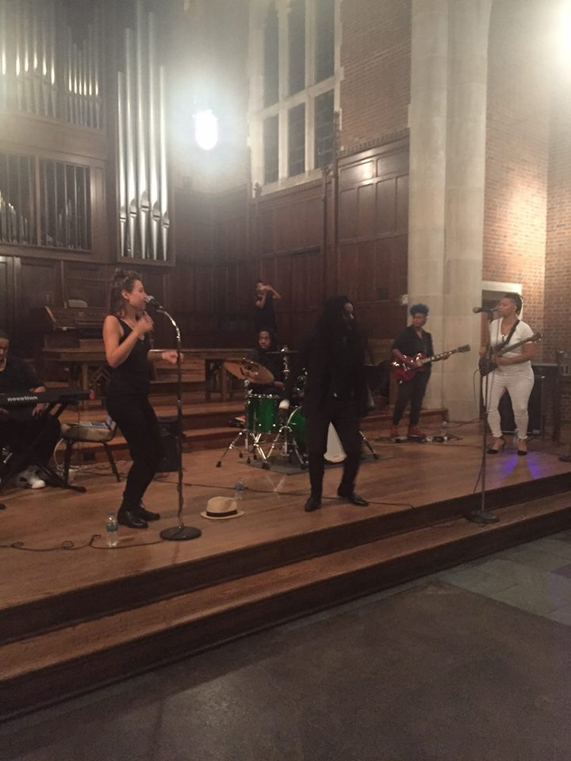
Our New & Emerging Work
ReviveLove Tour

Slide 13
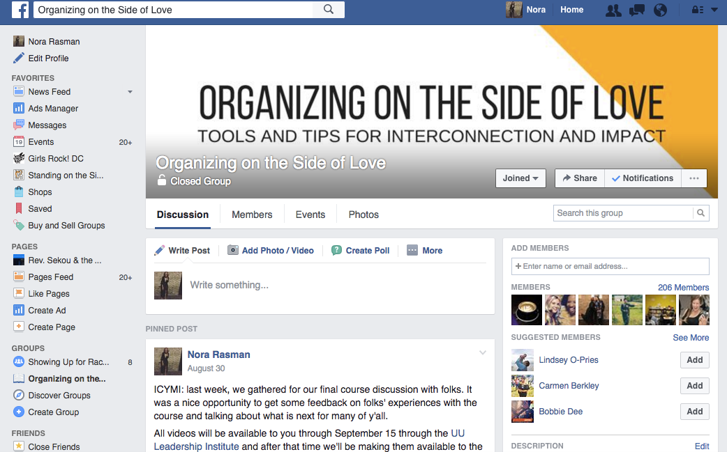
Our New & Emerging Work
Organizing on the Side of Love

Slide 14
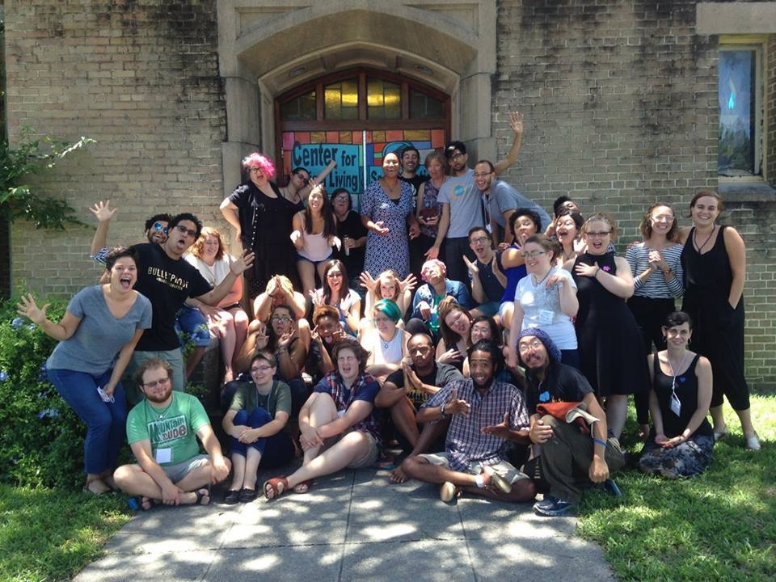
Our New & Emerging Work
GROW Curriculum & Training

Slide 15
Our New & Emerging Work
Ongoing and increasing mobilization and movement support
Exploring and Building a Fortification Network

Slide 16
SSL Work and Faith Development
Clarity in faith through organizing
Clarity in purpose through organizing
Opportunities to practice generosity
Opportunities to practice patience
Opportunities to practice humility and expansion
Spirituality & Sustainability in Movement Building - Module 2 of Organizing on the Side of Love: http://tiny.cc/Module2Spirituality

Slide 17
Guided Reflection Leadership Activity
Naming, honoring and celebrating the work of people in movement - known and unknown - is essential. These are folks who our collective success in liberation/social justice work is tied to. Grab a pen and paper and respond to the following prompts.
Make a list of three leaders who you know well - that if they win, we win, you win.
Make a list of three leaders you do not know - that if they win, we win, you win.
Make a list of three leaders who you have struggled with - that if they win, we win, you win.

Slide 18
How can you get involved?
Fortification Podcast - on iTunes and SoundCloud
Organizing on the Side of Love - Find the complete video list on SSL YouTube
Email updates and invitations - Join us on standingonthesideoflove.org
30 Days of Love 2017- coming to your inbox and on standingonthesideoflove.org this winter!
(Emerging) Fortification Network - Stay tuned!
Email us at love@uua.org for more info!

Slide 19
Upcoming Webinars
Spirituality and Aging Tues. Nov. 15 at 1 pm Eastern or, Wed. Nov. 16 at 9 pm Eastern
Implementing Themes in RE Tues. Dec. 13 at 1 pm Eastern or, Wed. Dec. 14 at 9 pm Eastern
www.uua.org/re/teachers/webinars

