Slide 1
An Introduction to the Revised Chalice Children
Preschool Curriculum
Katie Covey, author
Wednesday, Sept 9, 2015
UUA Faith Development Office
Notes:
*

Slide 2
Intro to Chalice Children
With Katie Covey, author and Pat Kahn, Developmental Editor

Slide 3
Chalice Lighting from Chalice Children
We light this chalice
For
The Warmth of Love
The Light of Truth
And
The Energy of Action

Slide 4
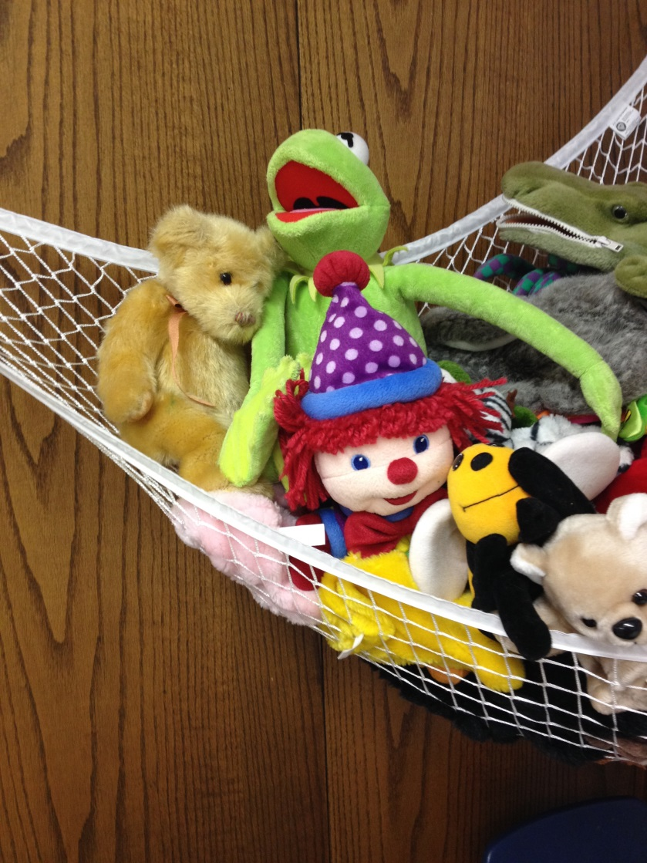
Who’s here?
In the chat box:
Name
Role
Location

Slide 5
Hi and Welcome!
Katie Covey
Religious Educator since 1984.
Currently Director of the School of the Spirit at the Boulder Valley Unitarian Universalist Fellowship (Colorado).
Author of Chalice Children (1998; 2014)
Toolbox of Faith
Spirit of Adventure
Picture Book Series
SpiritJam Model of RE
Website at www.uure.com
Notes:
Tell my story about being a young mother and the dirty preschool room

Slide 6
Pat Kahn
Children and Families Program Director in the Resource Development Office of Ministries and Faith Development
Joined the UUA staff in November 2011
Master level Credentialed Religious Educator
Director of Religious Education for two Atlanta area congregations for over fifteen years
Served on the board and Integrity Team of the Liberal Religious Educators Association (LREDA), on the leadership team of the Southeast LREDA chapter, and in several capacities for the MidSouth District.

Slide 7
The New Chalice Children
Finding out about realities such as death, suffering, violence, and evil, young ones need the reassurance of love, joy, beauty, goodness, hope, and community. Helping children find that balance is the goal of the new Chalice Children.
Young families come to us seeking support for their spiritual life. They experience their young children's questions and existential moments and wish to have resources. The new Chalice Children delivers those resources in the form of an extensive Taking It Home section.
Notes:
Linda Spencer’s story about Fiona in the shopping cart. Or create a preschool email group!

Slide 8
Heart melting story books
Notes:
Confidence to say I don’t know. Beging an investigation of the world

Slide 9
ANY BOOKS by Todd Parr!

Slide 10
More!

Slide 11
Program Structure
37 sessions of 1 hour each:
Free Play
Transition to Circle Time
Circle Time with storybook
Activity
Active group songs and games
Closing
Notes:
Same structure every Sunday. Long free play time.

Slide 12
What’s New
Updated suggestions for story books. www.pinterest.com/katcovey/chalice-children-revised
Recommended book purchases
A Cup of Light by Pamela Baxter
Meet Jesus: Life and Times of a Beloved Teacher
A Shutterfly (or other brand) book of familiar scenes
Notes:
You'll find some of the "classics," but there's more reliance on books published since 2005.

Slide 13
New to Chalice Children, part of Tapestry of Faith
“Love makes a bridge from heart to heart, and hand to hand.” Hymn 325 in “Singing the Living Tradition
Quote
Spiritual Preparation for leaders
Session at a Glance
Taking It Home
Alternate Activities
Find Out More
Faith in Action
Searchable!
Notes:
Pat to chat about faith in action

Slide 14
A little detour - Set Up before Session 1
Create the Preschool Room environment.
Create a print master copy and e-file. Or not!
Create a feelings chart or purchase “Feelings Flashcards” by Todd Parr
Create posters for clean up, Circle Rhymes, Circle Time and Circle Songs
Choose a preschool chalice
Create a family email group for ease of sending invitations, pictures, and Taking It Home section
Create a Faith in Action team of parents
Make a picture book or photo album of sights around your congregation to use as a picture book.
Notes:
Note the whole section on “Advance Preparation”

Slide 15
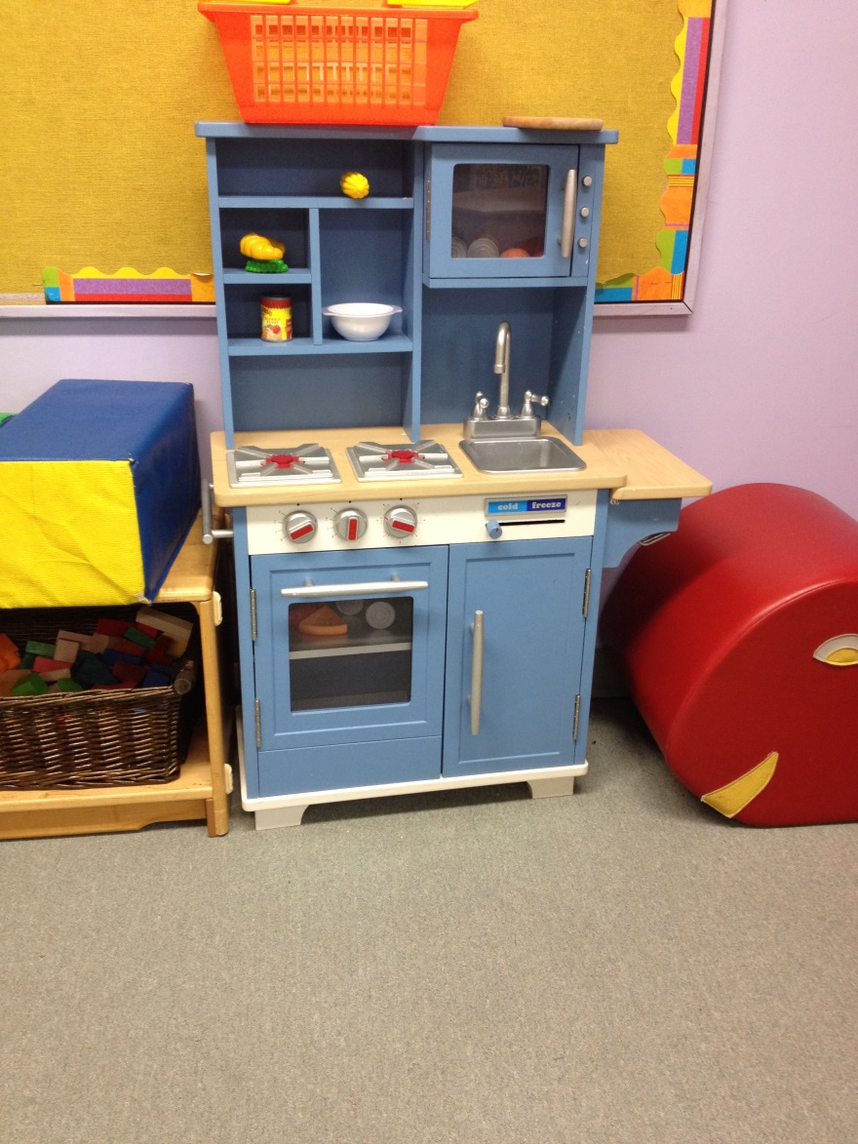
Preschool Room

Slide 16
Master Print Copy Suggestions
1 ½” 3 ring notebook with view pockets and spine pocket.
2 cardstock page protectors with 3 hole punch.
Add a nice calendar or magazine photo
Content – 368 pages, back-back, 3 hole punched
Tip - Don’t forget to add page numbers and widen margins to document!
Tip – you can write in ideas, add pocket pages for photos to a 3 hole punch notebook.
Or not!
Notes:
Show our copy.

Slide 17
Feelings Chart/ Flashcards
The Center for Emotional and Social Foundations for Early Learning offers a free downloadable feelings chart (PDF, 4 pages).
make your own chart, or
purchase a set of Feelings Flashcards created by Todd Parr (available from an online source such as Amazon).
TIP: If you create your own feelings chart, make it large enough to help everyone recognize the emotions it shows from a distance across the circle. You might mount it on cardboard and/or laminate it, for durability.

Slide 18
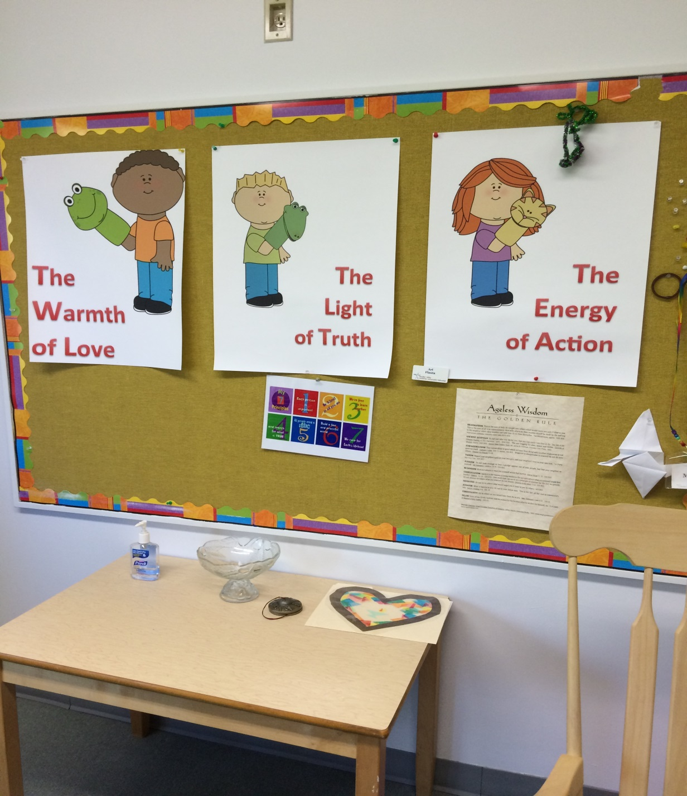
Posters

Slide 19
Done with the detour: The Sessions!
Unit 1: Our Congregation is a Special Place
Session 1: Welcome
Session 2: A Tour of the Inside of Our Congregation
Session 3: A Tour of the Outside (new)
Session 4: Making Chalices
Session 5: All Around Us (modified)
Session 6: Chalice Necklaces
Session 7: The Beauty of Nature (modified)
Session 8: Fruit Chalices (modified)

Slide 20
Unit 2: Our Congregation is People
Session 9: Chalice Flannel Board
Session 10: Helping Others
Session 11: A Special Jigsaw Puzzle
Session 12: Family Snack Party
Session 13: Feeling Sad
Session 14: Weddings and Other Services of Love and Union
Session 15: Babies
Session 16: Special Worship Services (new)

Slide 21
Unit 3: We Wonder
Session 17: Wondering About Stars
Session 18: Wondering About the Moon
Session 19: The Wonder of Weather
Session 20: Rainbows
Session 21: Dreams
Session 22: Imagination
Notes:
Fahs, deep winter

Slide 22
Unit 4: We Make Friends
Session 23: My Shadow
Session 24: Block Sunday
Session 25: Teddy Bear Month — Friendship
Session 26: Teddy Bear Month — Sick!
Session 27: Teddy Bear Month — Lost!
Session 28: Teddy Bear Party
Session 29: Closing Sunday

Slide 23
Unit 5: We Celebrate Holidays
Session 30: Halloween
Session 31: Thanksgiving
Session 32: How Many Days Until Christmas?
Session 33: Winter Lights
Session 34: Valentine's Day
Session 35: Easter
Session 36: Earth Day (new)
Session 37: Mother's/Father's Day
Notes:
Insert these into appropriate Sundays

Slide 24
Modified Sessions
4 sessions have been modified:
"Memory Cards" "All Around Us“
“Chalice Cookie" "Fruit Chalices"
"Snow" "Weather"
"Planting Fall Bulbs" "The Beauty of Nature"
P.S. "Teddy Bear Month: Fixed!" becomes "Teddy Bear Month: Sick!" to avoid implying that the session discusses neutering ☺

Slide 25
New Sessions
Tour of the Outside of the Congregation
Earth Day
Special Worship Services (i.e. Flower Service, Water Service or Sharing of Breads Service)

Slide 26
A closer look: Session 16: Special Worship Services
Flower Ceremony
Recreate the sharing of flowers
Go on a walk looking for flowers
Make corsages and boutonnieres
Five Little Flowers fingerplay
Flower related Story book
Notes:
Invite a chat re services they do that are special and multigenerational at their congregation; how might the preschoolers experience it?

Slide 27
Alternate 1. : Water Ceremony
Recreate the Merging of the Waters ceremony
Give a drink to a plant outside
Five little ducks song
Water related story book

Slide 28
Alternate 2: Sharing of Breads
Recreate a sharing of breads, cut in cubes
Bread related books
Do You Know the Muffin Man song
Make biscuits or pretzels
Sensory play with trays of flours

Slide 29
Songs and Rhymes
For clean-up time
Sing to the tune of “Row, Row, Row Your Boat”:
Clean, clean, clean up play,
Gently as we go.
Merrily, merrily, merrily, merrily
The room is getting clean.

Slide 30
Wiggle Rhyme
Notes:
Teaching listening and sharing quiet.

Slide 31
Other rich resources online
Advance preparation
Songs and Rhymes for the day
How to read a story book
Suggestions for Preschool Chalices
Preschool Environment
Separating from Parents and Caregivers
Faith in Action resources
Background reading for all Tapestry of Faith programs
Consider printing these sections out!

Slide 32
Chalice Children Closing
We gather the warmth of love, [bring hands over "flame" and gather to your heart]
The light of truth, [bring hands over "flame" and gather to your heart again]
And the energy of action [bring hands over "flame" and gather to your heart again]
Into our hearts as we blow out the chalice. [blow out the "flame"]
Back into the world of do and say, [hold world in cupped hands]
Carry it forward into the dawning day. [arms overhead, hands together making the sun]

Slide 33
Our Wish
“If I had a bucket list, raising my 4 daughters to be good strong women would be #1. – Matt Damon
Spirit of Life and Love,
Help us raise children with love, joy, beauty, goodness, hope and community to balance all of the challenges which are a part of life.
Amen.

