Slide 1
WELCOME!
Family Ministry Training:
unpacking “family”
Facilitators:
Co-facilitator Co-facilitator
family ministry training

Slide 2
WORKSHOP 1
Opening Worship
Hymn 360,
Here We Have Gathered
Words: Alicia Carpenter, permission pending
Music: Genevan psalter`
family ministry training

Slide 3
Here we have gathered,
Gathered side by side;
Circle of kinship,
Come and step inside!
May all who seek here
find a kindly word;
may all who speak here
feel they have been heard.
family ministry training

Slide 4
Sing now together
This, our heart’s own song.
family ministry training

Slide 5
Life has its battles,
Sorrow, and regret;
But in the shadows,
Let us not forget:
We who now gather
Know each other’s pain;
Kindness can heal us;
As we give, we gain.
family ministry training

Slide 6
Sing now in friendship
This, our heart’s own song.
family ministry training

Slide 7
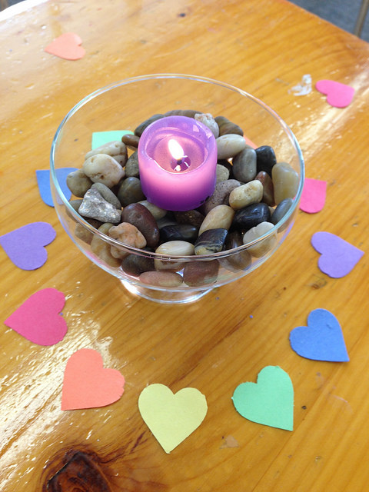
Introductions
I’m ___________ from ______________
where I ________________
And the object I brought represents family because ______
After you speak, please place your object on the altar.
family ministry training

Slide 8
Reviewing our agenda
and attending to logistics.
family ministry training

Slide 9
Creating Our Covenant
Our Unitarian Universalist tradition is covenantal, meaning that what holds us together are the promises we make to one another. Unitarian Universalist lay leader Walter Herz offers this definition of a covenant: “the common understandings, agreements, and promises made, one to another, that define our mutual obligations and commitments to each other as we try to live our faith and vision.” As we form our Unitarian Universalist learning community, let us establish our covenant, one with another.
family ministry training

Slide 10
An Open-Ended Covenant
Respect the needs of others.
Listen to your own needs.
When you are uncomfortable, turn to curiosity.
Do your best, and forgive others (and yourself) when someone makes a mistake.
family ministry training

Slide 11
Talking about Our Congregations
Feel free to …
Speak about events, programs, or systems within your congregations
Refrain from…
Sharing unflattering stories about individuals
family ministry training

Slide 12
Brainstorming about families …
No judgments;
No discussions;
No heavy thinking;
No worries!
Toss out as many ideas as you can
as quickly as you can!
family ministry training

Slide 13
What Makes a Family?
What are the necessary components of a family?
Are there limits to what can be called “family”?
family ministry training

Slide 14
First Round:
When I think about my family I …
The greatest gift I receive(d) from my family is …
What I wish other people knew about my experience of family is …
family ministry training

Slide 15
Second Round:
One of the hardest things my family faced was …
People would be surprised to learn that my family is …
If my family wrote a book together, it would be about …
family ministry training

Slide 16
Third Round:
What experiences of “family” have you had – yours or others – and how do these experiences shape your view of family?
family ministry training

Slide 17
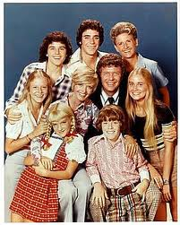
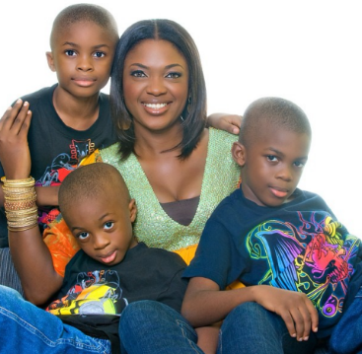
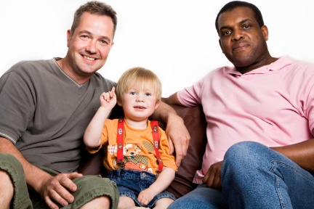
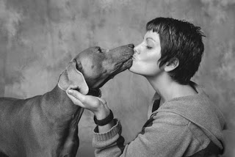
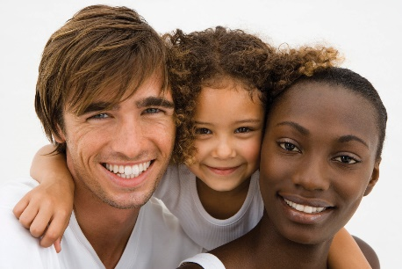
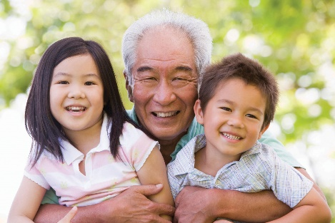
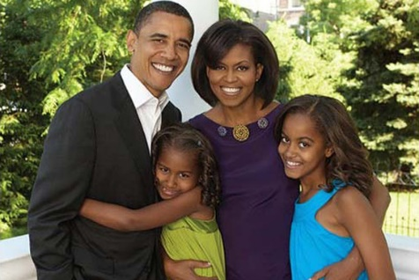
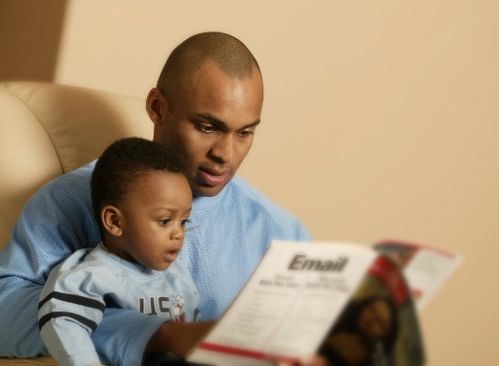
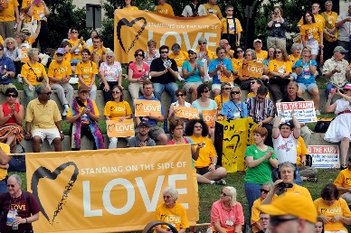
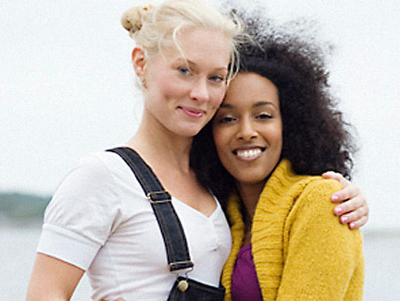
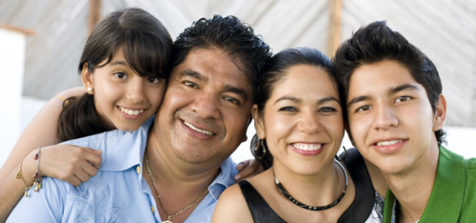
Families
family ministry training

Slide 18
The Silo Mentality
Sunday Worship in the Sanctuary
Children’s & Youth RE
Adult Faith Development
Pastoral Care
family ministry training

Slide 19
“MeChurch”
YouTube video
family ministry training

Slide 20
“I” Cultures
Sense of identity is personal;
Efficiency is prized;
Productivity is most important;
Highly value change and innovation;
Success is individual and competitive;
Communication is direct and explicit;
The nuclear family is the locus;
Question: what do I want/need?
“We” Cultures
Sense of identity is communal;
Relationships are prized;
Process is most important;
Highly value stability and tradition;
Success is shared and collaborative;
Communication is complex and intuitive;
Many generations together;
Question: what’s best for us all?
family ministry workshop

Slide 21
Building a New Way
Unitarian Universalists tend to be individualistic …
Our congregations often operate with a silo mentality …
Our faith calls us to live into becoming a truly multicultural Association …
Non-dominant cultures tend to be communal (i.e., “We”) rather than individualistic (i.e., “I”) …
SO …
We are called to learn how to develop a “we” culture, both for our own sake and as a model for the world.
family ministry workshop

Slide 22
Building a New Way
Families are the heart of congregational life!
family ministry training

Slide 23
Ask each other:
What would it mean in the congregation we serve if families really were the heart of congregational life?
How might things be different? What possibilities would open up? How can focusing on families with children provide a model for ministering to all families?
family ministry training

Slide 24
WORKSHOP 1
Closing Worship
Hymn 1017…
Building
a New Way
Words & Music: Martha Sandefer Used with permission
family ministry training

Slide 25
We are building a new way.
We are building a new way.
We are building a new way,
Feeling stronger ev’ry day,
We are building a new way.
family ministry training

Slide 26
We are working to be free.
We are working to be free.
We are working to be free
hate and greed and jealousy.
We are working to be free.
family ministry training

Slide 27
We can feed our every need.
We can feed our every need.
We can feed our every need.
Start with love, that is the seed.
We can feed our every need.
family ministry training

Slide 28
Peace and freedom is our cry.
Peace and freedom is our cry.
Peace and freedom is our cry.
Without these this world will die.
Peace and freedom is our cry.
family ministry training

