Slide 1
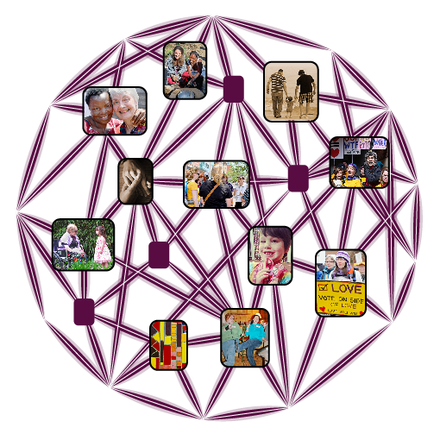
Igniting Growth Through Professional Membership Ministry
UU Association of Membership Professionals

Slide 2
UUAMP History

Slide 3
Areas of Focus
Continuing Education
Webinars
Book Discussion Groups
Regional and National Gatherings
Increasing Awareness
Visioning Work for Certification

Slide 4
Mission Statement
The UUAMP Mission Statement is to develop and support the ministry of membership through professional development and collaboration.

Slide 5
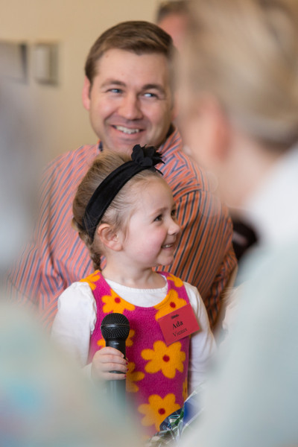
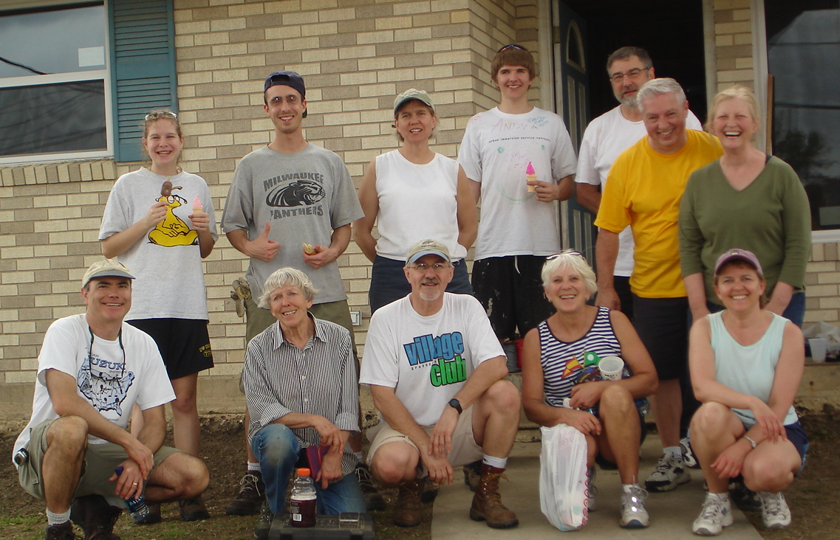
Stories

Slide 6
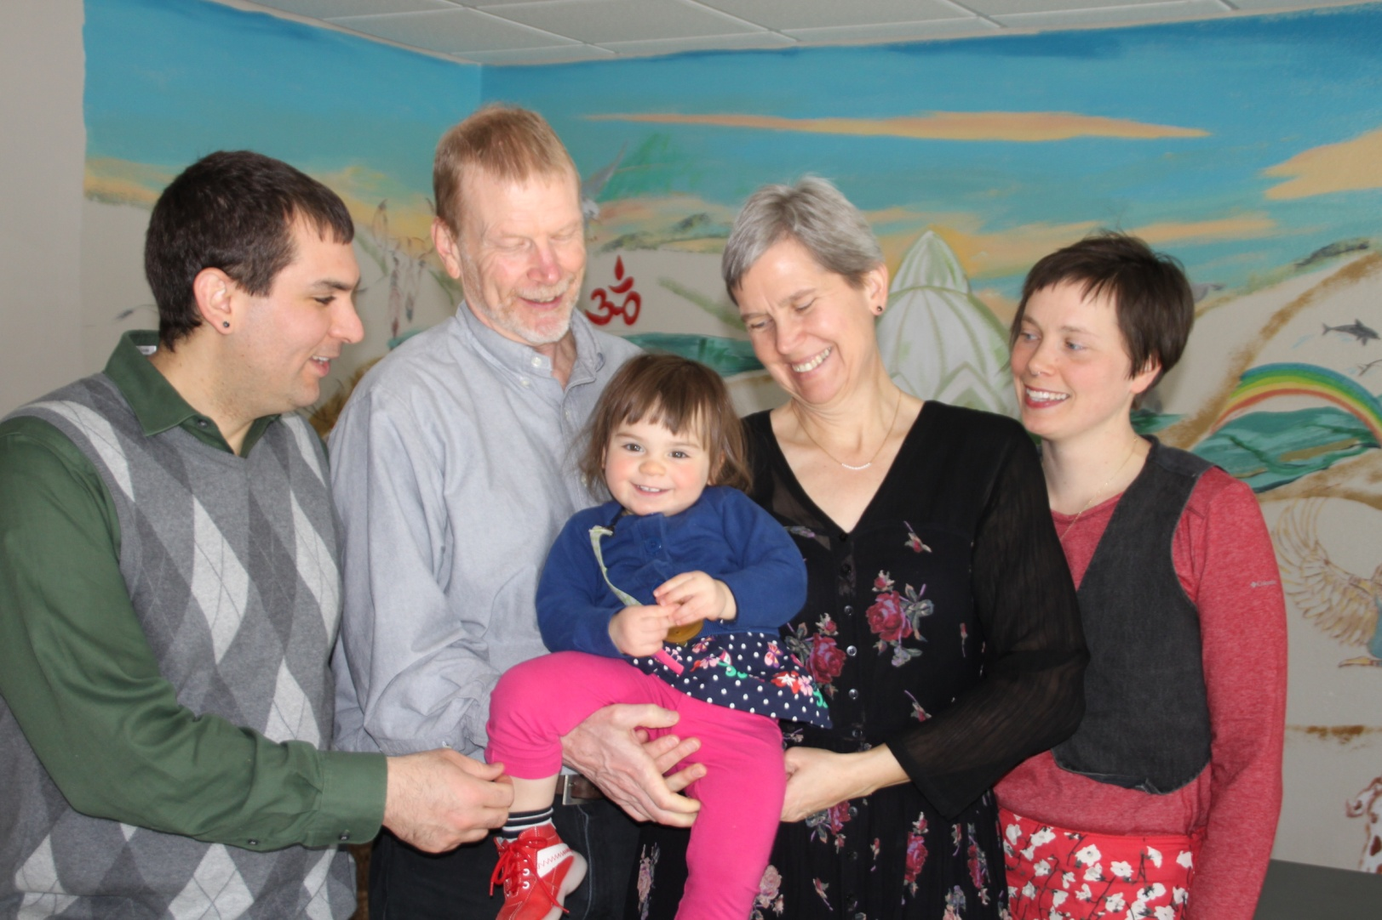
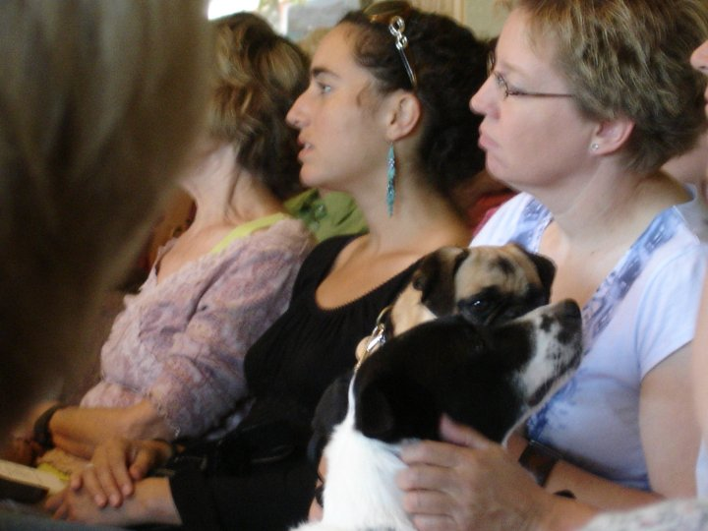
Break Out Questions
How could adding this staff member make the membership experience in your congregation more meaningful?
How could adding this staff member increase connectivity, engagement and integration?
What area does your congregation most need professional membership ministry?

Slide 7
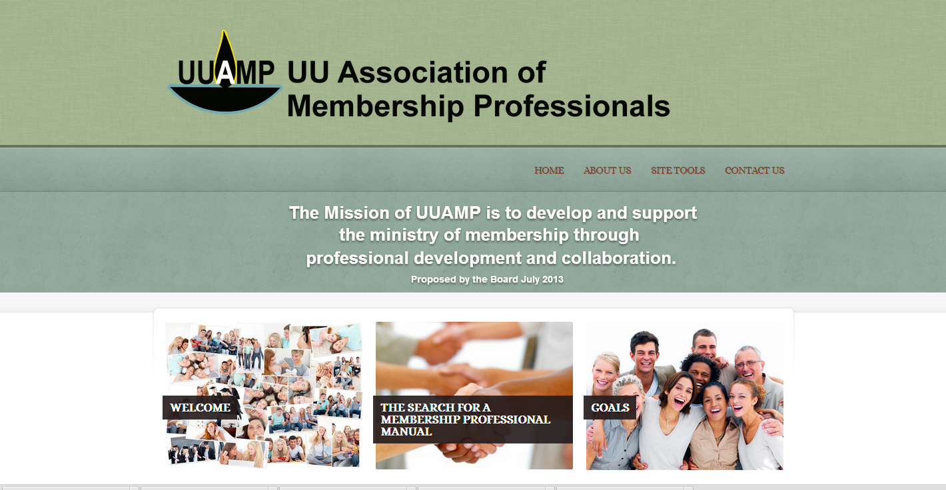
Membership Professional Manual

Slide 8
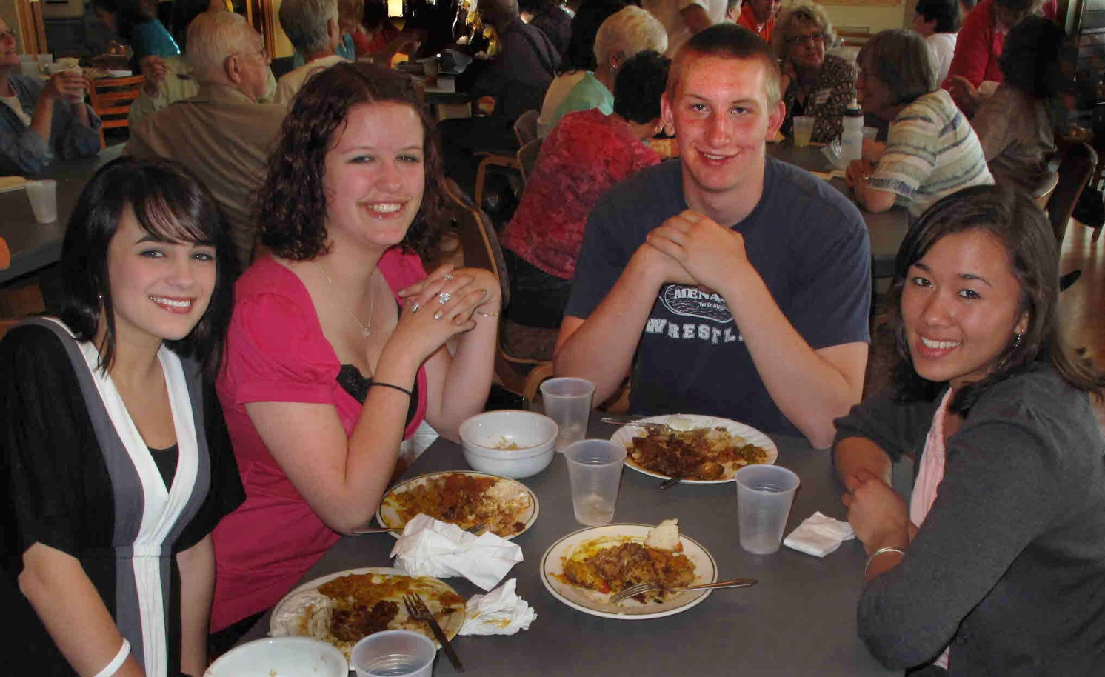
First Steps
Vision
Priorities

Slide 9
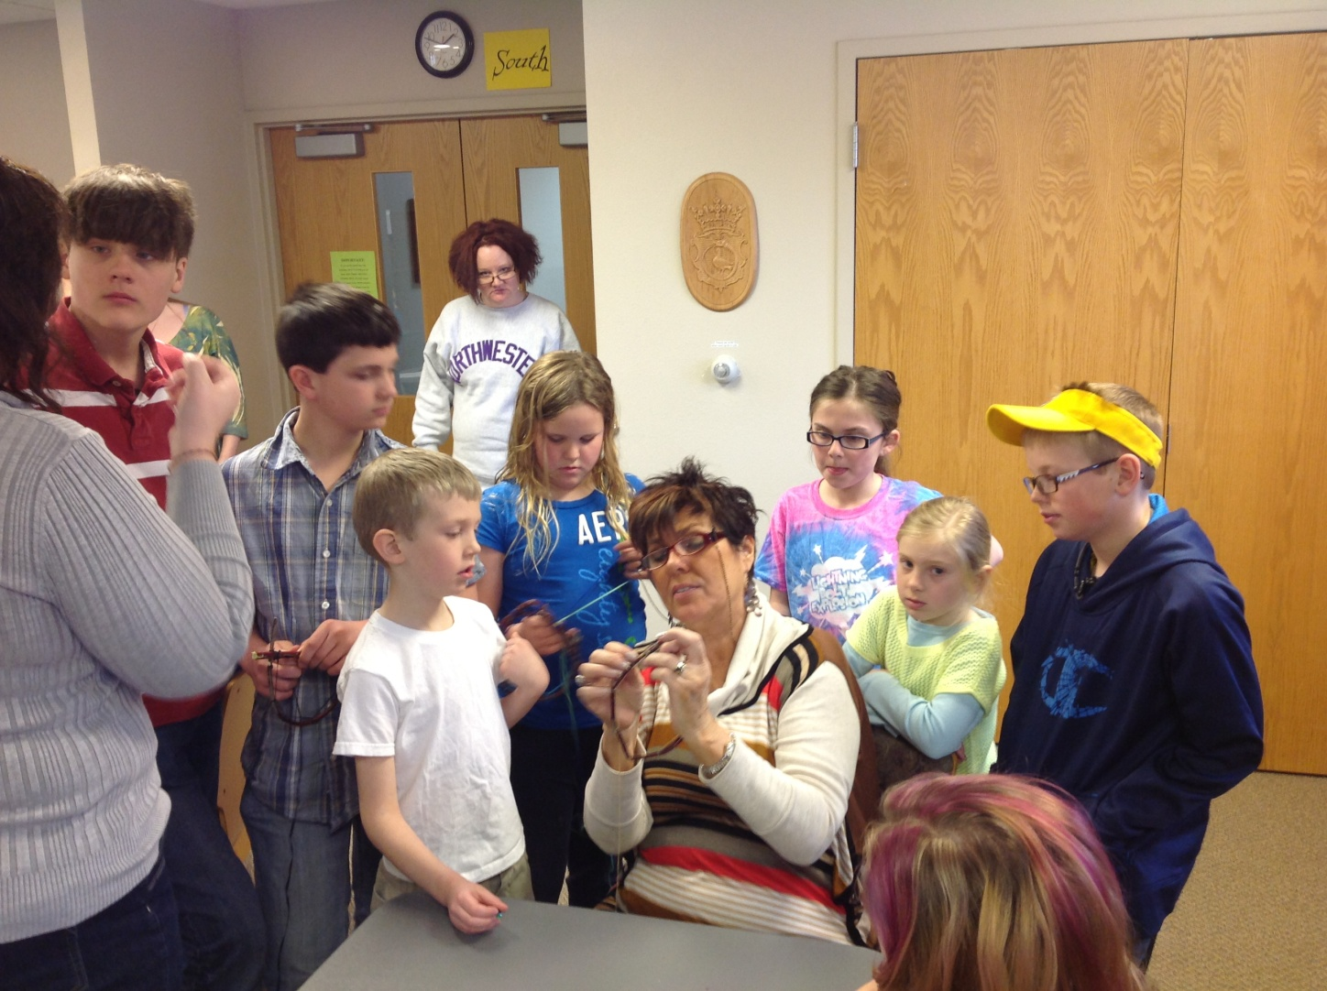
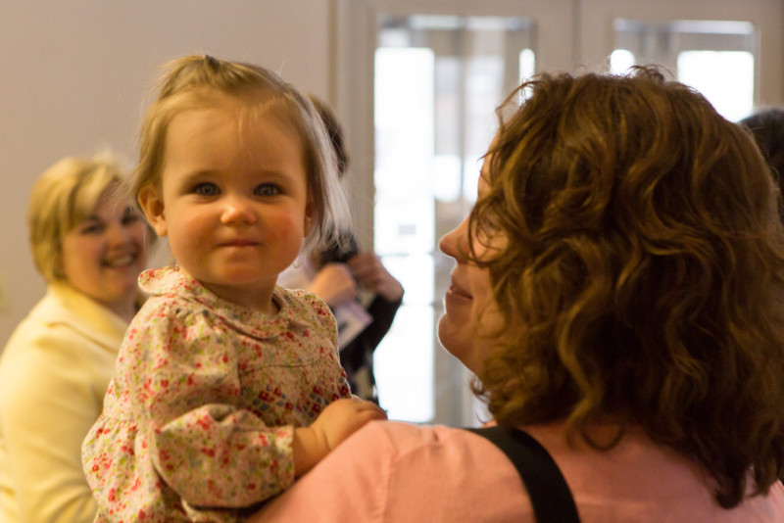
What’s in a Title?
Membership Coordinator
Membership Director
Director of Congregational Life

Slide 10
Testimonials
“Offers consistency”
“A great resource”
“Expands pastoral capacity”
“Without this position, leadership development efforts would be challenging”
“Helps the over-worked ministerial staff be a little less over-worked”
“What’s not to love about this position?”

Slide 11
Free Resources Available to All
www.uuamp.org
UUAMP Informational Sheet
UUAMP Members after this Program

