Slide 1
Findings from the Sharing Project
Multicultural Ministries
Multicultural Growth and Witness

Slide 2
Launched in July 2013
To solicit input through a survey from Unitarian Universalists (UUs) historically marginalized by:
Ability
Sexual orientation
Gender identity/expression
Race, and/or ethnicity
About their unique experiences and ministry needs within Unitarian Universalism

Slide 3
Goal
To help congregational leaders
and Unitarian Universalist Association staff
understand
Where We Are Now and What We Need
to be well-equipped to meet the ministry needs
of people seeking a liberal religious home
in the 21st century

Slide 4
Sharing Project Report
Demographic Profile
Age
Geography
Education
Employment
Financial Status and Income
Class
Relationships and Family
Households
Caregiving
Parenting
Identities and Marginalization
Sexual Orientation
Gender Identity
People with Disabilities
Experiences of Discrimination in the World

Slide 5
Sharing Project Report
Religion and Faith
Relationship with UU Congregations
Unitarian Universalist Theology
Pastoral Care Needs
Adult Religious Education
Children’s Religious Education
Role of Social Justice
Preparation to Face the Moral/Ethical/Spiritual Challenges of the Future
Welcome and Inclusion In Congregations
LGBTQ Welcome and Inclusion
Welcoming Congregation Program
Race and Ethnicity Welcome and Inclusion
People with Disabilities Welcome and Inclusion
Reflections about Sharing Circles

Slide 6
Demographic Highlights
1,500 responses from forty-eight U.S. states and nine other countries
All five UUA regions
Ages from 14-92 (22% youth and young adults)
27% people of color
56% people with disabilities
55% LGBTQ
Contextualizing the Survey

Slide 7
Discrimination
Respondents face discrimination every day

Slide 8
Education vs Class
Respondents are highly educated, although financial status is low considering the high levels of education
Education
Class

Slide 9
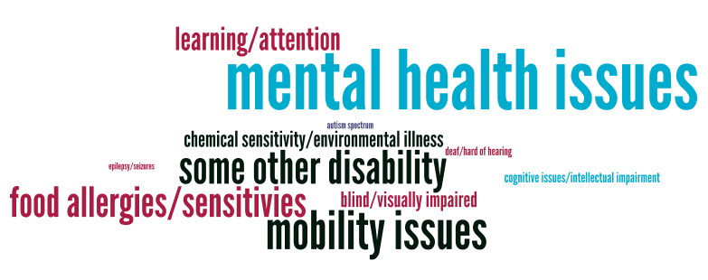
Disabilities UUs Are Living With

Slide 10
Primary Disabilities
Mental health issues rank highest of all disabilities identified
Top Four Disabilities
Mental health issues (anxiety disorders, mood disorders, psychotic disorders, co-occurring disorders, eating disorders, personality disorders, etc.) | 34%
Food allergies (gluten, dairy, nuts, eggs, yeast, or other extreme food sensitivities) | 17%
Mobility issues | 16%
Learning/attention (dyslexia, attention-deficit/hyperactivity disorder, etc.) | 13%

Slide 11
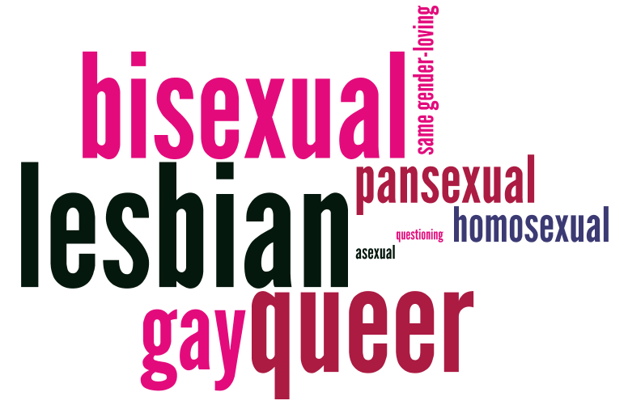
Sexual Orientation

Slide 12
Bisexuals represent a significant portion of the population
Lesbian | 25%
Bisexual | 21%
Queer | 21%
Gay | 16%

Slide 13
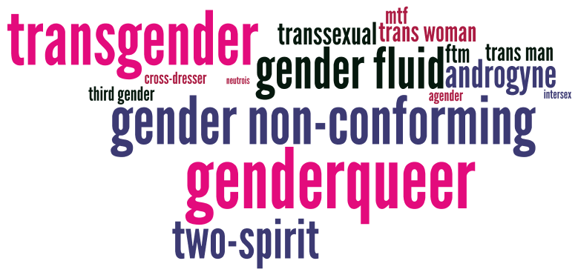
Gender Identity

Slide 14
Race and/or Ethnicity

Slide 15
Social Justice Priorities
Highest priority:
Building multicultural community
Top UU social justice priority for the next five years:
Economic justice

Slide 16
Spiritual/Religious Needs
Religion is important in respondents lives yet UU involvement is relatively recent, with a significant number joining in the last ten years
Spiritual needs are generally unmet by congregations
Grief is the number one reason for seeking pastoral care/support
The majority of parents with children have had positive Religious Education (RE) experiences

Slide 17
People Living with Disabilities
The primary concern raised by people with disabilities of all types is that they cannot participate fully in congregational life

Slide 18
People of Color
People of color consistently experience microaggressions, tokenization, and invisibility in their congregations

Slide 19
LGBTQ People
Transgender people experience higher incidences of microaggressions and feeling different from others in their congregations than people who are lesbian, gay, bisexual or queer (LGBQ)
The majority of survey respondents attend congregations that have gender-neutral bathrooms
The majority of survey respondents attend congregations that have LGBQ-inclusive policies and procedures and use inclusive language in worship
Less than half of UU congregations have transgender-inclusive policies and procedures and use inclusive language in worship

Slide 20
In Summary
The data in this presentation is only the beginning of what we learned and are continuing to learn from the Sharing Project.
This report is not designed to be read and forgotten – it’s designed to be engaged…
inside yourself
in your congregation
and
In your community
How might this data change your approach to welcome?

Slide 21
Next Steps
Download the full report at www.uua.org/sharingproject
Watch for congregational engagement resources to be posted on this site
Presentations and webinars
Discussion guides
Worship resources
Plan some conversations in your congregations
Plan your congregation’s next steps

